Slide 1
DeepIndex for Accurate and Efficient Image Retrieval Yu Liu, Yanming Guo, Song Wu, Michael S. Lew
Media Lab, Leiden Institute of Advance Computer Science

Slide 2
Outline
Motivation
Proposed Approach
Results
Conclusions

Slide 3
Outline
Motivation
Proposed Approach
Results
Conclusions

Slide 4
Motivation
Image retrieval aims to quickly search for similar images through their visual features.
Commonly, there is a natural trade-off
Accuracy : Discriminative features | Efficiency
Low-level: LBP (T. Ojala, 1994), SIFT (D. G. Lowe, 2004), HOG (N. Dalal, 2005)…… High-level: Deep learning, Conv neural networks 2014 Year: A. Babenko, ECCV; Y. Gong, ECCV; A. S. Razavian, CVPR workshop; J. Wan, ACM Multimedia; …… 2015 Year: J. Y.-H. Ng, CVPR workshop; H. Azizpour, CVPR workshop; A. S. Razavian, ICLR workshop; L. Xie, ICMR; …… | Low efficiency Nearest neighborhood search; Image matching with patches; …… High efficiency Inverted index is one of the most widely-used strategy in image retrieval system due to its low memory cost and fast query time.

Slide 5
Outline
Motivation
Proposed Approach
Results
Conclusions

Slide 6
Proposed Approach
deep features + inverted index = DeepIndex
Figure 1. The overview of single DeepIndex.

Slide 7
Proposed Approach
deep features + inverted index = DeepIndex
Stage 1
Stage 2
Stage 3
Stage 4

Slide 8
Proposed Approach
Spatial patches
Stage 1
Stage 2
Stage 3
Stage 4

Slide 9
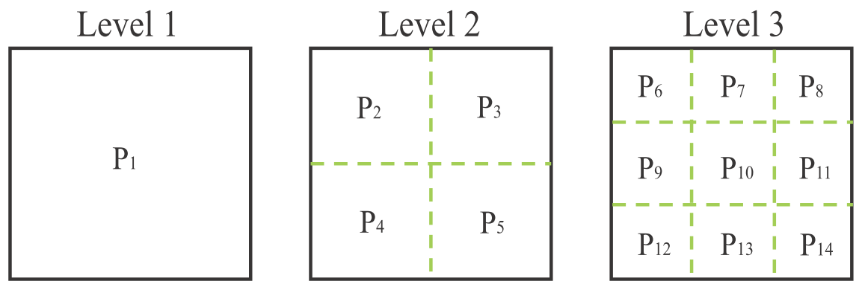
Spatial Patches
Spatial pyramids (S. Lazebnik, 2006)
three levels
14 patches per image
Simple and fast
Expensive sliding windows or object proposals

Slide 10
Proposed Approach
Spatial patches
Deep feature extraction
Stage 1
Stage 2
Stage 3
Stage 4

Slide 11
Deep Feature Extraction
Pre-trained models
Alexnet (A. Krizhevsky, 2012)
VGGnet (K. Simonyan, 2015)
The 1st and 2nd fully-connected activations
are used as patch features
4096 dimensions
L2 normalization
A. Krizhevsky, I. Sutskever, G. E. Hinton. ImageNet Classification with Deep Convolutional Neural Networks, NIPS 2012.
K. Simonyan, A. Zisserman. Very Deep Convolutional Networks for Large-Scale Image Recognition, ICLR 2015.

Slide 12
Deep Feature Extraction
Alexnet (A. Krizhevsky, 2012)
5 conv and 3 fully-connected(fc) layers
fc6 and fc7 (4096-Dim)
Caffe framework(Y. Jia, 2014)
Y. Jia, et al. Caffe: Convolutional Architecture for Fast Feature Embedding. ACM Multimedia 2014.

Slide 13
Deep Feature Extraction
VGGnet (K. Simonyan, 2015)
16 conv and 3 fully-connected(fc) layers
fc17 and fc18 (4096-Dim)
MatConvNet (A. Vedaldi, 2014)
A. Vedaldi and K. Lenc. MatConvNet-Convolutional Neural Networks for MATLAB. arXiv:1412.4564, 2014.

Slide 14
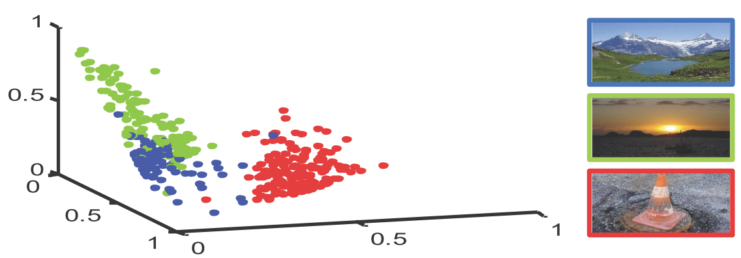
Visualizing Patches Features
Three categories in Holidays dataset.
Each category has about 10 images.
Each image has 14 patches
fc18 feature in VGGnet
Map 4096-Dim feature into 3D space by classical Multi-Dimensional Scaling(MDS) .
Promising separation of data points.
see Matlab function ‘cmdscale’ for MDS algorithm.

Slide 15
Proposed Approach
Spatial patches
Deep feature extraction
Stage 1
Stage 2
Stage 3
Stage 4
Codebook and index

Slide 16
Codebook and index
Cluster patches features
various codebook sizes
Quantization
multiple assignment (H. Jegou, 2010)
Bulid inverted index
tf-idf scheme (J. Sivic, 2003)
the matching function is computed as:

Slide 17
Proposed Approach
Spatial patches
Deep feature extraction
Stage 1
Stage 2
Stage 3
Stage 4
Codebook and index
Query image

Slide 18
Query Image
Query
Spatial patches
Deep feature extraction
Search the inverted index
Matching and ranking
Return similar image candidates

Slide 19
Question:
How to develop accuracy efficiently?
One answer:
single inverted index ->inverted multi-index!!

Slide 20
Question:
How to develop accuracy efficiently?
One answer:
single inverted index ->inverted multi-index!!
Figure from A. Babenko & V.S. Lempitsky(2012)
(1) Inverted multi-index subdivides the vector space with product quantization.
(2) For inverted multi-index, the neighborhoods are mostly centered at the queries (light-blue and light-red circles).
higher accuracy of retrieval and nearest neighbor search.
A. Babenko and V. S. Lempitsky. The inverted multi-index. CVPR 2012.

Slide 21
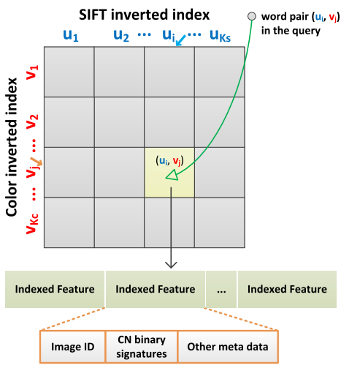
Question:
How to develop accuracy efficiently?
One answer:
single inverted index --> inverted multi-index!!
Figure from L. Zheng(2014)
Build a coupled Multi-Index
structure that incorporates two
different features at indexing level:
SIFT and color names .
L. Zheng, et al. Packing and padding: Coupled Multi-index for Accurate Image Retrieval. CVPR 2014.

Slide 22
Proposed Approach
Multiple DeepIndex
for example: 2-D DeepIndex
incorporate two kinds of deep features
row indexing and column indexing
Two variants:
Intra-CNN
Inter-CNN

Slide 23
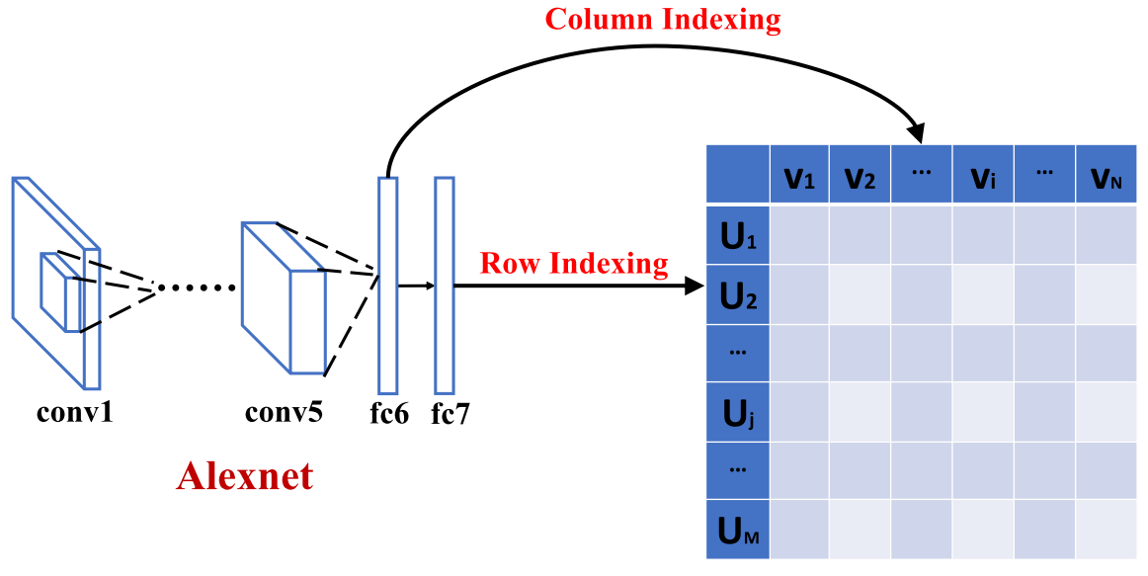
Multiple DeepIndex
Intra-CNN: two kinds of deep features from the same CNN model.
Alexnet example: fc6 is column indexing and fc7 is row indexing.
U and V are codebooks clustered separately.

Slide 24
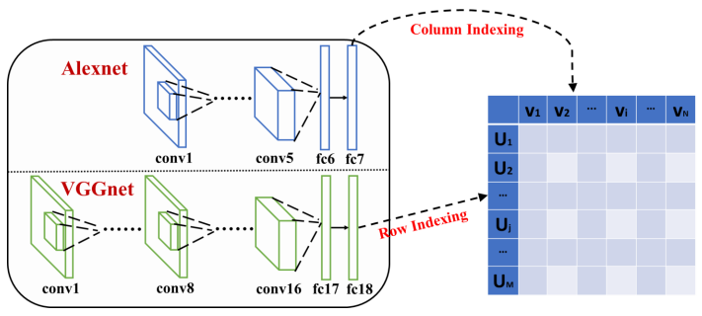
Multiple DeepIndex
Inter-CNN: two kinds of deep features from different CNN models.
Alexnet and VGGnet example: fc7 is column indexing and
fc18 is row indexing.
Mid-level CNN
High-level CNN

Slide 25
Proposed Approach
Multiple DeepIndex
for example: 2-D DeepIndex
incorporate two kinds of deep features
row indexing and column indexing
Two variants:
Intra-CNN
Inter-CNN
Update matching function:
where, r is row indexing and c is column indexing.

Slide 26
Global Image Signature(GIS)
Signature is useful
like Hamming embedding (H. Jegou, 2008)
GIS: holistic deep feature for the whole image
global image characteristics
GIS distance:
Update matching function with GIS:
1-D DeepIndex:
returns the holistic deep feature for one image.
α measures the GIS matching strength.
Efficiency: all patches in one image share the same holistic feature.

Slide 27
Global Image Signature(GIS)
Signature is useful
like Hamming embedding (H. Jegou, 2008)
GIS: holistic deep feature for the whole image
global image characteristics
GIS distance:
Update matching function with GIS:
2-D DeepIndex:
GIS is a kind of global similarity constraint, and is complementary
for local patches features.

Slide 28
2-D DeepIndex with GIS
Figure. The overall 2-D DeepIndex pipeline. GIS serves as an additional clue stored in the indexed items. We pre-compute the holistic image features in a Global Features Table.

Slide 29
Outline
Motivation
Proposed Approach
Results
Conclusions

Slide 30
Results
Notations for the proposed methods
Method | Description
DPI 1-D DPI 2-D DPI | DeepIndex Single DeepIndex Two-inverted DeepIndex
DPIi | Single DeepIndex with ith fc layer: DPI6 , DPI7 , DPI17 , DPI18
DPIi, j | 2-D DeepIndex with ith and jth layers: Intra-CNN: DPI6+7 ; DPI17+18 Inter-CNN: DPI6+17 ; DPI6+18 ; DPI7+17, ; DPI7+18

Slide 31
Results
Dataset | Train Images | Test Images | Measurement
Holidays(H. Jegou, 2008) | 991 | 500 | mAP
Paris (J. Philbin, 2008) | 6337 | 55 | mAP
UKB (D. Nister, 2006) | 10200 | 10200 | Top-4 score
Environment:
CPU: i7 at 2.67Ghz with 12GB RAM
GPU: NVIDIA Titan Black with 6GB GRAM.

Slide 32
Results
Evaluate codebook size on three datasets
Cluster each kind of fc feature separately
Codebook=5000
Codebook=5000
Codebook=10000

Slide 33
Results
Overall evaluation results

Slide 34
Results
Overall evaluation results
(1) Multiple assignment(MA) is useful to increase recall.

Slide 35
Results
Overall evaluation results
1-D DPI
2-D DPI
(1) Multiple assignment(MA) is useful to increase recall.
(2) Mostly, 2-D DPI > 1-D DPI

Slide 36
Results
Overall evaluation results
1-D DPI
Intra-CNN
2-D DPI
Inter-CNN
(1) Multiple assignment(MA) is useful to increase recall.
(2) Mostly, 2-D DPI > 1-D DPI
(3) Mostly, Inter-CNN> Intra-CNN

Slide 37
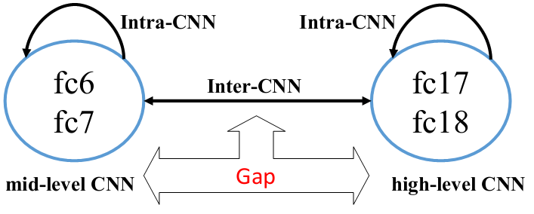
Results
Why Inter-CNN is better than Intra-CNN ?
mid-level CNN like Alexnet
high-level CNN like VGGnet
Answers:
close relationship in Intra-CNN structure alleviates the strength of 2-D inverted index.
mid-level and high-level CNNs in Inter-CNN compensate mutually. Inter-CNN is an attempt to bridge the gap between mid-level and high-level CNNs at indexing level.

Slide 38
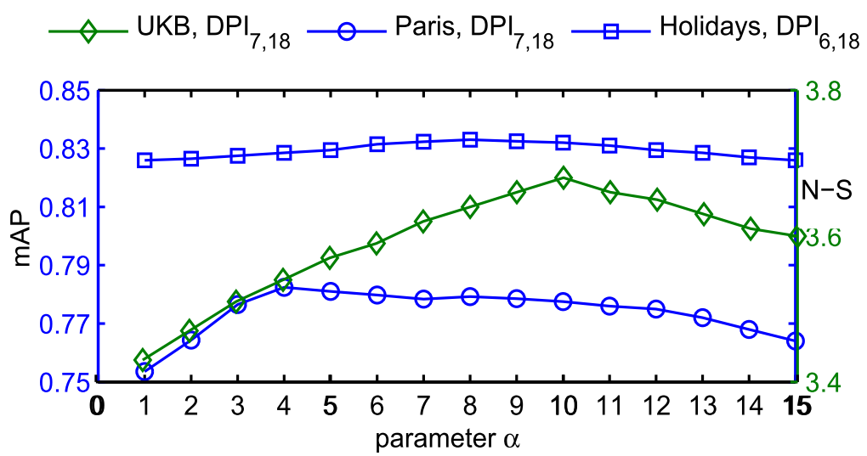
Results
Global image signature(GIS) result
Method | Holidays(mAP) | Paris(mAP) | UKB(top-4 score)
Inter-CNN without GIS | 82.38 | 75.35 | 3.37
Inter-CNN with GIS | 83.30 | 78.24 | 3.68
GIS is necessary to increase accuracy.

Slide 39
Results
PCA dimensionality reduction
both patches features and GIS features.
Inter-CNN | Holidays(mAP) | Paris(mAP) | UKB(top-4 score)
Dim=4096 | 83.30 | 78.24 | 3.68
Dim=2048 | 84.11 | 79.45 | 3.72
Dim=1024 | 84.63 | 80.65 | 3.74
Dim=512 | 85.65 | 81.24 | 3.76
Dim=256 | 83.67 | 78.75 | 3.71
Dim=128 | 82.72 | 77.24 | 3.65
PCA is useful to reduce memory complexity, yet with high accuracy.

Slide 40
Results
Comparison
mAP
mAP
top-4 score
Method | Group | Holidays | Paris | UKB
ASMK-small (G. Tolias, 2013) | Non-CNN | 82.20 | 78.20 | ▬
c-Multi-Index(L. Zheng, 2014) | Non-CNN | 84.02 | ▬ | 3.71
ASMK-large(G. Tolias, 2013) | Non-CNN | 88.00 | 80.50 | ▬
CNNaug-ss (A. S. Razavian, 2014) | CNN | 84.30 | 79.50 | 91.1mAP
DF.FC1+SL(J. Wan, 2014) | CNN | ▬ | 86.83 | ▬
Ours | CNN | 85.65 | 81.24 | 3.76
Binary(L. Zheng, 2014) | SIFT-CNN | 85.30 | ▬ | 3.79
Float(L. Zheng, 2014) | SIFT-CNN | 88.08 | ▬ | 3.85
*For a fair comparison, we only report results that exclude post-processing
like spatial re-ranking and query expansion. Also, we do not consider fine-tuning.

Slide 41
Results
Comparison
mAP
mAP
top-4 score
Method | Group | Holidays | Paris | UKB
ASMK-small (G. Tolias, 2013) | Non-CNN | 82.20 | 78.20 | ▬
c-Multi-Index(L. Zheng, 2014) | Non-CNN | 84.02 | ▬ | 3.71
ASMK-large(G. Tolias, 2013) | Non-CNN | 88.00 | 80.50 | ▬
CNNaug-ss (A. S. Razavian, 2014) | CNN | 84.30 | 79.50 | 91.1mAP
DF.FC1+SL(J. Wan, 2014) | CNN | ▬ | 86.83 | ▬
Ours | CNN | 85.65 | 81.24 | 3.76
Binary(L. Zheng, 2014) | SIFT-CNN | 85.30 | ▬ | 3.79
Float(L. Zheng, 2014) | SIFT-CNN | 88.08 | ▬ | 3.85
*For a fair comparison, we only report results that exclude post-processing
like spatial re-ranking and query expansion. Also, we do not consider fine-tuning.

Slide 42
Results
Complexity
--memory cost to store one image
-- query time for a given image
Memory(Bytes) | Binary(L. Zheng, 2014) | 1-D DPI | 2-D DPI
ImageID | 4 × 500 | 4 × 14 | 4 × 14
Signature | 10.18KB | 4 × 512 | 4 × 2 × 512
Total Memory | 12.13KB | 2.06KB | 4.06KB
Query Time(S) | 2.32 | 0.25 | 0.45
(1) Each image has 500 SIFT descriptors (L. Zheng, 2014).
(2) Our query time does not include the feature extraction.

Slide 43
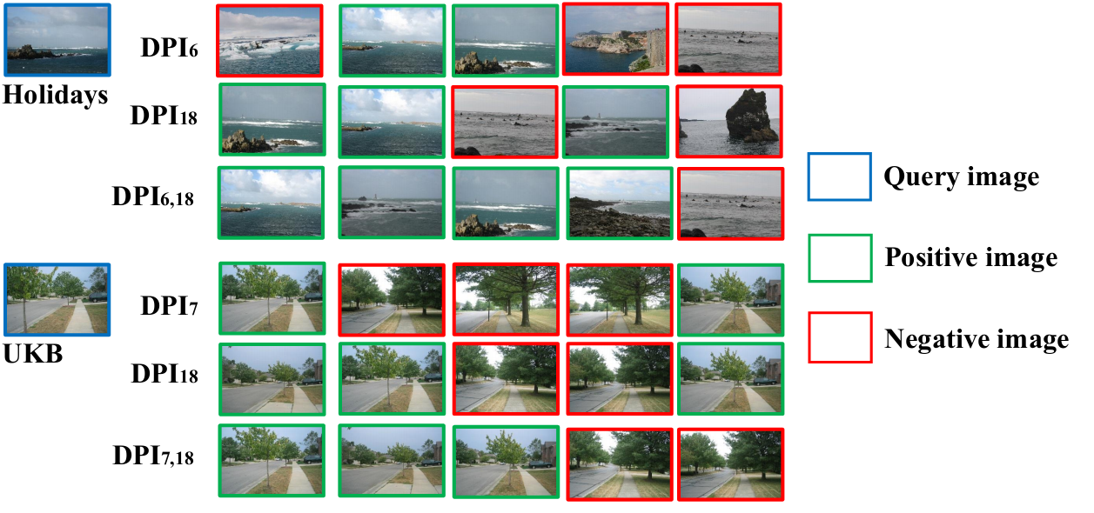
Results
Query example
Inter-CNN method returns more positive images.

Slide 44
Outline
Motivation
Proposed Approach
Results
Conclusions

Slide 45
Conclusions
We propose the DeepIndex framework that takes advantage of the strong discrimination of CNN features and the high efficiency of the inverted index.
Multiple DeepIndex is potential to bridge the gap between mid-level and high-level CNNs at indexing level.
Future Work
Accuracy: develop the matching function
burstiness (H. Jegou, 2009)
Lp-norm IDF (L. Zheng, 2013)
……
Efficiency: fully convolutional networks-FCNs (J. Long, 2015)
Code and data available http://press.liacs.nl/lml/deepindex

Slide 46
Thank you!
Questions, please?

