Slide 1
Robotics
Erwin M. Bakker| LIACS Media Lab

Slide 2
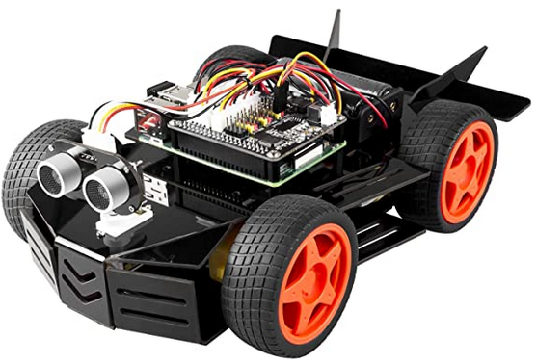
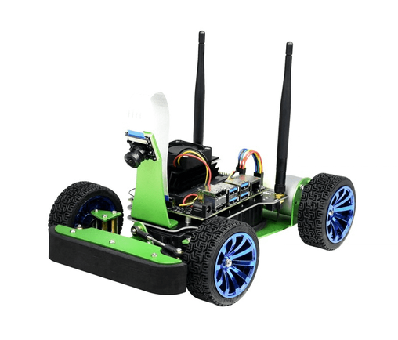
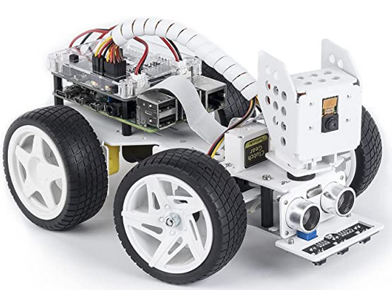
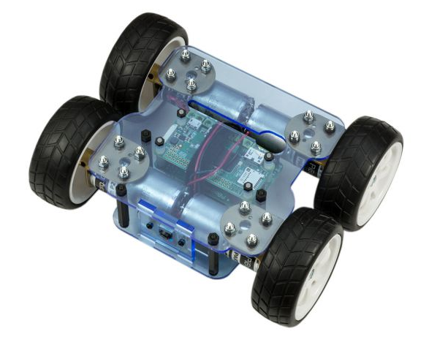
Organization and Overview
Period: February 7th – May 23rd 2022
Time: Monday 16.15 – 18.00
Place: Room 407 - 409
Lecturer: Erwin M. Bakker ( erwin@liacs.nl )
Assistant: Hainan Yu (h.yu@liacs.leidenuniv.nl )
NB Register on Brightspace
Schedule:
7-2 Introduction and Overview
14-2 Locomotion and Inverse Kinematics
21-2 Robotics Sensors and Image Processing
28-2 SLAM + SLAM Workshop
7-3 Mobile Robot Challenge Introduction
14-3 Project Proposals I (presentation by students)
21-3 Project Proposals II (presentation by students)
28-3 Robotics Vision
4-4 Robotics Reinforcement Learning
11-4 Robotics Reinforcement Learning Workshop II
18-4 No Class (Eastern)
25-4 Project Progress I (presentations by students)
2-5 Project Progress II (presentations by students)
9-5 Mobile Robot Challenge
16-5 Project Demos I
23-5 Project Demos II
Website: http://liacs.leidenuniv.nl/~bakkerem2/robotics/
Grading (6 ECTS):
Presentations and Robotics Project (60% of grade).
Class discussions, attendance, workshops and assignments (40% of grade).
It is necessary to be at every class and to complete every workshop and assignment.

Slide 3
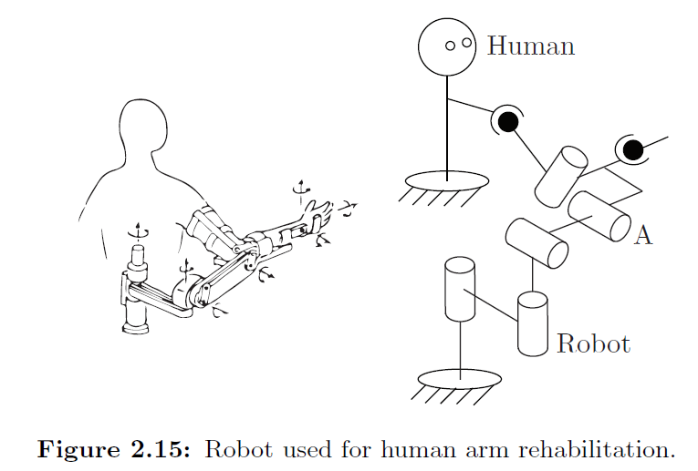
HomeWork II
Adding the 2 links together adds
6 constraints
(x,y,z) + orientation
Human Arm
m = 3D Space dof = 6
N = #links = 4
J = #joints = 3
2x Spherical: dof 2x 3
1x Revolute: dof 1x 1
dof = m(N-1-J) + ∑f_{i}
= 6(4-1-3) + 2x3 + 1x1 = 7
S
1
S
4
2
R
3
5
R
4
rm
R
3
R
2
Robot Arm
m = 3D Space dof = 6
N = #links = 5
J = #joints = 4
4x Revolute: dof 4x 1
dof = m(N-1-J) + ∑f_{i}
= 6(5-1-4) + 4x1 = 4
=> Human Arm connected to Robot Arm has 7 + 4 - 6 = 5 dof
1
R

Slide 4
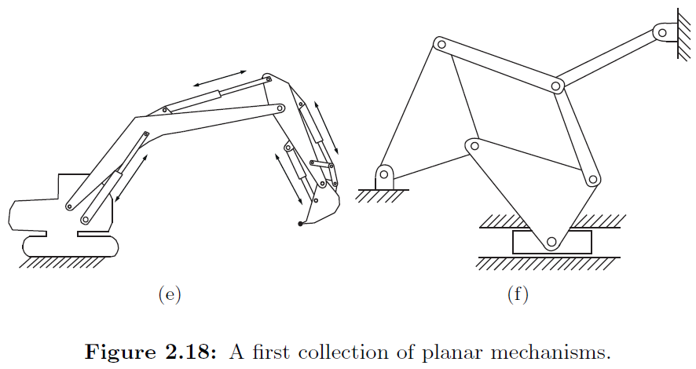
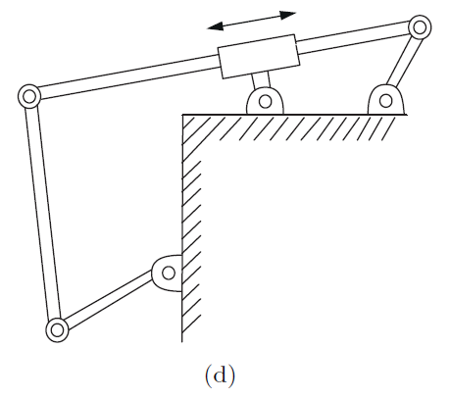
P
R
R
R
P
R
7
R
4
6
6
R
5
R
R
5
6
7
R
R
R
5
R
8
P
R
4
R
2
4
9
R
12
11
R
R
P
13
10
3
3
3
P
R
1
14
R
R
5R
2
P
2
1
1
R
Fig. 1.18 d)
m = 2D Space dof = 3
N = #links = 6
J = #joints = 7
6x Revolute: dof 6x 1
1x Prismatic: dof 1x 1
dof = m(N-1-J) + ∑f_{i}
= 3(6-1-7) + 6x1 + 1x1 = 1
Fig. 1.18 e)
m = 2D Space dof = 3
N = #links = 14
J = #joints = 17
13x Revolute: dof 13x 1
4x Prismatic: dof 4x 1
dof = m(N-1-J) + ∑f_{i}
= 3(14-1-17) + 13x1 + 4x1 = 5
Fig. 1.18 f)
m = 2D Space dof = 3
N = #links = 7
J = #joints = 8
7x Revolute: dof 7x 1
1x Prismatic: dof 1x 1
dof = m(N-1-J) + ∑f_{i}
= 3(7-1-8) + 7x1 + 1x1 = 2

Slide 5
Fig. 1.18 d) without the encircled part:
m = 2D Space dof = 3
N = #links = 5
J = #joints = 5
4x Revolute: dof 4x 1
1x Prismatic: dof 1x 1
dof = m(N-1-J) + ∑f_{i}
= 3(5-1-5) + 4x1 + 1x1 = 2
P
R
R
4
6
R
5
R
3
R
1
2
R
Encircled part has 1 dof.
Joining the 2 structures adds 2 constraints.
=> dof of complete structure equals 2+1 – 2 = 1

Slide 6
Fig. 1.18 e)
m = 2D Space dof = 3
N = #links = 14
J = #joints = 17
13x Revolute: dof 13x 1
4x Prismatic: dof 4x 1
dof = m(N-1-J) + ∑f_{i}
= 3(14-1-17) + 13x1 + 4x1 = 5
R
R
P
R
7
6
R
R
6
7
R
5
R
5
R
8
P
R
4
R
2
4
9
R
R
12
11
R
10
3
R
3
P
13
But: not taken any dependent joints into account:
You can select 3 joints such that all others have to follow.
Thus it is clear that the dof of this structure is:
P
R
14
R
5R
2
P
1
1
m = 2D Space dof = 3
N = #links = 4
J = #joints = 3
3x Revolute: dof 3x 1
dof = m(N-1-J) + ∑f_{i}
= 3(4-1-3) + 3x1 = 3

Slide 7
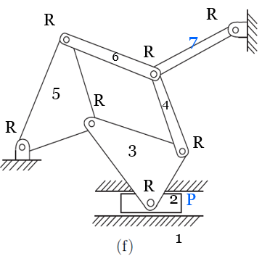
Fig. 1.18 f)
m = 2D Space dof = 3
N = #links = 7
J = #joints = 8
7x Revolute: dof 7x 1
1x Prismatic: dof 1x 1
dof = m(N-1-J) + ∑f_{i}
= 3(7-1-8) + 7x1 + 1x1 = 2
But this is not taking into account any dependent joints:
The encircled substructure has:
m = 2D Space dof = 3
N = #links = 4
J = #joints = 4
3x Revolute: dof 3x 1
1x Prismatic: dof 1x 1
dof = m(N-1-J) + ∑f_{i}
= 3(4-1-4) + 4x1 = 1 dof
Adding the links 6 and 4 keeps this 1 dof.
Link 7 and its revolute has 1 dof.
Combining the 2 structures gives 2 constraints =>
1 + 1 -2 = 0 dof

Slide 8
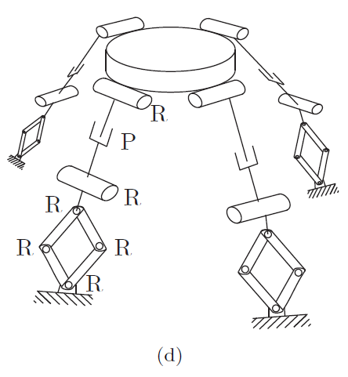
Fig. 2.21 d)
m = 3D Space dof = 6
N = #links = 30
J = #joints = 4 x 7 = 28
24x Revolute: dof 24x 1
4x Prismatic: dof 4x 1
dof = m(N-1-J) + ∑f_{i}
= 6(30-1-28) + 24x1 + 4x1 = 34
(Probably not as links are not independent.)
2
3
4
1
5
1
Fig. 2.21 d) with 1 leg on the ground
m = 3D Space dof = 6
N = #links = 24 + 1
J = #joints = 4x 6
20x Revolute: dof 20x 1
4x Prismatic: dof 4x 1
dof = m(N-1-J) + ∑f_{i}
= 6(25-1-24) + 20x1 + 4x1 = 24
3 legs are constrained to the ground
=> dof= 24 – 3*6 = 6
6
7
omit these for each leg
8
1
1

Slide 9
Organization and Overview
Period: February 7th – May 23rd 2022
Time: Monday 16.15 – 18.00
Place: Room 407 - 409
Lecturer: Erwin M. Bakker ( erwin@liacs.nl )
Assistant: Hainan Yu (h.yu@liacs.leidenuniv.nl )
NB Register on Brightspace
Schedule:
7-2 Introduction and Overview
14-2 Locomotion and Inverse Kinematics
21-2 Robotics Sensors and Image Processing
28-2 SLAM + SLAM Workshop
7-3 Mobile Robot Challenge Introduction
14-3 Project Proposals I (presentation by students)
21-3 Project Proposals II (presentation by students)
28-3 Robotics Vision
4-4 Robotics Reinforcement Learning
11-4 Robotics Reinforcement Learning Workshop II
18-4 No Class (Eastern)
25-4 Project Progress I (presentations by students)
2-5 Project Progress II (presentations by students)
9-5 Mobile Robot Challenge
16-5 Project Demos I
23-5 Project Demos II
Website: http://liacs.leidenuniv.nl/~bakkerem2/robotics/
Grading (6 ECTS):
Presentations and Robotics Project (60% of grade).
Class discussions, attendance, workshops and assignments (40% of grade).
It is necessary to be at every class and to complete every workshop and assignment.

Slide 10
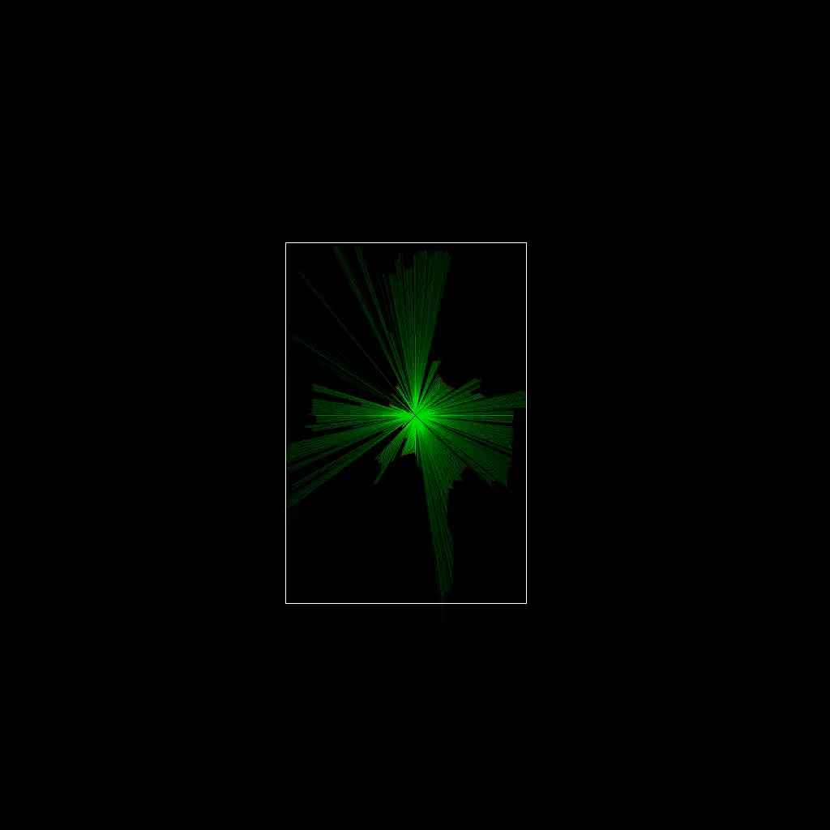
SLAM: Simultaneous Localization And Mapping
Mapping
Use sensor data: US, LIDAR, Camera, Structured Light, etc. to make a map of the environment of the robot.
Localization
Determine the pose of the robot relative to the map.
Initial pose can be given: pose tracking problem
No initial pose given: global localization problem
SLAM: do both Mapping and Localization at the same time.
VSLAM: use camera (mono, stereo, multi-, depth, etc.) to solve SLAM
MonsterBorg SLAM by E. van der Zande

Slide 11
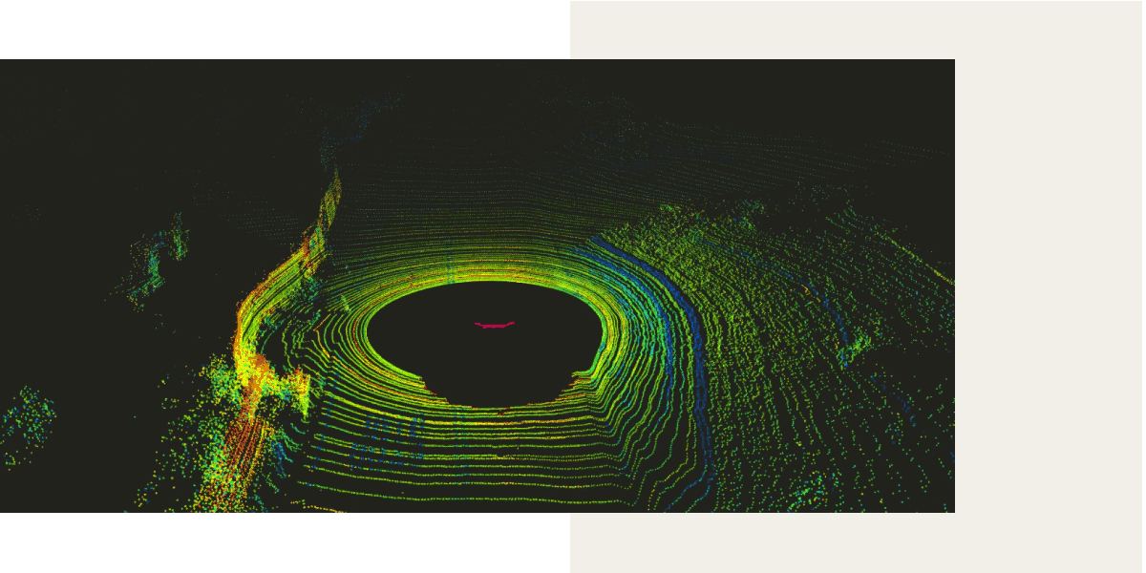
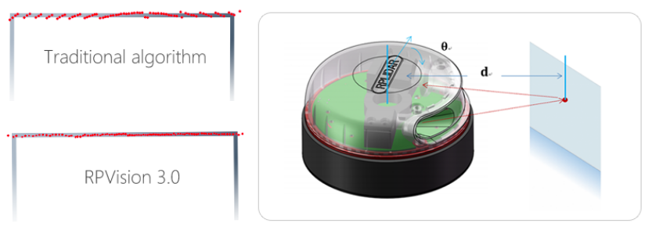
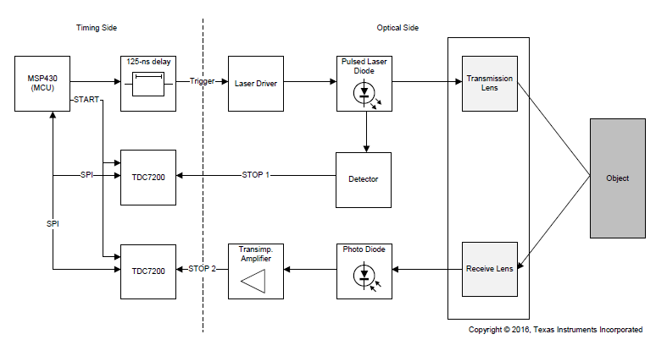
LIDAR
http://www.slamtec.com/en/lidar/A3
https://news.voyage.auto/an-introduction-to-lidar-the-key-self-driving-car-sensor-a7e405590cff
Time of Flight
Laser
Detector
Speed of light ~ 3 x 10⁸ m/s
In 1 picosecond (= 10⁻¹² sec) light travels ~ 3 x 10⁻⁴ m = 0.3 mm
During 33 picoseconds light travels ~ 1cm
Texas Instruments LIDAR Pulsed Reference Design
Notes:
Leica Disto 510 +/- 1mm 200m
Rplidar a3 +/- several mm

Slide 12
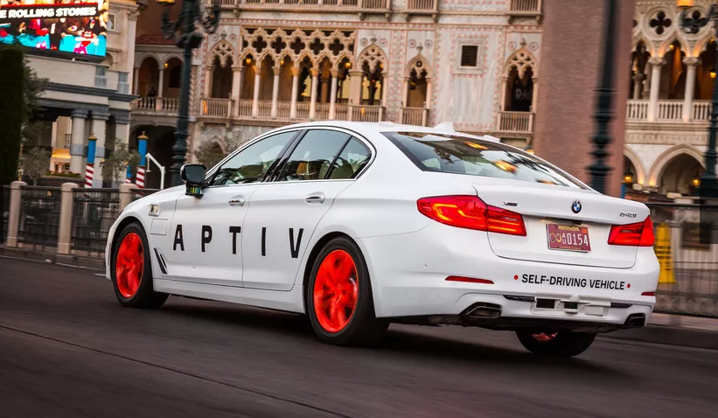
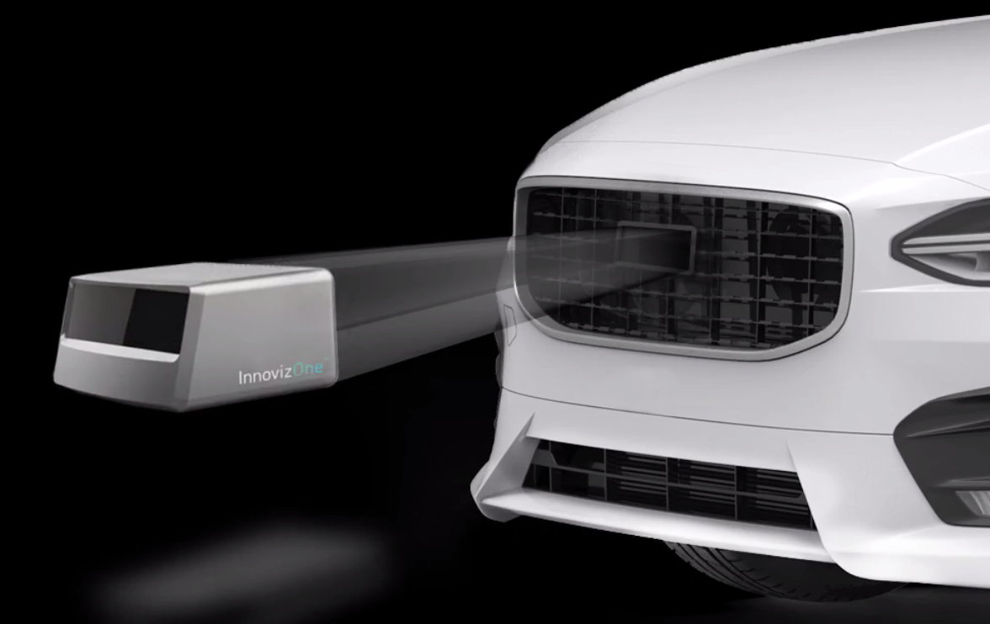
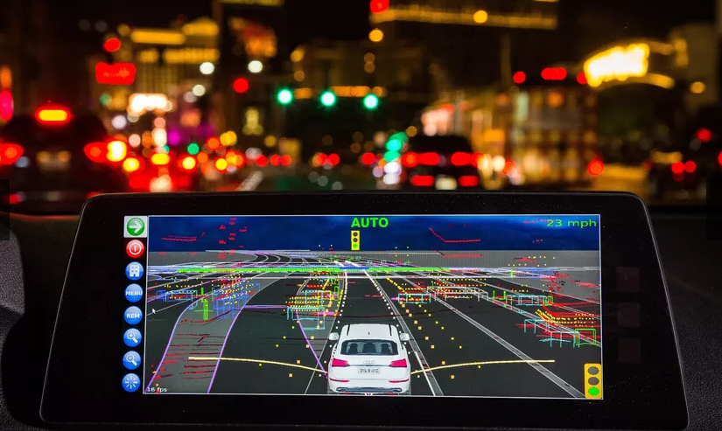
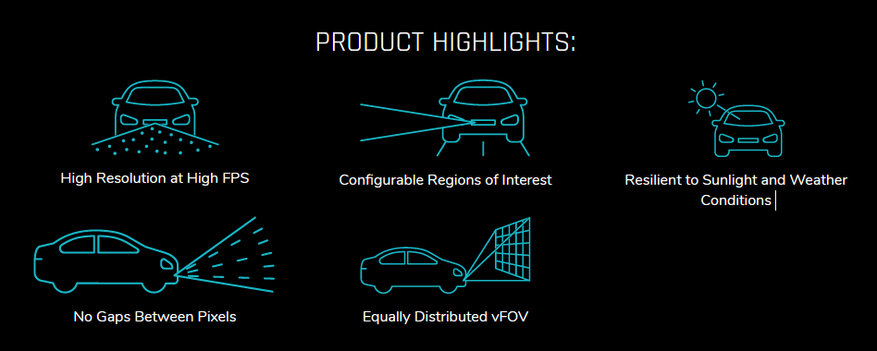
CES2019
BMW Self Driving Car
InnovizOne Solid-state Lidar (goal: sub $1000 sensor)
Angular resolution 0.1º x 0.1⁰
FOV 120º x 25º
25 FPS
Range 250m
Perception Capabilities
Object detection and classification
Lane detection
Object Tracking
SLAM
SLAM (Simultaneous Localization And Mapping)
Notes:
https://www.oxbotica.com/on-road-people-and-goods/
https://www.theguardian.com/technology/2021/jan/03/peak-hype-driverless-car-revolution-uber-robotaxis-autonomous-vehicle
Prof Nick Reed, a transport consultant who ran UK self-driving trials, says: “The perspectives have changed since 2015, when it was probably peak hype. Reality is setting in about the challenges and complexity.”
Advertisement
Automated driving, says Reed, could still happen in the next five years on highways with clearly marked lanes, limited to motorised vehicles all going in the same direction. Widespread use in cities remains some way further out, he says: “But the benefits are still there.”
social acceptance, cybersecurity and cost have never been addressed.

Slide 13
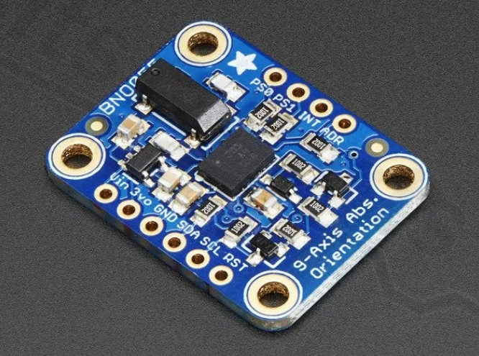
IMU, or Inertial Measurement Unit
IMU consist of Sensors for
orientation, by measuring the earths magnetic field and a gyroscope.
acceleration,
(angular) velocity.
In SLAM
Orientation is very useful for scan matching: a good initial guess.
Acceleration is calculated by subtracting the earth gravity vector from the raw accelerometer data.
Velocity is calculated by time integration of the acceleration (tends to accumulate large errors)
IMU Bosch BNO055 Sampling Frequencies:
Accelerometer: 1 KHz
Gyroscope: 523 Hz
Magnetometer: 30Hz

Slide 14
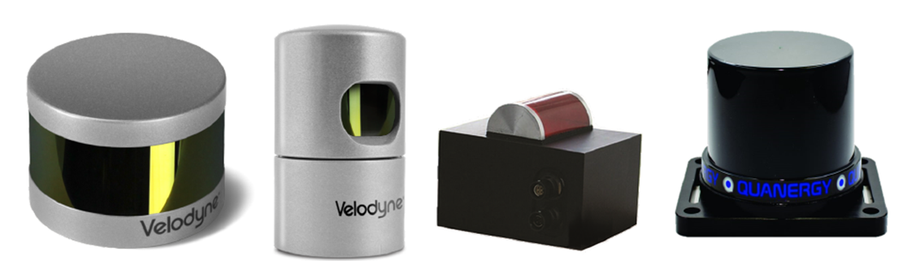
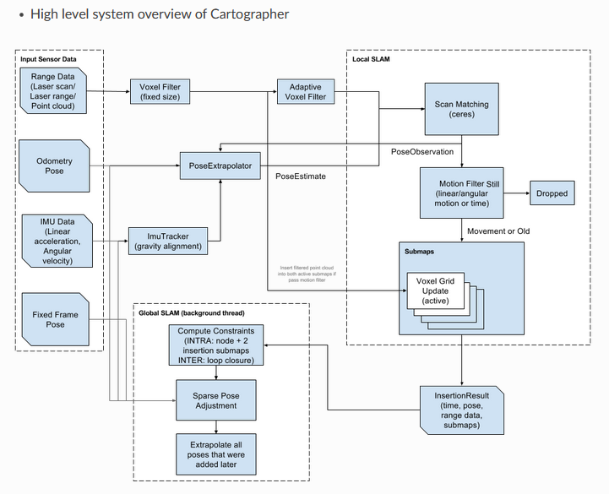
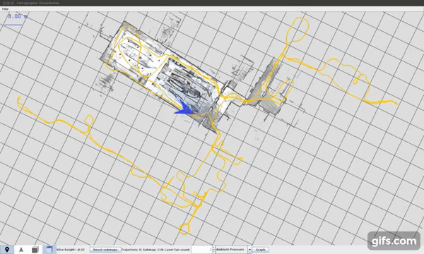
Cartographer
https://github.com/cartographer-project/cartographer
Cartographer gives real-time simultaneous localization and mapping (SLAM) in 2D and 3D.

Slide 15
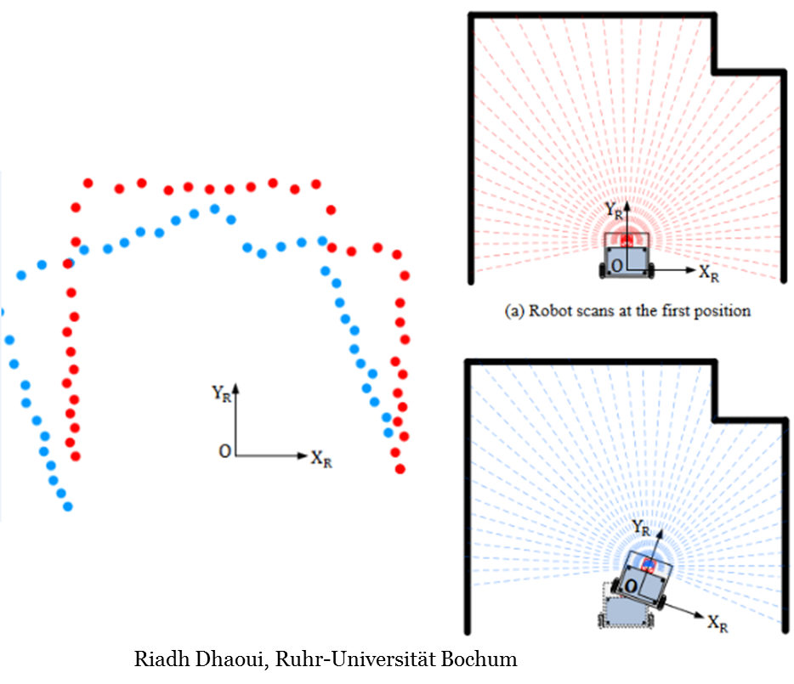
2D and 3D Lidar SLAM
Front-end:
Matching new measurements against the current belief of the environment
Measurements:
  typically point clouds of lidar data
  Movement and heading data: IMU, wheelencoders, etc.
Filtering of the data
  Missing or invalid data (zero length rays)
  Noisy data: measured too far away
  Distorted data: e.g., as a result of robot acceleration
Transform
  Scan matching tries to find a rigid body transform: translation and rotation
  IMU can give heading information: more reliable than deriving it from scan matching

Slide 16
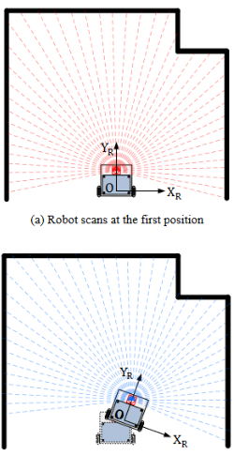
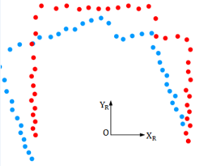
2D and 3D Lidar SLAM: Scan Matching
Point to Point Matching
  Between the 2 scans point associations are found
  The translation from points to associated points determines a rigid body transform
  E.g found by Singular Value Decomposition
  Fails in case of degenerate clouds (coplanar)
  Point association is difficult to obtain
Iterative closest point (ICP) determination
  Compute closest points
  Compute and apply the transformation
  Check if it is good enough, otherwise repeat
Tangent Matching
  In each of the 2 scans find Tangent lines between neighboring points
  Instead of point matching now line matching between 2 scans
  Movement and heading data: IMU, wheelencoders, etc.
Point to Grid Map
Etc.
Riadh Dhaoui, Ruhr-Universität Bochum
Notes:
In geometry, a set of points in space are coplanar if there exists a geometric plane that contains them all. For example, three points are always coplanar, and if the points are distinct and non-collinear, the plane they determine is unique. However, a set of four or more distinct points will, in general, not lie in a single plane.
ICP NlogNref

Slide 17
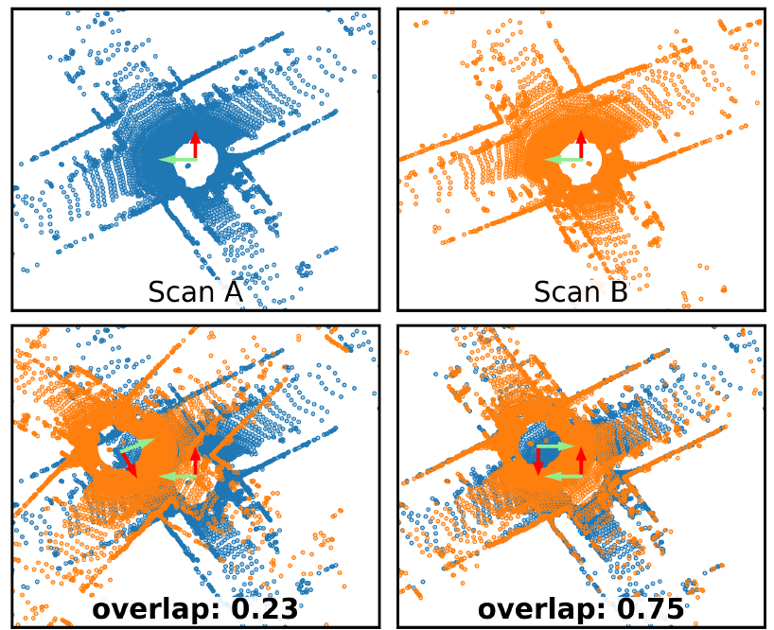
SLAM
Pose estimation relative to recent poses: incremental scan matching, odometry
Loop closing: correcting accumulated drift, maintaining consistency between measurements
Loop closure detection:
Estimate lidar point clouds overlap (note: also used in photogrammetry):
  Yaw transformation estimate
  Score, e.g., using Iterative Closest Point
Can also be used for global scan matching.
OverlapNet a DNN method that does an estimate without transformation guessing, uses spherical projection of 3D Lidar data.
Performance on Kitty-odometry dataset.
Example: Scan A and B overlap detection: scored after transformation.

Slide 18
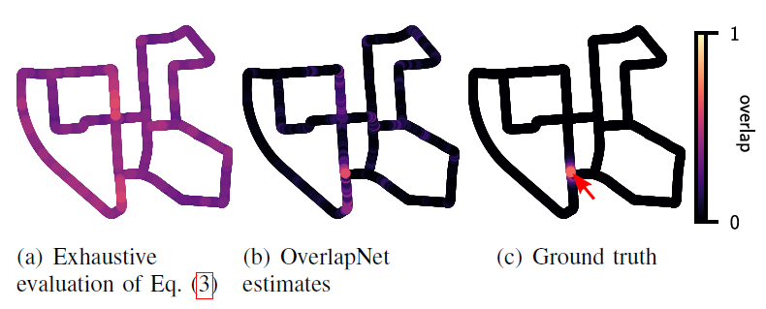
SLAM: Loop Closing
OverlapNet
Pose estimation relative to recent poses: incremental scan matching, odometry
Loop closing: correcting accumulated drift
Loop closure detection:
In general overlap scores based on point-cloud differences (see Eq. 3 of X Chen et al., May 2021) will be high at many locations of the map.
OverlapNet a DNN method that does an estimate without transformation guessing, uses spherical projection of 3D Lidar data.
Example: Scan A and B overlap detection: scored after transformation.

Slide 19
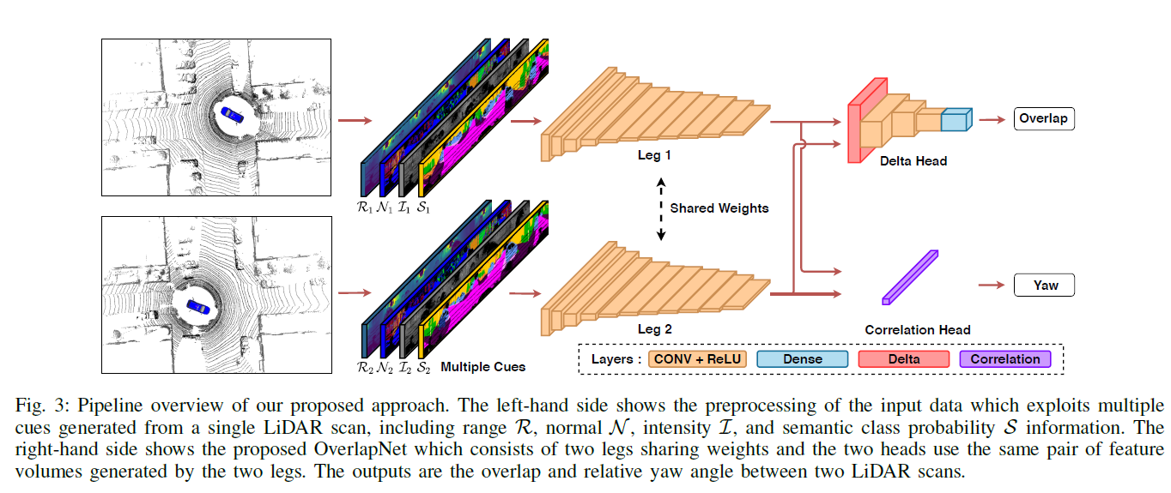
OverlapNet

Slide 20
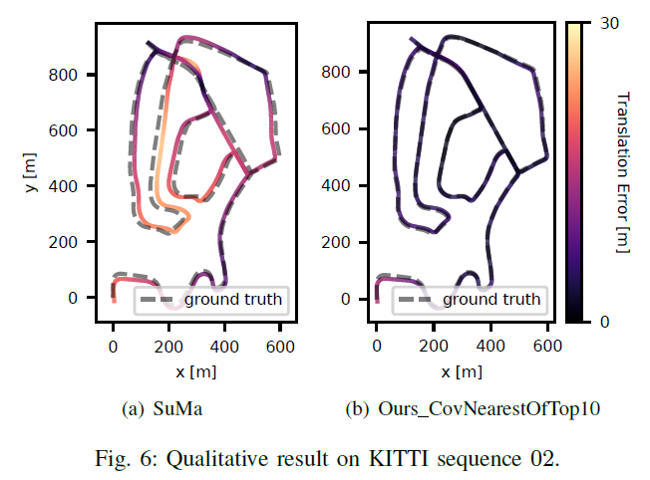
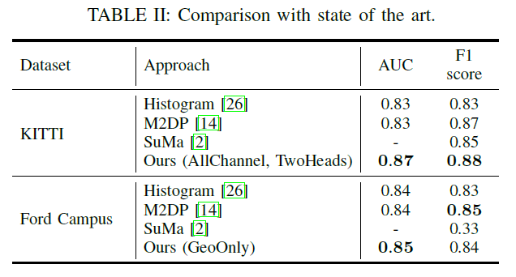
OverlapNet
X. Chen et al., OverlapNet: Loop Closing for Lidar-based SLAM, May 2021.

Slide 21
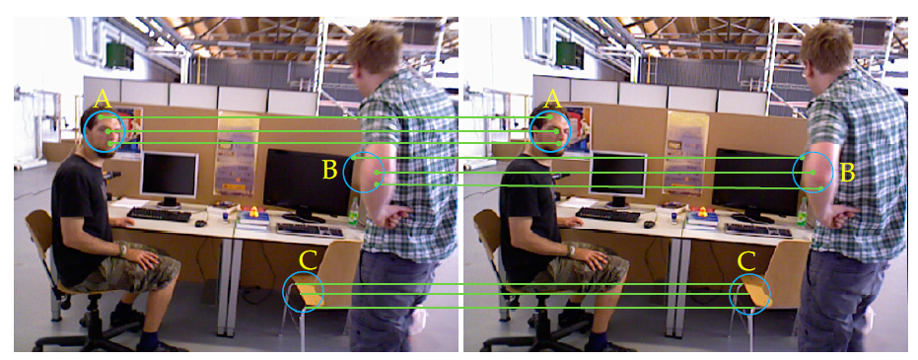
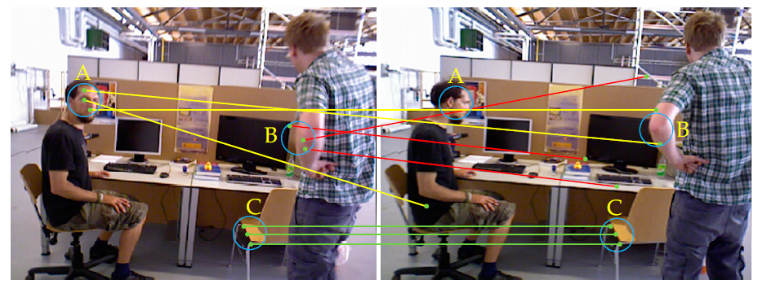
Visual SLAM
VSLAM: use camera (mono, stereo, multi-, depth, etc.) to solve SLAM
Readily available on mobile platforms: drones, cars, mobile phones, AR/VR Glasses
DMS-SLAM, OpenVSLAM, ORBSLAM
DMS-SLAM:
pose tracking, closed-loop detection and relocalization based on static 3D map points of the local map
supports monocular, stereo and RGB-D visual sensors in dynamic scenes.
A and B partial Motion, C static => A and B matching errors, C still correct.

Slide 22
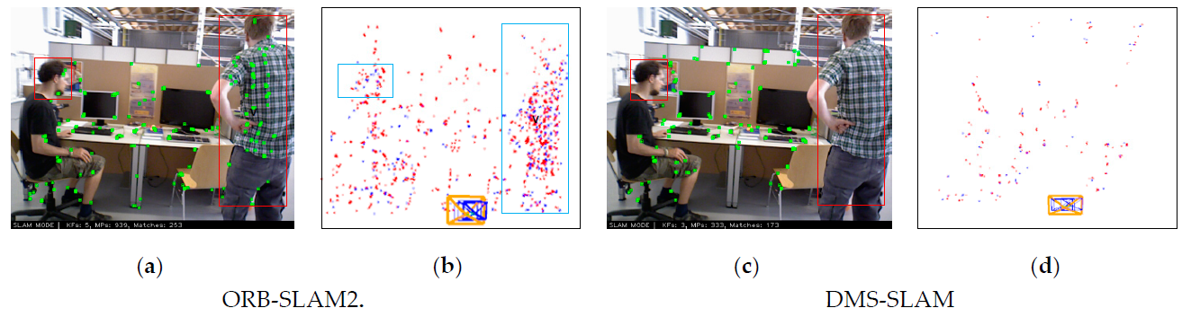
Visual SLAM
VSLAM: use camera (mono, stereo, multi-, depth, etc.) to solve SLAM
DMS-SLAM, OpenVSLAM, ORBSLAM
A and B partial Motion, C static => A and B matching errors, C still correct.
Red-boxes moving

Slide 23
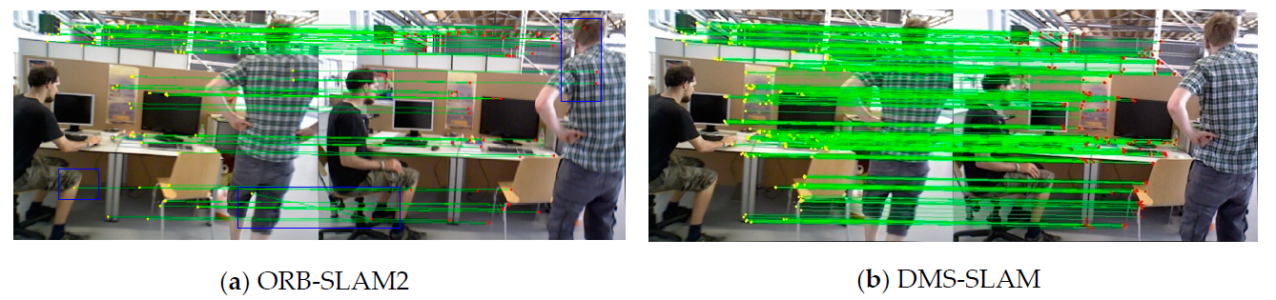
Visual SLAM
VSLAM: use camera (mono, stereo, multi-, depth, etc.) to solve SLAM
DMS-SLAM, OpenVSLAM, ORBSLAM
A and B partial Motion, C static => A and B matching errors, C still correct.
Blue-boxes wrong
feature matching point pairs.

Slide 24
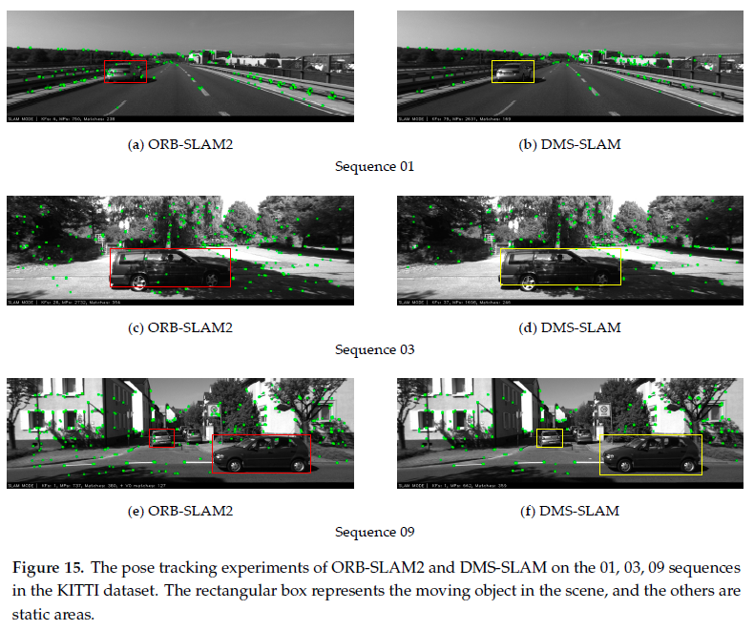

Slide 25
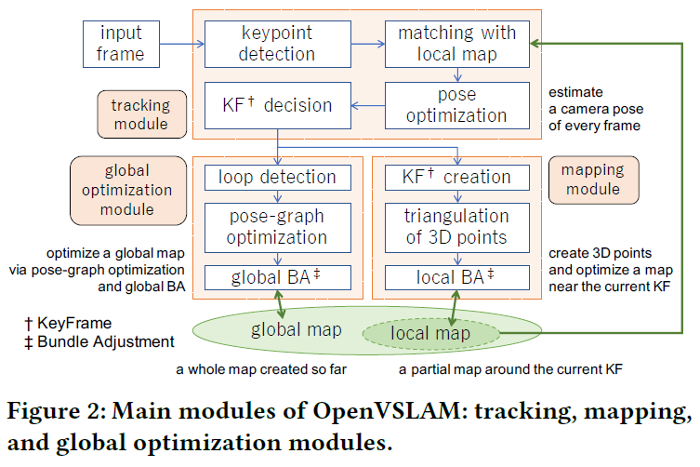
OpenVSLAM
A Versatile Visual SLAM Framework. (S. Sumikura et al., 2019)

Slide 26
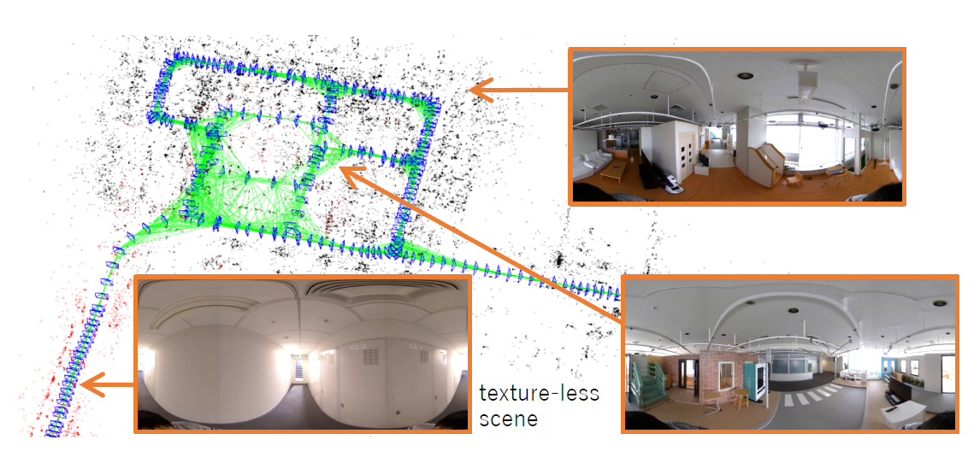
OpenVSLAM

Slide 27
Organization and Overview
Period: February 7th – May 23rd 2022
Time: Monday 16.15 – 18.00
Place: Room 407 - 409
Lecturer: Erwin M. Bakker ( erwin@liacs.nl )
Assistant: Hainan Yu (h.yu@liacs.leidenuniv.nl )
NB Register on Brightspace
Schedule:
7-2 Introduction and Overview
14-2 Locomotion and Inverse Kinematics
21-2 Robotics Sensors and Image Processing
28-2 SLAM + SLAM Workshop
7-3 Mobile Robot Challenge Introduction
14-3 Project Proposals I (presentation by students)
21-3 Project Proposals II (presentation by students)
28-3 Robotics Vision
4-4 Robotics Reinforcement Learning
11-4 Robotics Reinforcement Learning Workshop II
18-4 No Class (Eastern)
25-4 Project Progress I (presentations by students)
2-5 Project Progress II (presentations by students)
9-5 Mobile Robot Challenge
16-5 Project Demos I
23-5 Project Demos II
Website: http://liacs.leidenuniv.nl/~bakkerem2/robotics/
Grading (6 ECTS):
Presentations and Robotics Project (60% of grade).
Class discussions, attendance, workshops and assignments (40% of grade).
It is necessary to be at every class and to complete every workshop and assignment.

Slide 28
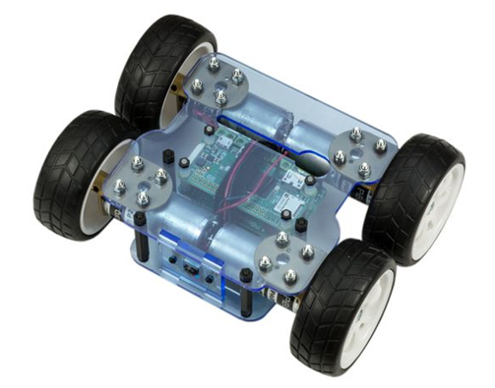
Yeti Borg Introduction
YetiBorg
Raspberry Pi Zero W
4 motors
1 Camera
No odometry
Programming and control through SSH
Python and OpenCV
No live camera footage from the YetiBorg
Live view of environment through Kaltura

Slide 29
YetiBorg URBAN Challenge (previously: 2021)
Urban Challenge
Keep right
Traffic Lights
Traffic Signs
Obstacles
Qualification Track
Keep Right
Traffic Lights
Stop as close as possible
before the blue line

Slide 30
Mobile Robot Challenge Teams
Form Mobile Robot Challenge Teams of 4-5 members.
Determine a Team Name and 1 contact person.
Further details will follow on Brightspace1.

Slide 31
Organization and Overview
Period: February 7th – May 23rd 2022
Time: Monday 16.15 – 18.00
Place: Room 407 - 409
Lecturer: Erwin M. Bakker ( erwin@liacs.nl )
Assistant: Hainan Yu (h.yu@liacs.leidenuniv.nl )
NB Register on Brightspace
Schedule:
7-2 Introduction and Overview
14-2 Locomotion and Inverse Kinematics
21-2 Robotics Sensors and Image Processing
28-2 SLAM + SLAM Workshop
7-3 Mobile Robot Challenge Introduction
14-3 Project Proposals I (presentation by students)
21-3 Project Proposals II (presentation by students)
28-3 Robotics Vision
4-4 Robotics Reinforcement Learning
11-4 Robotics Reinforcement Learning Workshop II
18-4 No Class (Eastern)
25-4 Project Progress I (presentations by students)
2-5 Project Progress II (presentations by students)
9-5 Mobile Robot Challenge
16-5 Project Demos I
23-5 Project Demos II
Website: http://liacs.leidenuniv.nl/~bakkerem2/robotics/
Grading (6 ECTS):
Presentations and Robotics Project (60% of grade).
Class discussions, attendance, workshops and assignments (40% of grade).
It is necessary to be at every class and to complete every workshop and assignment.

Slide 32
Robotics Project Proposals Presentations
Monday 14-3 2022 and 21-3 2022
Present your Robotics Project Proposal during a 5 minute (max) talk. Clearly state the title of your project, the team members, your goals, how you will pursue them, what are the challenges and what at least can and should be delivered on the demo days: May 16th 2022 and May 23rd 2022.
Note: Groups of 1-5 members are allowed.
The presentation should contain slides for:
Title and group members.
Goal of the project.
How will you pursue these goals.
What are the challenges.
What at least can and should be delivered on the demo days: May 16th 2022 and May 23rd 2022.
The LIACS Media Lab can support your project with some materials for your project. Please clearly state any materials that you would need for your proposal.
Please note that these materials are limited so project goals may need to be adjusted accordingly.
Each presentation will be followed by a short class discussion.

Slide 33
Previous Projects
Evolutionary Locomotion
Nao plays Tic-Tac-Toe
Slam Robot Project.
Dolphin Drone: Drone Recognition and Maneuvering with Hoops.
Delivery Drone.
Programming a NAO to play a tune using a xylophone.
Floor mapping with Swarm Robotics
Tootballing Yetiborg
Cat Flap Opening Based on Audio/Video/RFID
DrawBot
Traffic coordination (simulation).
Plane filling curves (simulation).
AimBot
Artificial Muscles
Ball Tracking Car
BorrelBot
Fetch Bot
Floor Mapping Robot
Gesture Control Pachenko
Hexapod
Nao Pose
Position Estimation
Race Car Training
Face Touch

Slide 34
References
SLAM
M. Sualeh, G.-W. Kim, Simultaneous Localization and Mapping in the Epoch of Semantics: A Survey, International Journal of Control, Automation and Systems 17(3) (2019) 729-742.
W. Hess, D. Kohler, H. Rapp, D. Andor, Real-Time Loop Closure in 2D LIDAR SLAM, Published in: 2016 IEEE International Conference on Robotics and Automation (ICRA).
X. Chen et al., OverlapNet: Loop Closing for Lidar-based SLAM, May 2021.
E.R. van der Zande, An Introduction to 2D Lidar SLAM, December 2021.
S. Sumikura et al., OpenVSLAM: A Versatile Visual SLAM Framework, 2019.
G. Liu et al. DMS-SLAM: A General Visual SLAM System for Dynamic Scenes with Multiple Sensors, Sensors, 2019.
Yetiborg Challenge
https://navoshta.com/detecting-road-features/ by Alex Staravoitau
OpenCV.org

Slide 35
Robotics

Slide 36

Image Processing using OpenCV
Core module: the basic building blocks of this library for manipulating the images on a pixel level.
Imgproc module: the image processing (manipulation) functions inside OpenCV.
High Level GUI and Media (highgui module)
Image Input and Output (imgcodecs module)
Video Input and Output (videoio module)
Camera calibration and 3D reconstruction (calib3d module)
2D Features framework (feature2d module): feature points detectors, descriptors and matching framework found inside OpenCV.
Video analysis (video module) algorithms usable on your video streams like motion extraction, feature tracking and foreground extractions.
Object Detection (objdetect module) face detectors, etc.
Deep Neural Networks (dnn module)
Machine Learning (ml module) machine learning classes for statistical classification, regression and clustering of data.
Graph API (gapi module)
Computational photography (photo module) for advanced photo processing.
Images stitching (stitching module) create photo panoramas and more with OpenCV stitching pipeline.
GPU-Accelerated Computer Vision (cuda module); OpenCV iOS:

Slide 37
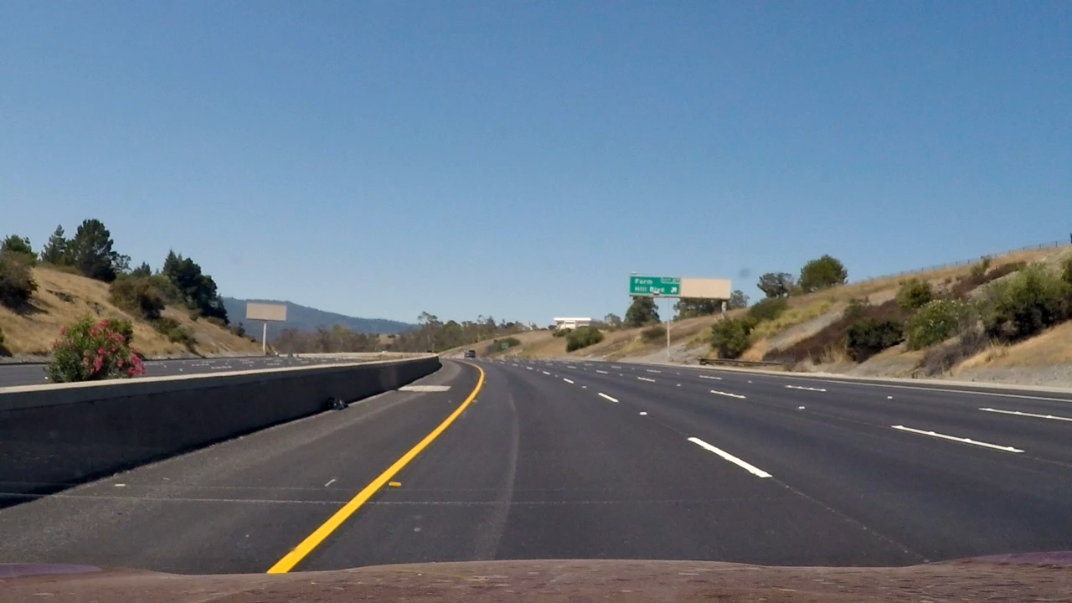
Lane Tracking
Some example project for detecting road features using OpenCV:
https://navoshta.com/detecting-road-features/ by Alex Staravoitau

Slide 38
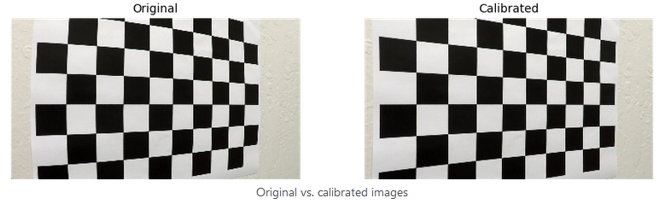
Processing Pipeline: Camera Calibration
… cv2.findChessboardCorners(image, (9, 6), None) // Inner corners 9x6
… cv2.calibrateCamera( pattern_points, image_points, (image.shape[1], image.shape[0]), None, None)
corrected_image = cv2.undistort(image, self.camera_matrix, self.dist_coefficients, None, self.camera_matrix)

Slide 39
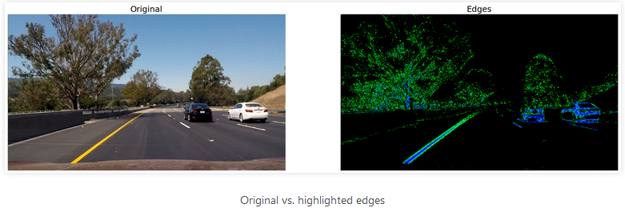
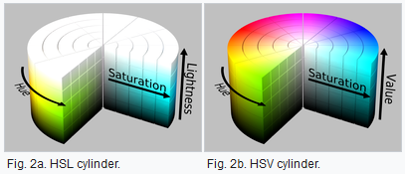
Processing Pipeline: Edge Detection
Gradient Absolute Values, Ranges within certain magnitudes, Gradient Directions
Sobel Operator (using a convolutional Kernel)
Color Ranges
HLS Color Space: Hue, Lightness, and Saturation (for road detection, etc.)
Notes:
HLS more perceptual
HSV more for color detection

Slide 40
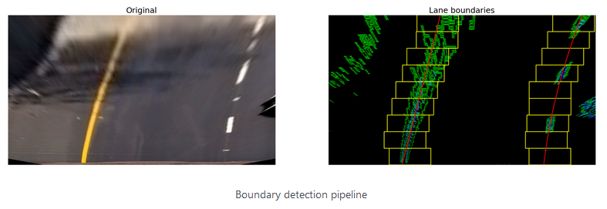
Processing Pipeline: Perspective Transformation
Left: The original image after the camera calibration and perspective transform.
Right: After edge detection with edges highlighted in green and blue.
Scanning windows boundaries for areas with pixel that may belong to lines are highlighted in yellow,
A second order polynomial approximation of the collected points in red.

Slide 41
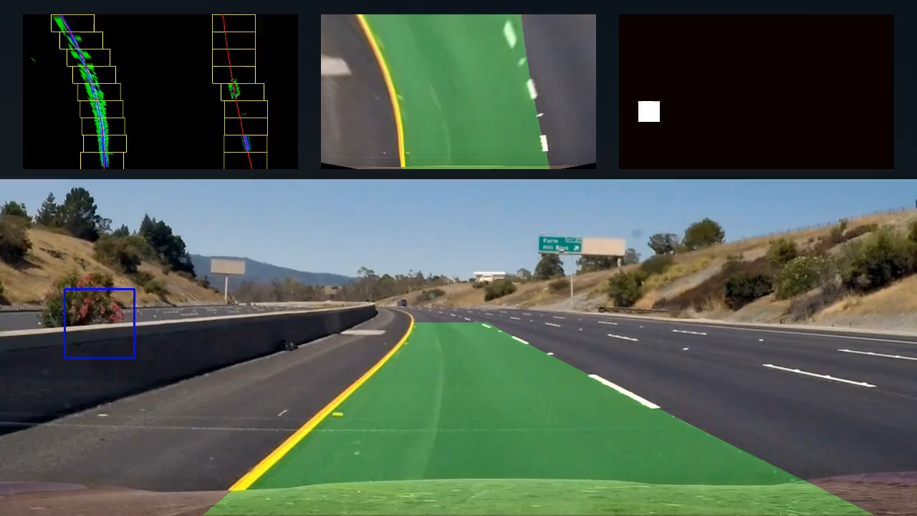
Lane and Vehicle Tracking

Slide 42
MonsterBorg SLAM
E. van der Zande

Slide 43
Robotics Discussion Session
Wednesday 3-3 at 13.00
Robotics Kaltura Room
During this session we discuss practical aspects and any further questions of robotics in an informal and interactive setting.

