Slide 1
Robotics
Erwin M. Bakker| LIACS Media Lab

Slide 2
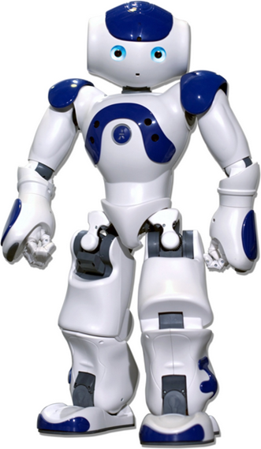
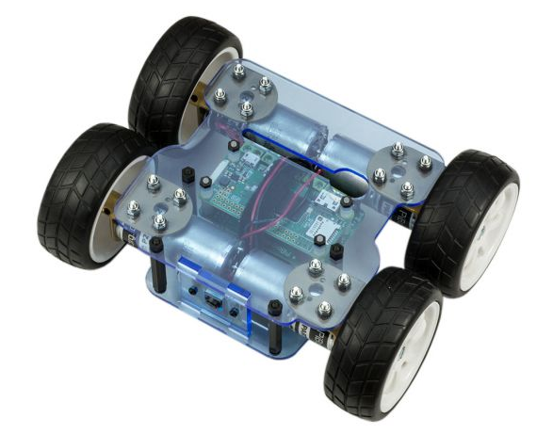
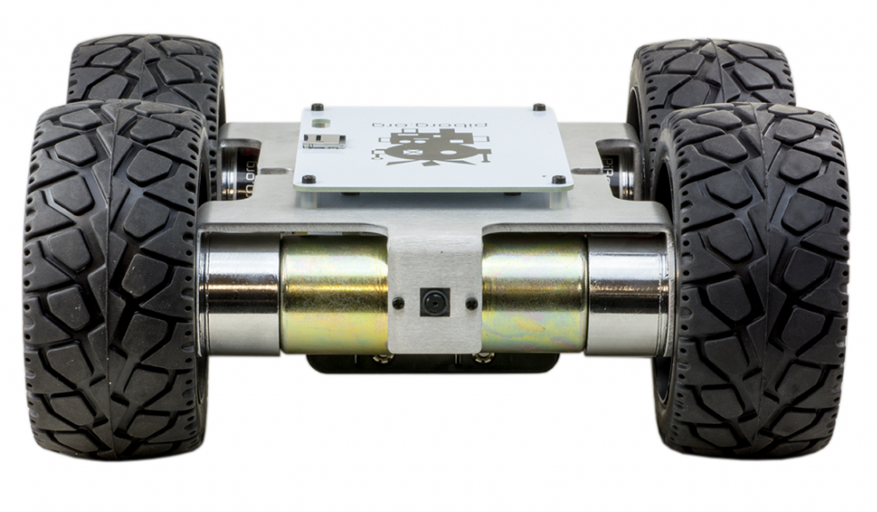
Organization and Overview
Period: February 4th – April 28th 2020
Time: Tuesday 14.15 – 16.00
Place: LIACS, Room 407-409 (Workshops Room 302-304)
Lecturer: Dr Erwin M. Bakker ( erwin@liacs.nl )
Assistant: Laduona Dai
NB E-mail your name and student number to erwin@liacs.nl
Schedule:
4-2 Introduction and Overview
17-2 No class
18-2 Locomotion and Inverse Kinematics &
Yetiborg Introduction
25-2 Robotics Sensors and Image Processing
27-2 Yetiborg available in Room 126a 13.15 – 14.45
3-3 Project Proposals (presentation by students)
10-3 Yetiborg Qualification Challenge + SLAM Workshop I
17-3 Robotics Image Processing and Understanding
24-3 Yetiborg Race
31-3 Project Progress Report (by students)
7-4 Robotics Reinforcement Learning
14-4 Robotics Reinforcement Learning Workshop II
21-4 TBA
28-4 Project Demos (by students)
Website: http://liacs.leidenuniv.nl/~bakkerem2/robotics/
Grading (6 ECTS):
Presentations and Robotics Project (60% of grade).
Class discussions, attendance, workshops and assignments (40% of grade).
It is necessary to be at every class and to complete every workshop.

Slide 3
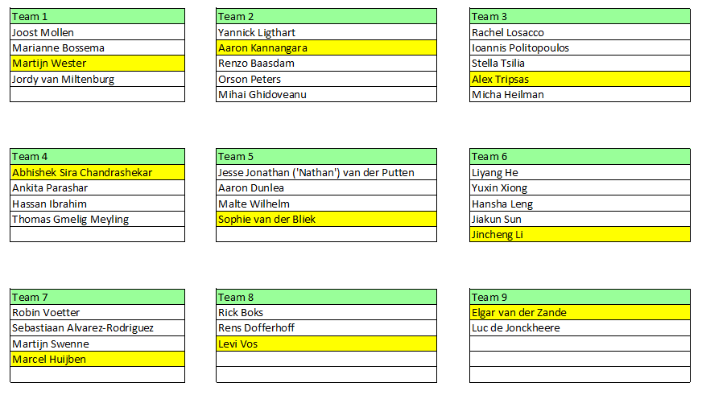

Slide 4
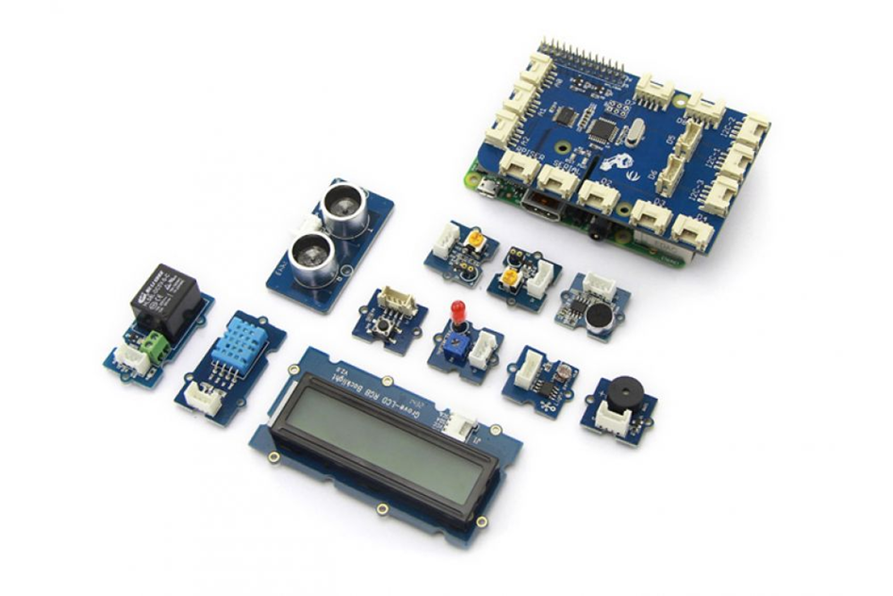
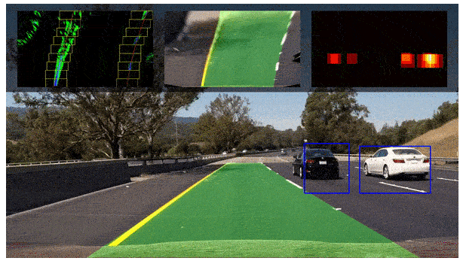
Overview
Sensors
Lane Tracking
OpenCV
Line Tracking

Slide 5
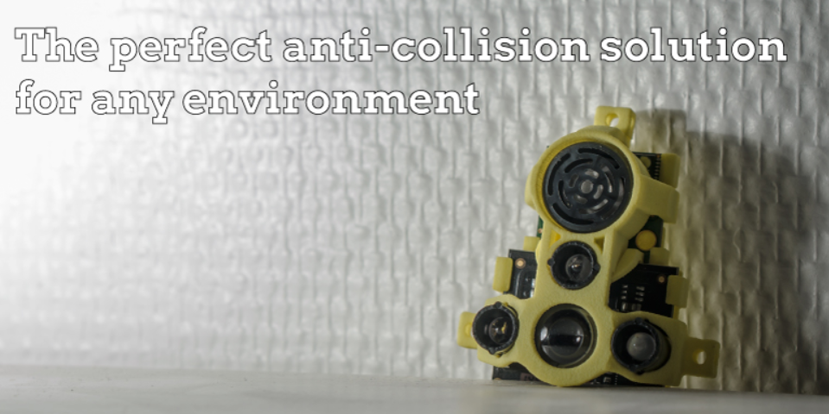
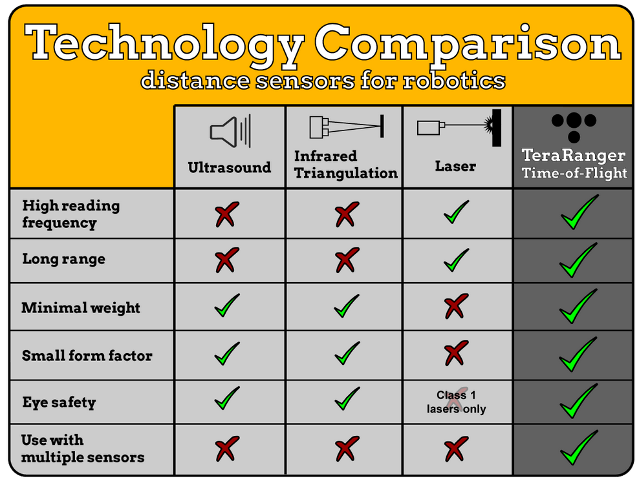
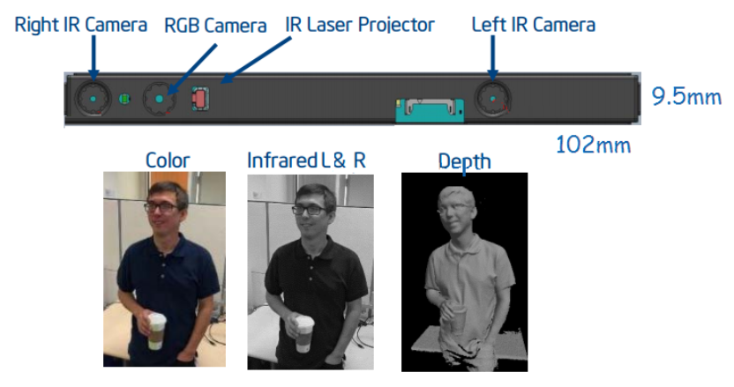
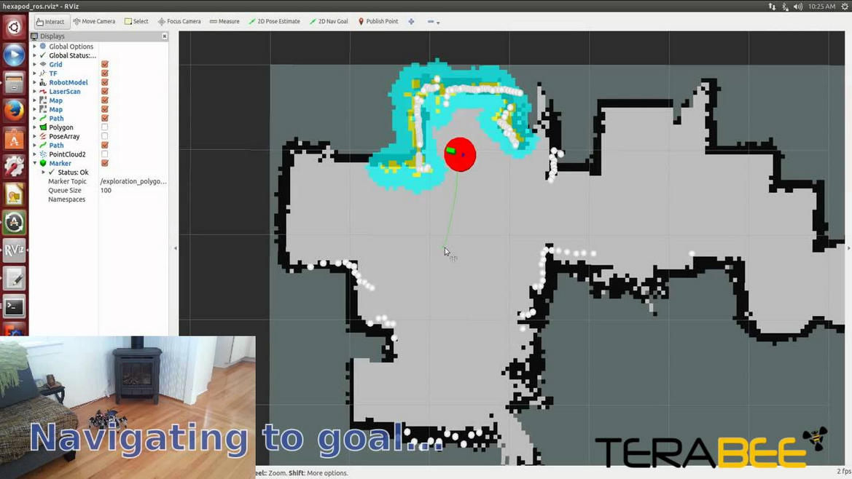
Robotics Sensors
Bumper switches
Acceleration, Orientation, Magnetic
IR/Visible Light
Pressure, Force
Ultrasonic, Lidar, Radar
Camera’s, stereo camera’s
Structured Light Camera’s

Slide 6
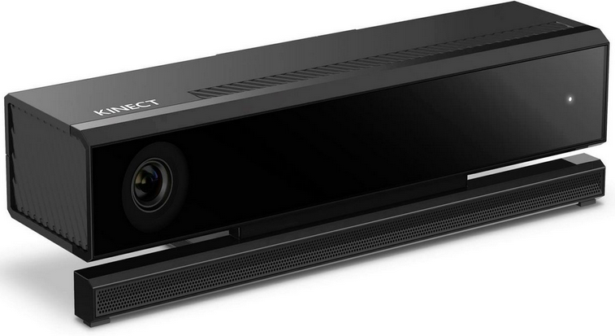
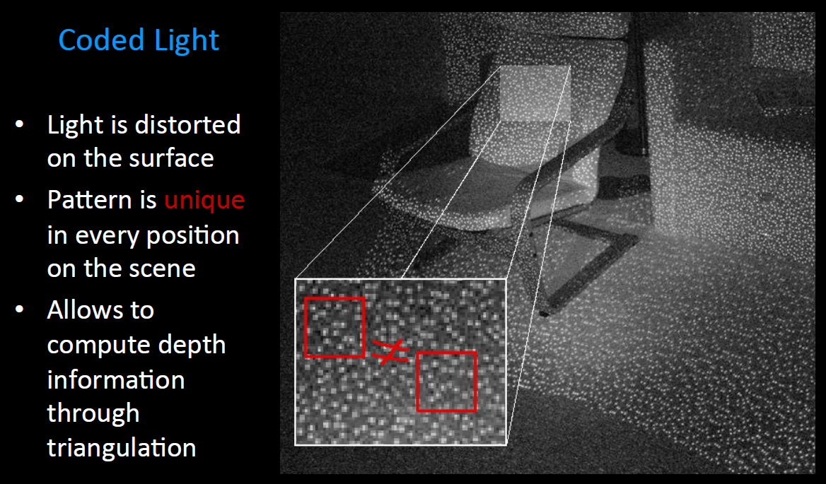
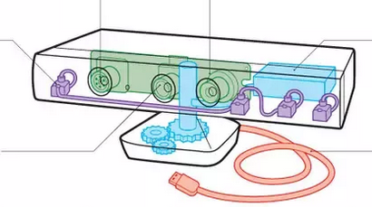
Structured Light
Primesense based Occipital
Asus X-tion Pro Live
Microsoft Kinect v1, v2
Intel RealSense F200, R200 (blue)
IR Emitter
IR Depth Camera
Mic-array (4xmic)
Color Camera
From: Anyline presentation by Peter Sperl

Slide 7
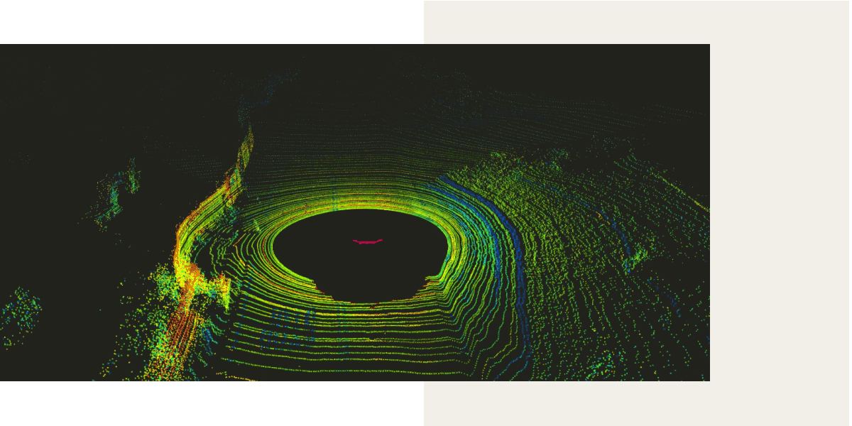
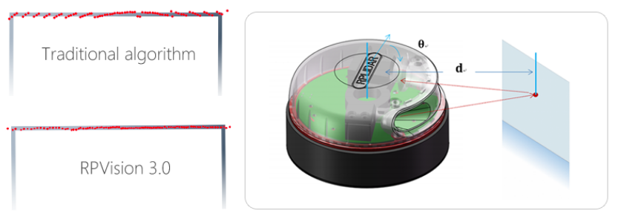
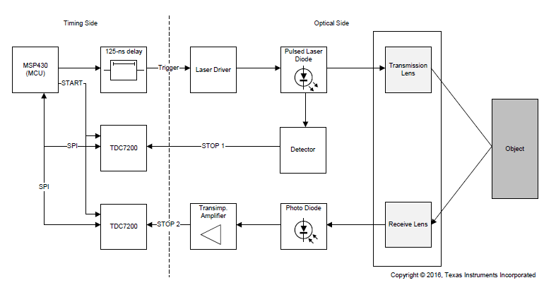
LIDAR Explanation
http://www.slamtec.com/en/lidar/A3
https://news.voyage.auto/an-introduction-to-lidar-the-key-self-driving-car-sensor-a7e405590cff
Time of Flight
Laser
Detector
Speed of light ~ 3 x 10⁸ m/s
In 1 picosecond (= 10⁻¹² sec) light travels ~ 3 x 10⁻⁴ m = 0.3 mm
During 33 picoseconds light travels ~ 1cm
Texas Instruments LIDAR Pulsed Reference Design

Slide 8
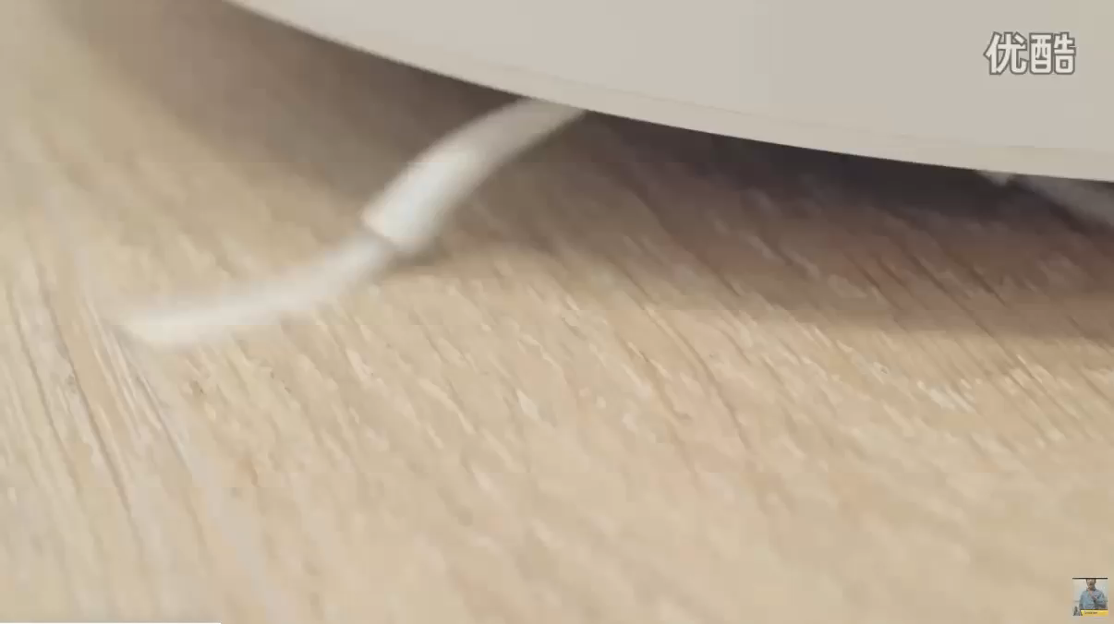

Slide 9
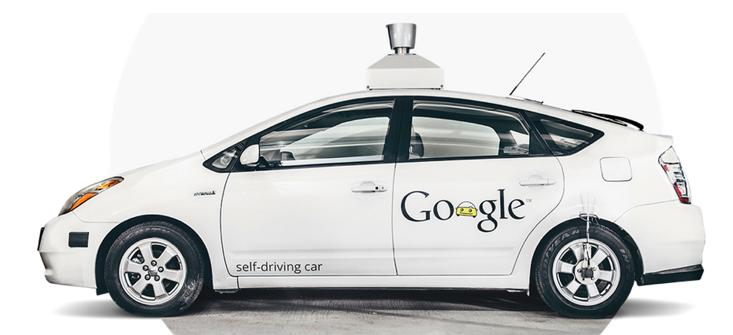
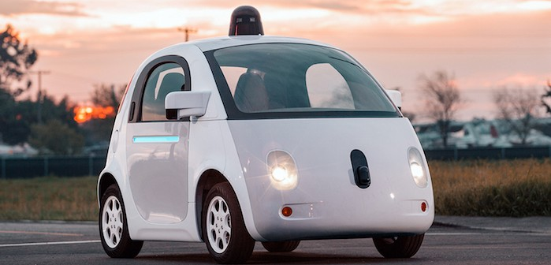
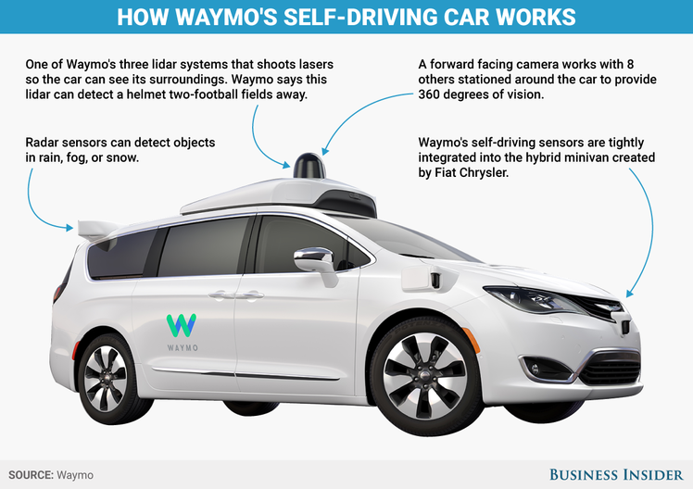
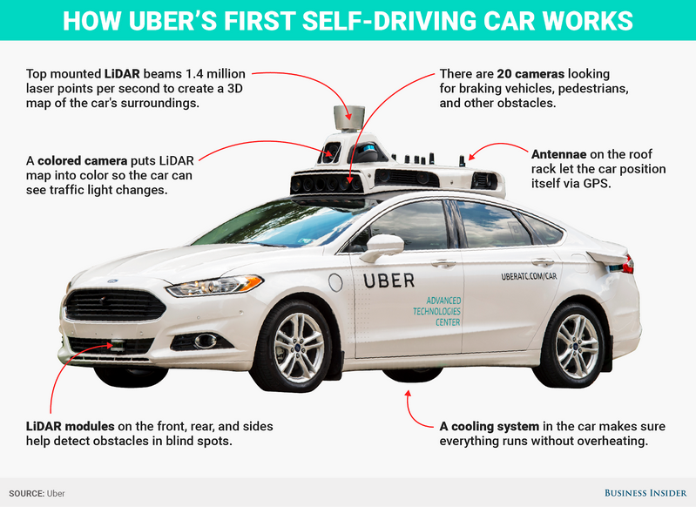
Robotics Self Driving Cars
Google Firefly, 2015
Google, 2009
https://waymo.com/tech/
Waymo, 2017 -

Slide 10
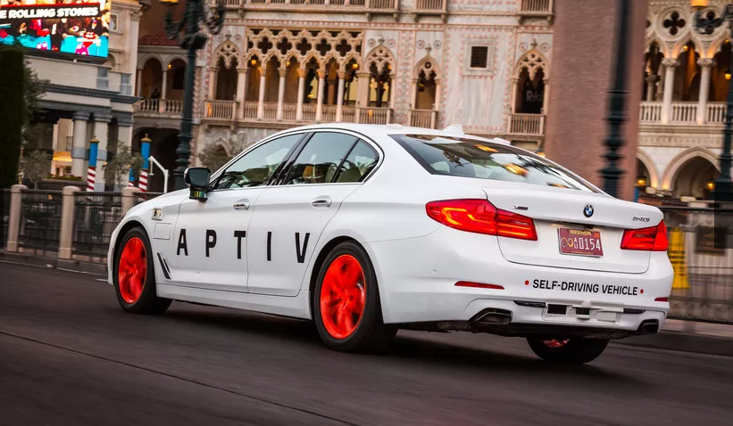
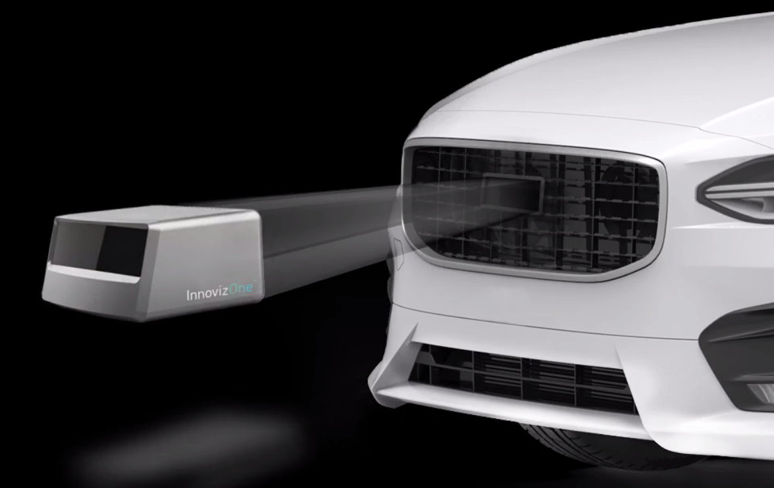
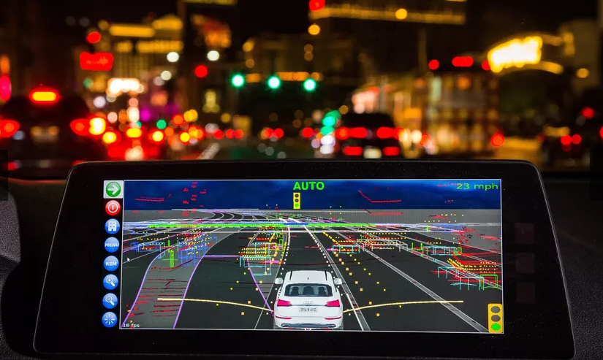
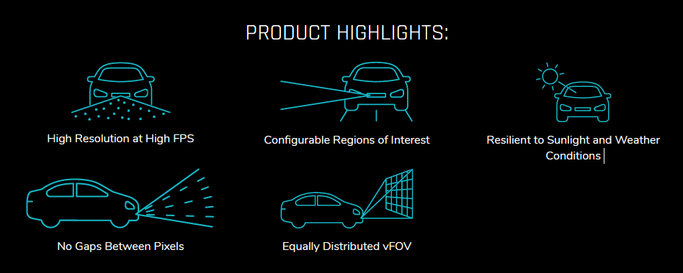
CES2019
BMW Self Driving Car
InnovizOne Solid-state Lidar (goal: sub $1000 sensor)
Angular resolution 0.1º x 0.1⁰
FOV 120º x 25º
25 FPS
Range 250m
Perception Capabilities
Object detection and classification
Lane detection
Object Tracking
SLAM
SLAM (Simultaneous Localization And Mapping)

Slide 11
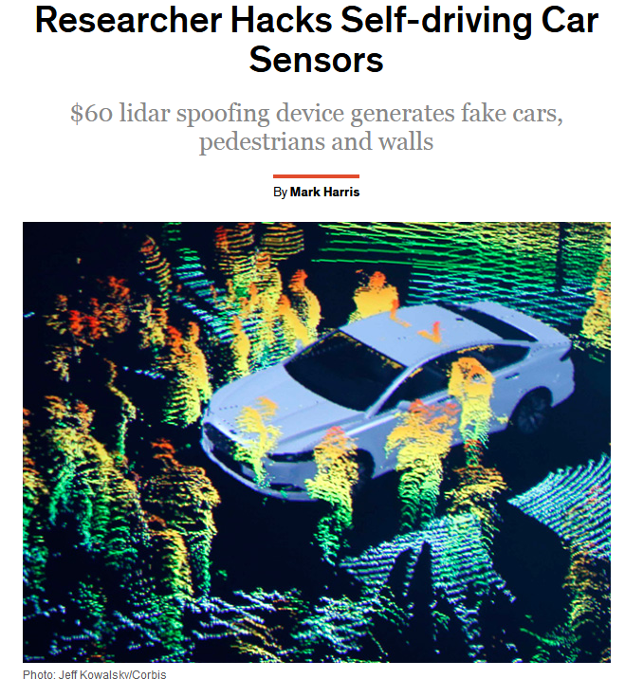
(2015)
https://spectrum.ieee.org/cars-that-think/transportation/self-driving/researcher-hacks-selfdriving-car-sensors

Slide 12
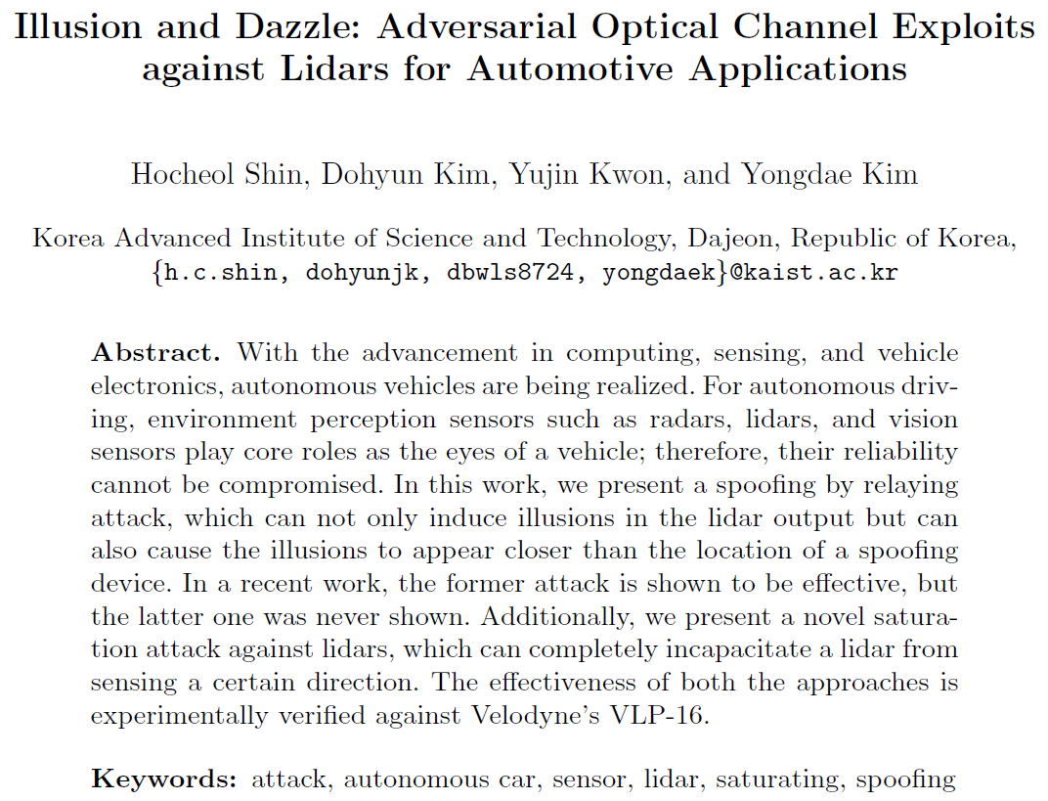
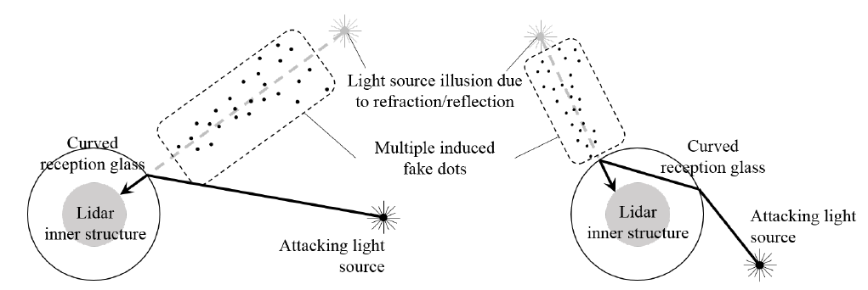
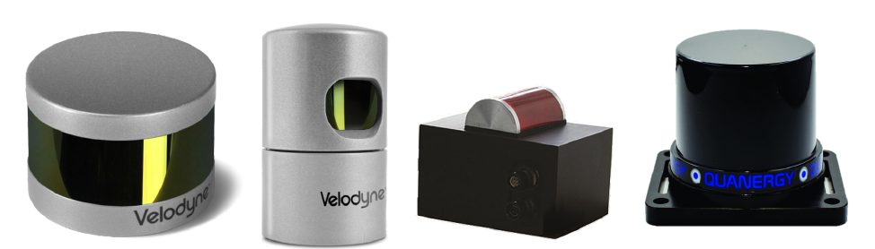
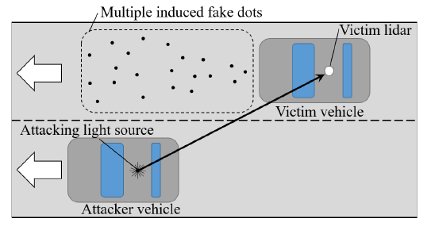
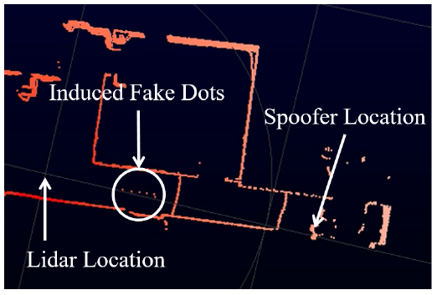
(2017)

Slide 13
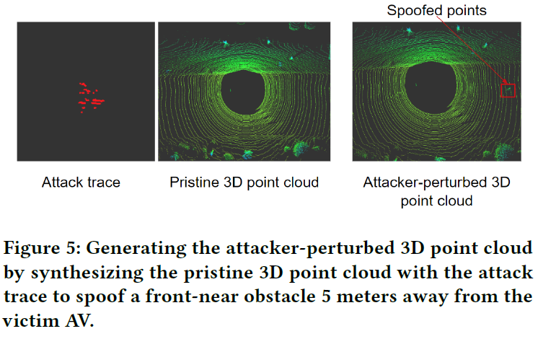
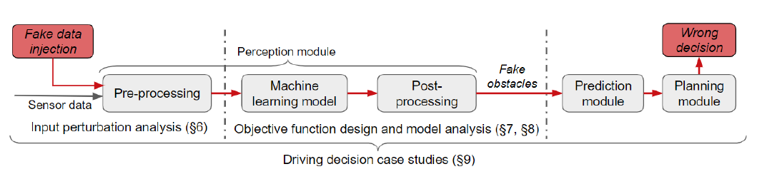
Adversarial Sensor Attack on LiDAR-based Perception in
Autonomous Driving by Yulong Cao et al.
CCS ’19, November 11–15, 2019, London, UK.

Slide 14

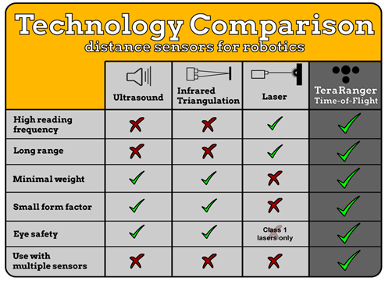

Slide 15

RaspberryPi Sensors Kit
GrovePi+ Board for Raspberry Pi
De ATMEGA328 microcontroller communicates with the Raspberry Pi.
Sound Sensor
Temperature & Humidity
Light Sensor
Button
UItrasonic Ranger
Rotary Angle Sensor

Slide 16
Lane Tracking
Joel C. McCall and Mohan M. Trivedi, Video Based Lane Estimation and Tracking for Driver Assistance: Survey, System, and Evaluation. IEEE Transactions on Intelligent Transportation Systems, 2006
A. Bar Hillel, R. Lerner, D. Levi, G. Raz, Recent progress in road and lane detection: a survey. Machine Vision and Applications (2014) 25:727–745
J. Fritsch, T. Kühnl, F. Kummert, Monocular Road Terrain Detection by Combining Visual and Spatial Information. IEEE Transactions on Intelligent Transportation Systems, 2014.
J. Sattar, J. Mo, SafeDrive: A Robust Lane Tracking System for Autonomous and Assisted Driving Under Limited Visibility. January 31, 2017
( https://arxiv.org/abs/1701.08449 )
Some example project for detecting road features using OpenCV:
https://navoshta.com/detecting-road-features/ by Alex Staravoitau

Slide 17
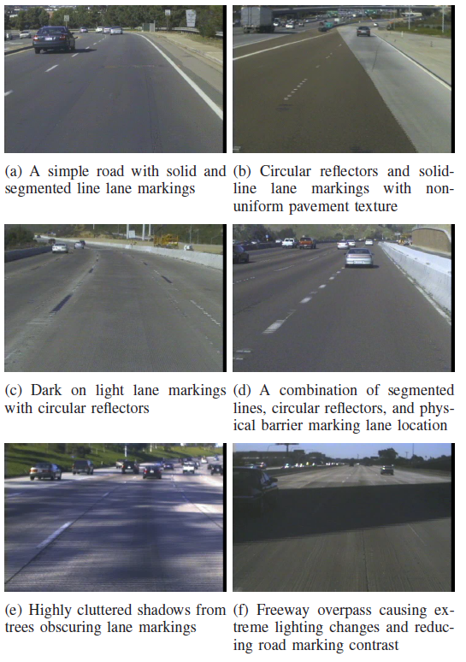
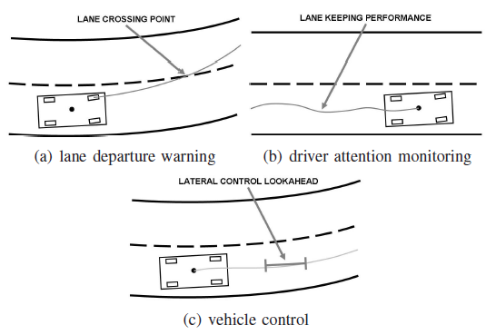
Lane Tracking
Joel C. McCall and Mohan M. Trivedi, Video Based Lane Estimation and Tracking for Driver Assistance: Survey, System, and Evaluation. IEEE Transactions on Intelligent Transportation Systems, 2006

Slide 18
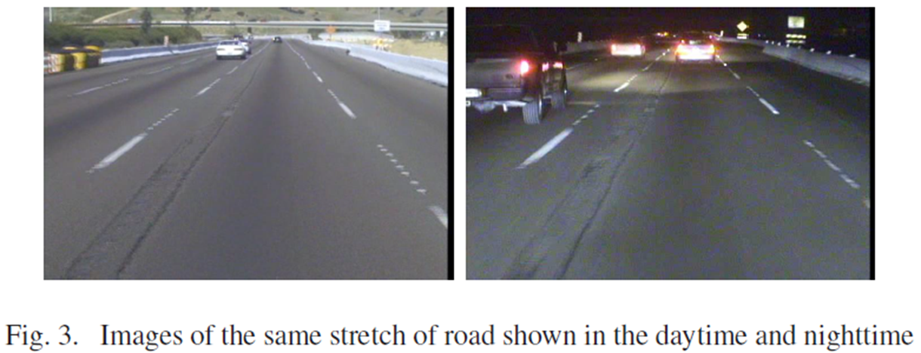
Lane Tracking by Day and Night

Slide 19
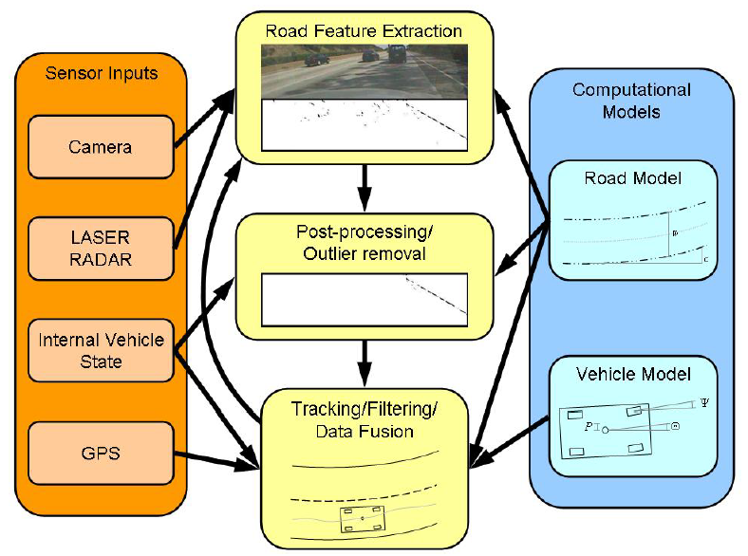
General System
camera and vision sensors
internal vehicle state sensors
line sensors
LASER RADAR sensors
GPS sensors
A generalized flow chart for lane position detection systems combining multiple modalities an iterative detection/tracking loop and road and vehicle models.

Slide 20
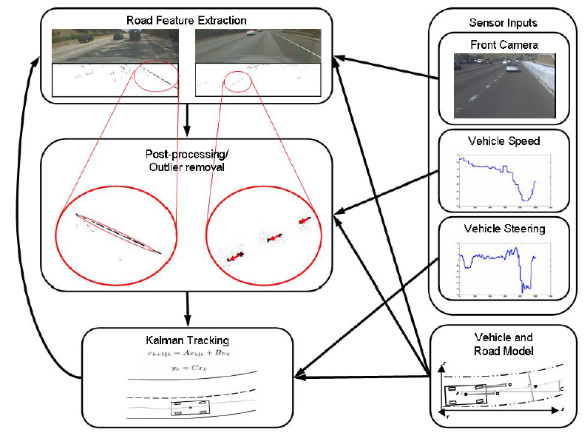
A generalized flow chart for lane position detection systems combining multiple modalities an iterative detection/tracking loop and road and vehicle models.

Slide 21
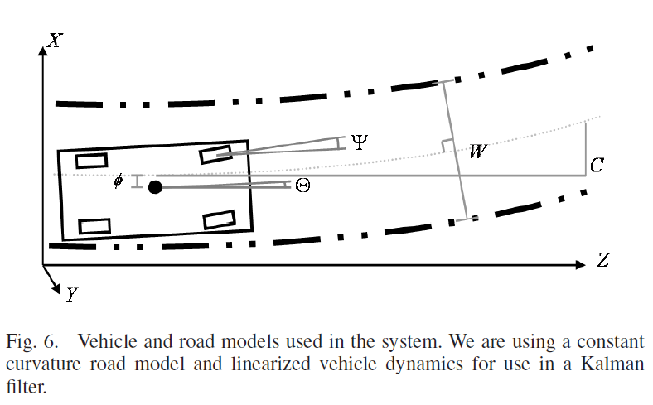
Vehicle and Road Models
Kalman Filter: Linear Quadratic Estimation to cope with noisy data.
Notes:
Linear control/linear system under quadratic cost optimization (variance estimation)

Slide 22
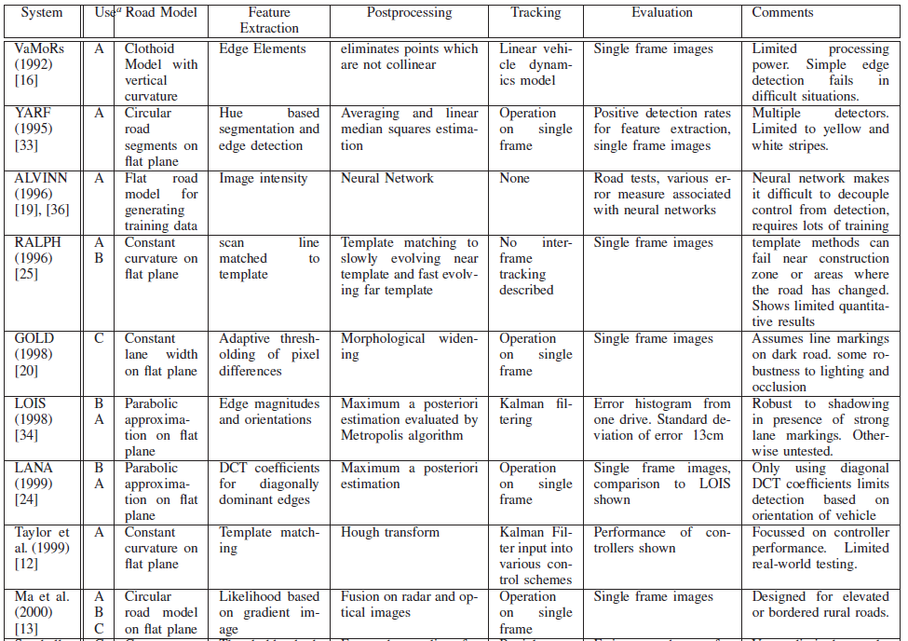


Slide 23
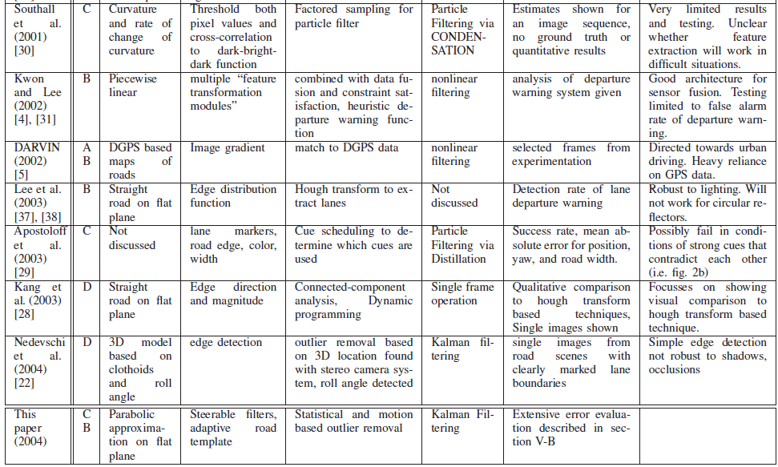

Slide 24
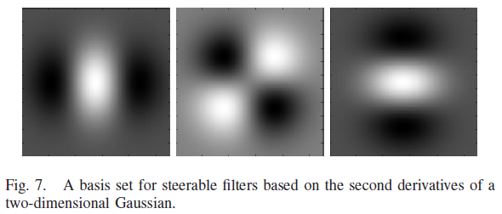
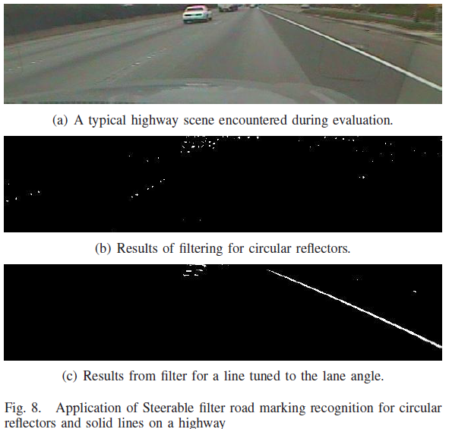
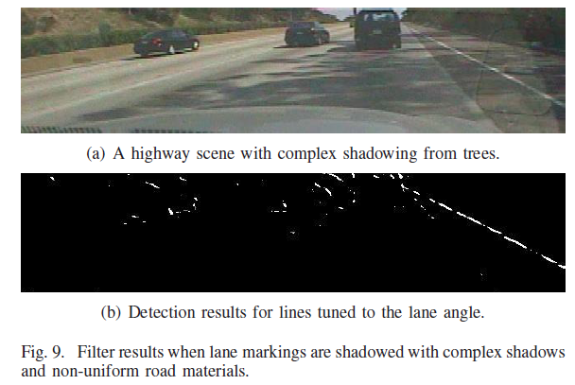
Steerable Filters

Slide 25
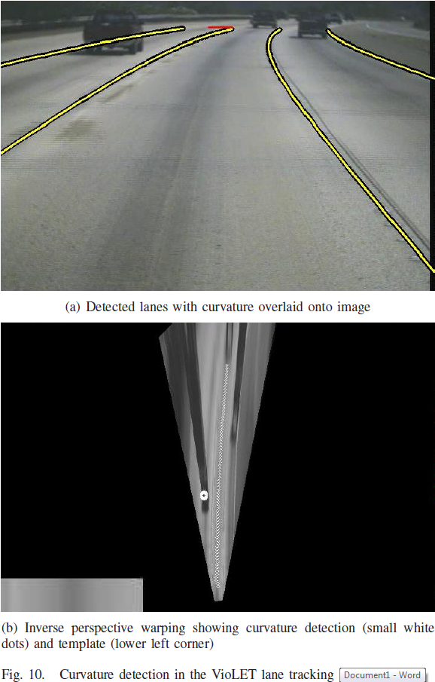
Inverse Perspective Warping and Template Matching
Curvature detection done by using an intensity template of past images in order to detect the curvature of the road ahead.

Slide 26
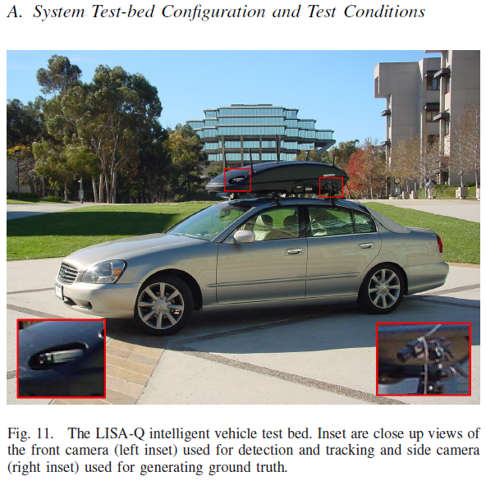
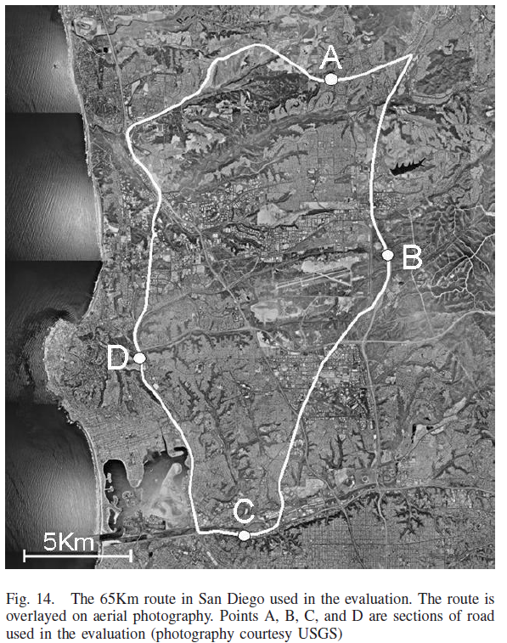

Slide 27
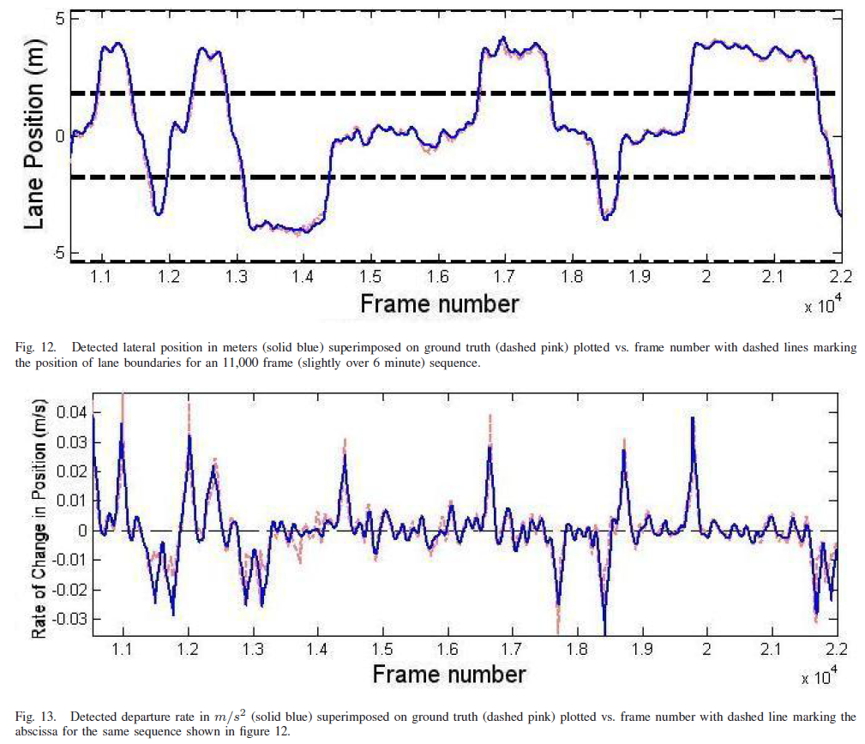
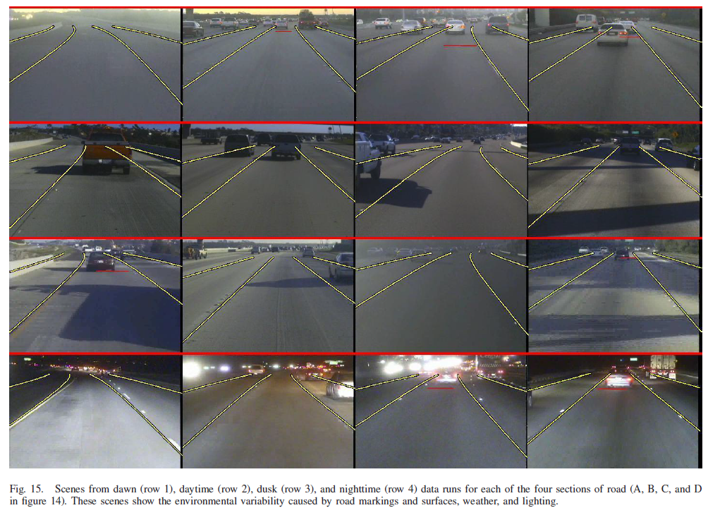
Results
Ground truth = pink dashed line

Slide 28


Challenges: Occlusions and Highlights

Slide 29

Lane Tracking
J. Fritsch, T. Kühnl, F. Kummert, Monocular Road Terrain Detection by Combining Visual and Spatial Information. IEEE Transactions on Intelligent Transportation Systems, 2014.

Slide 30


Overview System

Slide 31

Ground Truth

Slide 32


Slow Feature Analysis (SFA)
Slow Feature Analysis (SFA)
  Generating the slowest varying output functions y_{j}(t) from a multidimensional input signal x(t)
Spatial patch sequence extraction for SFA training: on the left the horizontal path and on the right the vertical path is illustrated. The paths are partitioned into road (dotted) and non-road (dashed) sections.

Slide 33


Result of the base road and base boundary classification for the given ground truth scene.
From left to right the positive and negative part of the confidence values is depicted for each base classifier.
Dark points denote high confidence of the classification.
Feature vectors:
- SFA features
- Color features (RGB)
- Walsh Hadamard texture features
Notes:
The Hadamard transform can be regarded as being built out of size-2 discrete Fourier transforms (DFTs), and is in fact equivalent to a multidimensional DFT of size 2 × 2 × ⋯ × 2 × 2
The Hadamard transform is also used in data encryption, as well as many signal processing and data compression algorithms, such as JPEG XR and MPEG-4 AVC. In video compression applications, it is usually used in the form of the sum of absolute transformed differences. It is also a crucial part of Grover's algorithm and Shor's algorithm in quantum computing. The Hadamard transform is also applied in experimental techniques such as NMR, mass spectrometry and crystallography.

Slide 34


SPRAY Features: Spatial Rays
1) 2) 3)
Distribution of base points in metric space
The SPRAY feature generation procedure for one base point (BP)
The ego SPRAY feature.

Slide 35

Ground Truth

Slide 36



Results
Result of the road terrain classification for the ground truth (above):
The classification result for road area (middle blue).
The classification result for the ego-lane (right green)

Slide 37

Results
Ego Lanes

Slide 38





Results
(BL = Baseline)
Harmonic mean of precision and recall.

Slide 39

J. Sattar, J. Mo, SafeDrive: A Robust Lane Tracking System for Autonomous and Assisted Driving Under Limited Visibility. January 31, 2017 ( https://arxiv.org/abs/1701.08449 )
Visual lane tracking on several urban scenes from YouTubeTM videos. Snapshot (1a) (output in (1b)): lane markers not distinct in the center, though side markers are detectable. Snapshot (1c) (output in (1d)): lane markers mostly washed out. Snapshot (1e) (output in (1f)): evening drive, low-light conditions make the lane markers almost undetectable. Snapshot (1g) (output in (1h)): snow-covered roads, no lane markers visible.

Slide 40


System Overview
The process of extracting pixels with common" visual content.
The feature-based matching (in red lines) are used to choose the point features, and for each feature point, a square sub-window is extracted from the candidate image, centered on that feature point.
Stitching together all these windows results in an image with most uncommon" visual elements removed.

Slide 41



Slide 42

Image Processing using OpenCV
Core module: the basic building blocks of this library for manipulating the images on a pixel level.
Imgproc module: the image processing (manipulation) functions inside OpenCV.
High Level GUI and Media (highgui module)
Image Input and Output (imgcodecs module)
Video Input and Output (videoio module)
Camera calibration and 3D reconstruction (calib3d module)
2D Features framework (feature2d module): feature points detectors, descriptors and matching framework found inside OpenCV.
Video analysis (video module) algorithms usable on your video streams like motion extraction, feature tracking and foreground extractions.
Object Detection (objdetect module) face detectors, etc.
Deep Neural Networks (dnn module)
Machine Learning (ml module) machine learning classes for statistical classification, regression and clustering of data.
Graph API (gapi module)
Computational photography (photo module) for advanced photo processing.
Images stitching (stitching module) create photo panoramas and more with OpenCV stitching pipeline.
GPU-Accelerated Computer Vision (cuda module); OpenCV iOS:

Slide 43

Lane Tracking
Some example project for detecting road features using OpenCV:
https://navoshta.com/detecting-road-features/ by Alex Staravoitau

Slide 44
Overview Processing Pipeline
Camera calibration
Each camera gives image distortions, these can be rectified using information from a camera calibration. OpenCV has functionality to calibrate and correct camera images. Calibration is done using chessboard images.
Edge detection
OpenCV has many different edge detectors using gradient and color information. These edges can be used for the detection of structures such as lines etc.
Perspective transformation
A perspective transformation, can be used to obtain an overview of the road ahead of the vehicle. This can make the problem of lane boundaries extraction easier.
Fitting boundary lines
The resulting frame pixels are determined that may belong to lane boundaries.
These are then used to approximate lines, road properties and vehicle position.
Furthermore a rough estimate on road curvature and vehicle position within the lane is determined using known road dimensions.

Slide 45

Processing Pipeline: Camera Calibration
… cv2.findChessboardCorners(image, (9, 6), None) // Inner corners 9x6
… cv2.calibrateCamera( pattern_points, image_points, (image.shape[1], image.shape[0]), None, None)
corrected_image = cv2.undistort(image, self.camera_matrix, self.dist_coefficients, None, self.camera_matrix)

Slide 46

Processing Pipeline: Edge Detection
Gradient Absolute Values, Ranges within certain magnitudes, Gradient Directions
Sobel Operator (using a convolutional Kernel)
Color Ranges
HLS Color Space: Hue, Saturation, and Level (for road detection, etc.)

Slide 47

Processing Pipeline: Perspective Transformation
…. transform_matrix = cv2.getPerspectiveTransform(source, destination)
…. image = cv2.warpPerspective(image, transform_matrix, (w, h))

Slide 48

Processing Pipeline: Perspective Transformation
Left: The original image after the camera calibration and perspective transform.
Right: After edge detection with edges highlighted in green and blue.
Scanning windows boundaries for areas with pixel that may belong to lines are highlighted in yellow,
A second order polynomial approximation of the collected points in red.

Slide 49

Lane and Vehicle Tracking

Slide 50
Some remarks
Alex Staravoitau:
“This clearly is a very naive way of detecting and tracking road features, and wouldn’t be used in real world application as-is, since it is likely to fail in too many scenarios: “
Going up or down the hill.
Changing weather conditions.
Worn out lane markings.
Obstruction by other vehicles or vehicles obstructing each other.
Vehicles and vehicle positions different from those classifier was trained on.
…

Slide 51
Organization and Overview
Period: February 4th – April 28th 2020
Time: Tuesday 14.15 – 16.00
Place: LIACS, Room 407-409 (Workshops Room 302-304)
Lecturer: Dr Erwin M. Bakker ( erwin@liacs.nl )
Assistant: Laduona Dai
NB E-mail your name and student number to erwin@liacs.nl
Schedule:
4-2 Introduction and Overview
17-2 No class
18-2 Locomotion and Inverse Kinematics &
Yetiborg Introduction
25-2 Robotics Sensors and Image Processing
27-2 Yetiborg available in Room 126a 13.15 – 14.45
3-3 Project Proposals (presentation by students)
10-3 Yetiborg Qualification Challenge + SLAM Workshop I
17-3 Robotics Image Processing and Understanding
24-3 Yetiborg Race
31-3 Project Progress Report (by students)
7-4 Robotics Reinforcement Learning
14-4 Robotics Reinforcement Learning Workshop II
21-4 TBA
28-4 Project Demos (by students)
Website: http://liacs.leidenuniv.nl/~bakkerem2/robotics/
Grading (6 ECTS):
Presentations and Robotics Project (60% of grade).
Class discussions, attendance, workshops and assignments (40% of grade).
It is necessary to be at every class and to complete every workshop.

Slide 52
References
Joel C. McCall and Mohan M. Trivedi, Video Based Lane Estimation and Tracking for Driver Assistance: Survey, System, and Evaluation. IEEE Transactions on Intelligent Transportation Systems, 2006
A. Bar Hillel, R. Lerner, D. Levi, G. Raz, Recent progress in road and lane detection: a survey. Machine Vision and Applications (2014) 25:727–745
J. Fritsch, T. Kühnl, F. Kummert, Monocular Road Terrain Detection by Combining Visual and Spatial Information. IEEE Transactions on Intelligent Transportation Systems, 2014.
J. Sattar, J. Mo, SafeDrive: A Robust Lane Tracking System for Autonomous and Assisted Driving Under Limited Visibility. January 31, 2017 ( https://arxiv.org/abs/1701.08449 )
https://navoshta.com/detecting-road-features/ by Alex Staravoitau
OpenCV.org

Slide 53
Robotics

