Slide 1
Robotics
Erwin M. Bakker| LIACS Media Lab

Slide 2
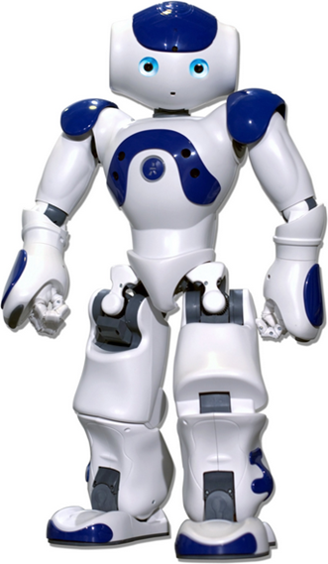
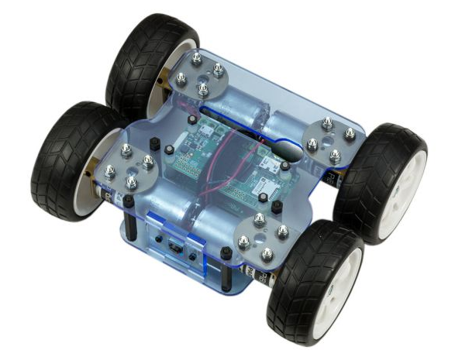
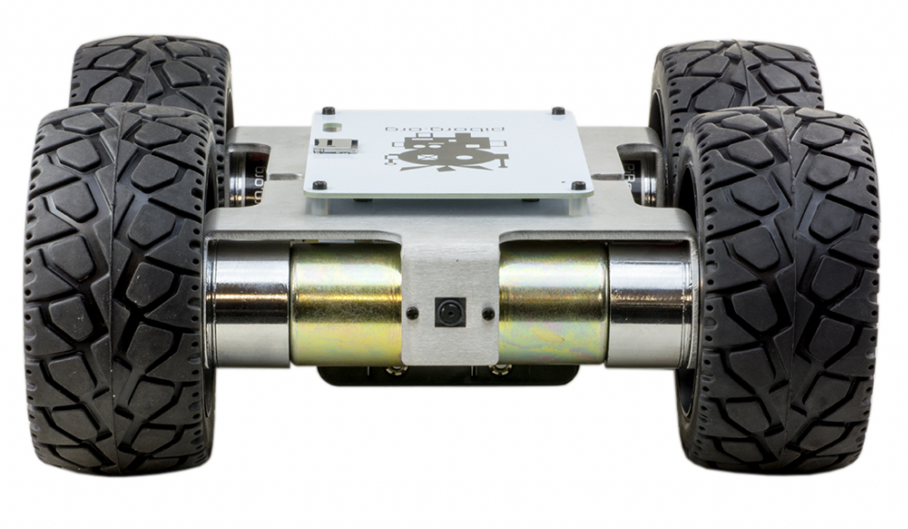
Organization and Overview
Period: February 15th - May 10th 2019
Time: Friday 09.00 – 10.45
Place: LIACS, Room 401 (Workshops Room 303)
Lecturer: Dr Erwin M. Bakker ( erwin@liacs.nl )
Assistant: Andrius Bernatavicius
NB E-mail your name and student number to erwin@liacs.nl
Schedule:
15-2 Introduction and Overview
22-2 Control Space, Locomotion and Kinematics
1-3 Inverse Kinematics and Sensors
8-3 Yetiborg Introduction and SLAM Workshop I
15-3 Project Proposals (presentation by students)
22-3 Yetiborg Qualification
29-3 Robotics Image Processing
5-4 Yetiborg Race and ROS Workshop II
12-4 Robotics Image Processing and Understanding
19-4 No Class
26-4 Robotics Reinforcement Learning.
3-5 Robotics Reinforcement Learning Workshop III
10-5 Project Demos (by students)
Website: http://liacs.leidenuniv.nl/~bakkerem2/robotics/
Grading (6 ECTS): Presentations and Robotics Project (60% of grade). Class discussions, attendance, workshops and assignments (40% of grade). It is necessary to be at every class and to complete every workshop.

Slide 3
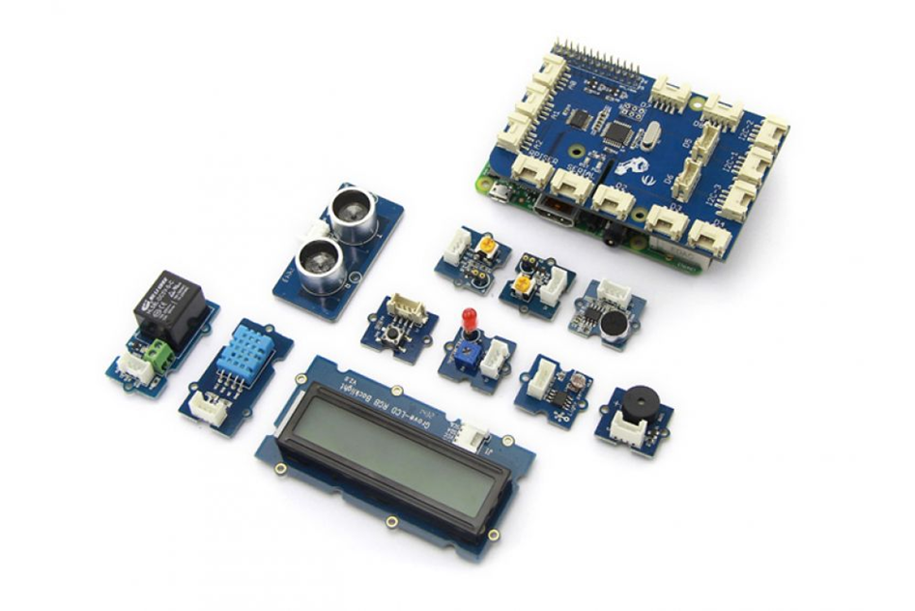
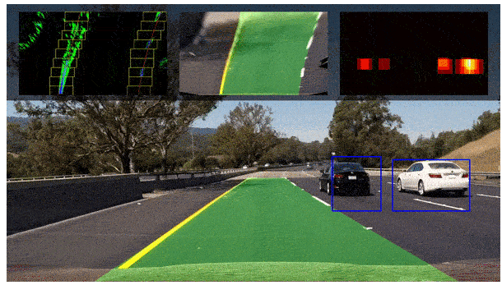
Overview
Sensors
Lane Tracking
OpenCV
Line Tracking

Slide 4
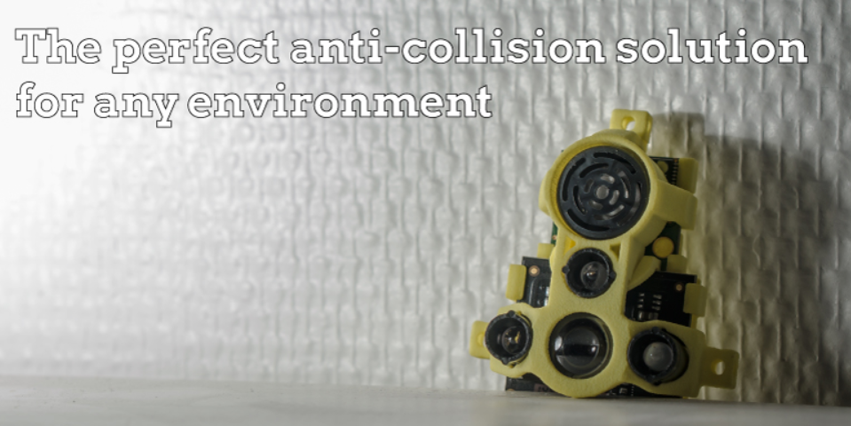
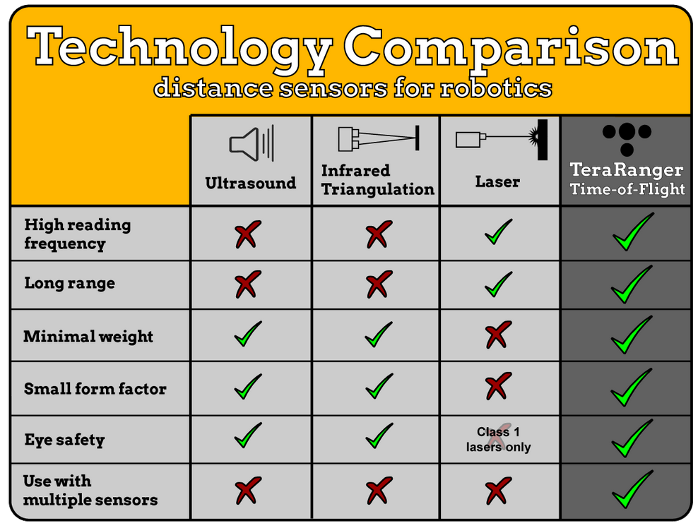
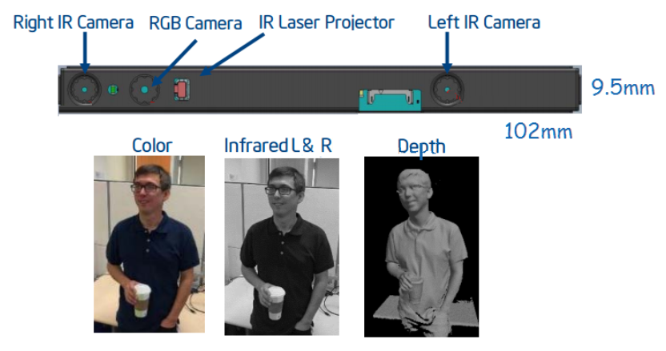
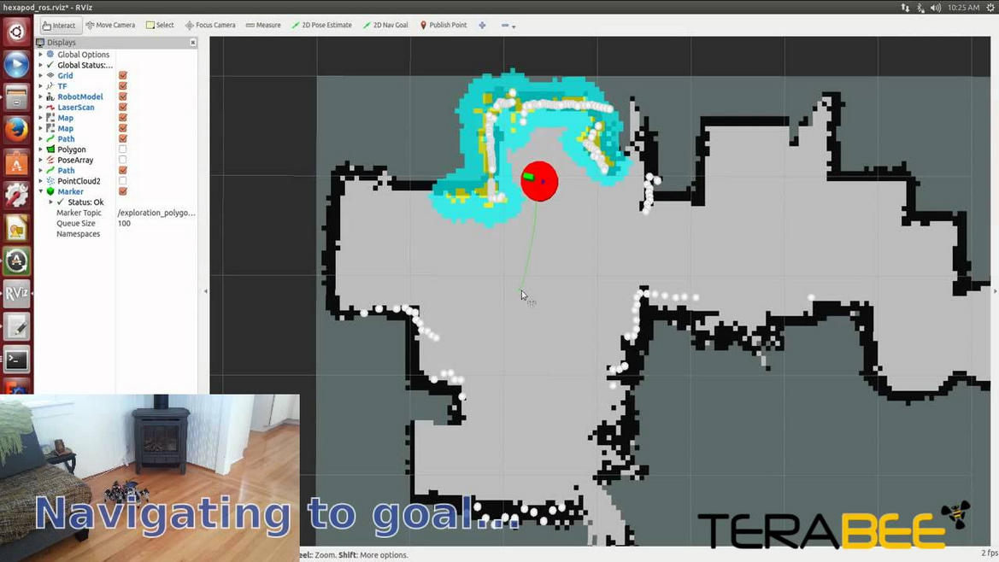
Robotics Sensors
Bumper switches
Acceleration, Orientation, Magnetic
IR/Visible Light
Pressure, Force
Ultrasonic, Lidar, Radar
Camera’s, stereo camera’s
Structured Light Camera’s

Slide 5
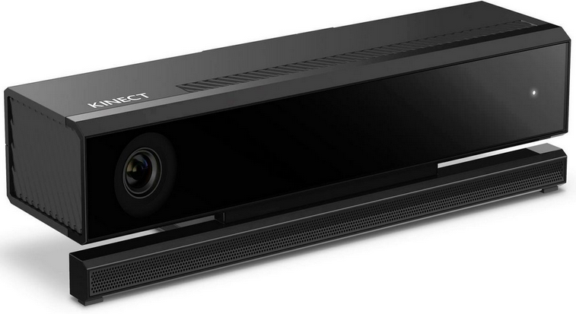
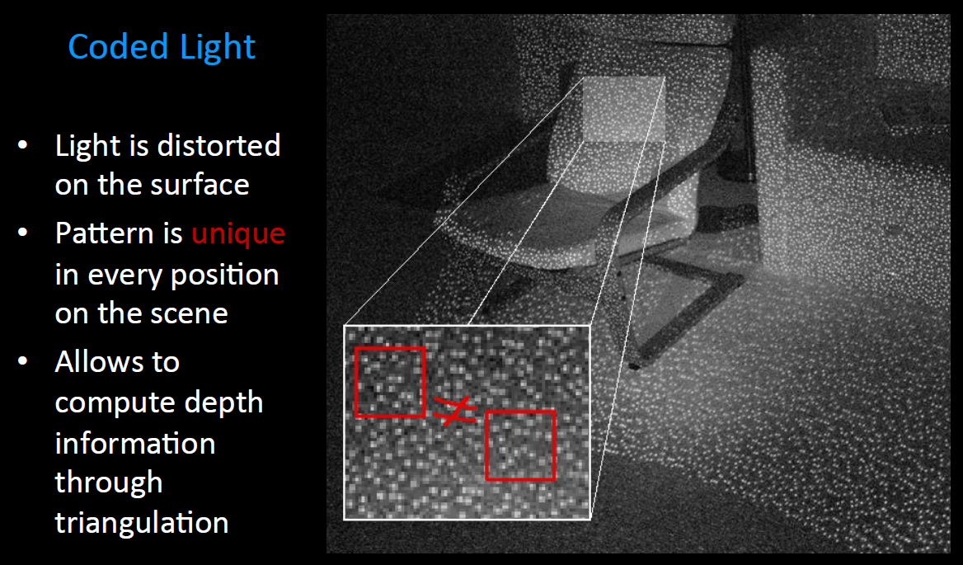
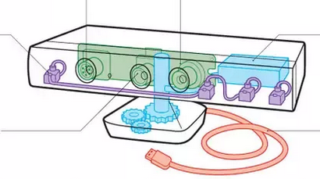
Structured Light
Primesense based Occipital
Asus X-tion Pro Live
Microsoft Kinect v1, v2
Intel RealSense F200, R200 (blue)
IR Emitter
IR Depth Camera
Mic-array (4xmic)
Color Camera
From: Anyline presentation by Peter Sperl

Slide 6
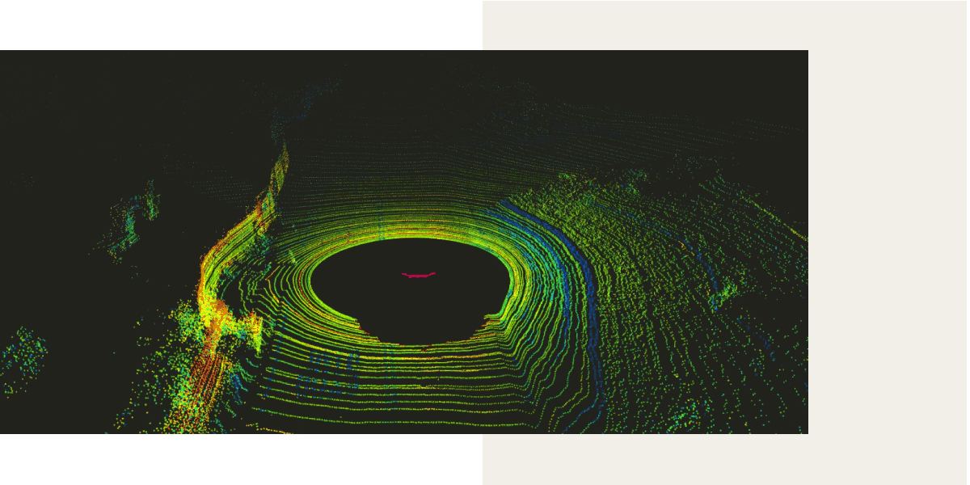
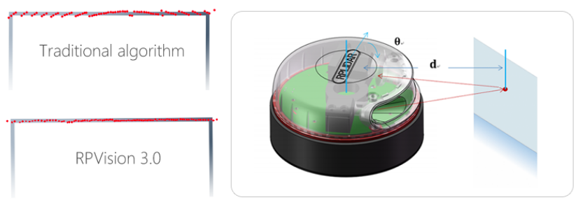
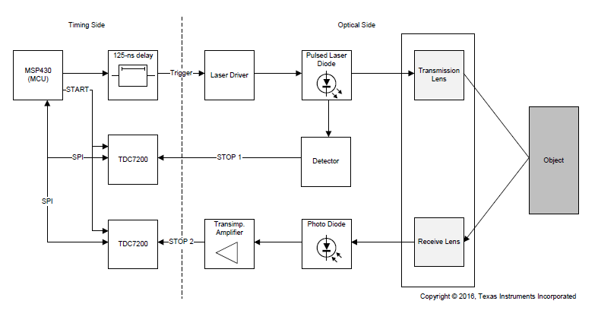
LIDAR Explanation
http://www.slamtec.com/en/lidar/A3
https://news.voyage.auto/an-introduction-to-lidar-the-key-self-driving-car-sensor-a7e405590cff
Time of Flight
Laser
Detector
Speed of light ~ 3 x 10⁸ m/s
In 1 picosecond (= 10⁻¹² sec) light travels ~ 3 x 10⁻⁴ m = 0.3 mm
During 33 picoseconds light travels ~ 1cm
Texas Instruments LIDAR Pulsed Reference Design

Slide 7
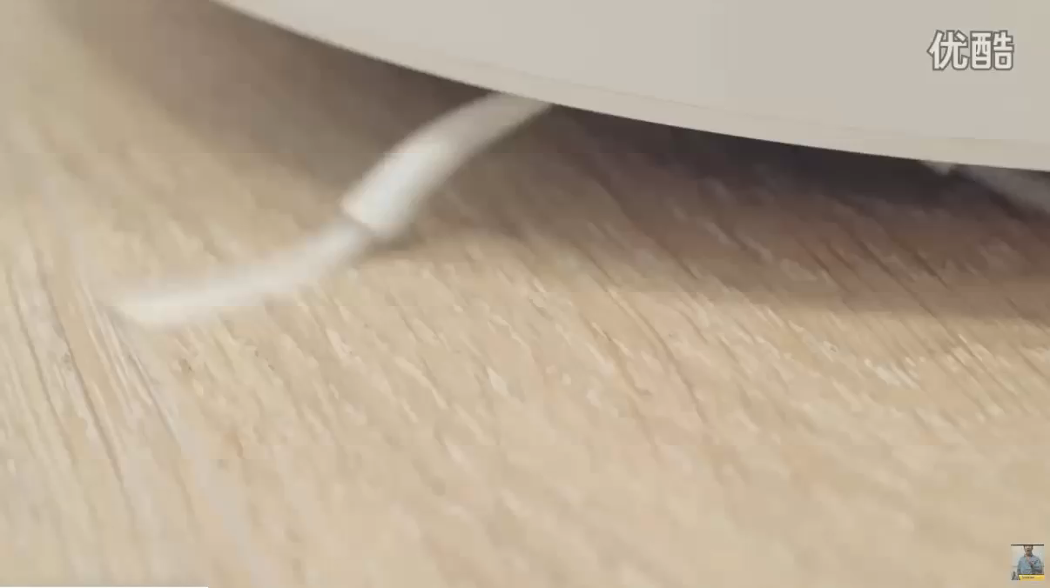

Slide 8
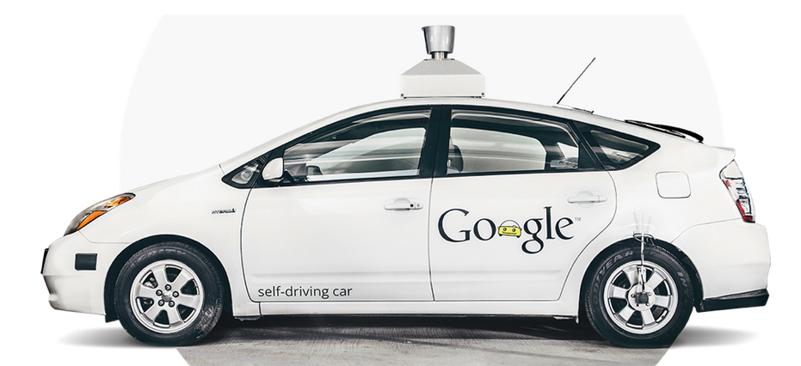
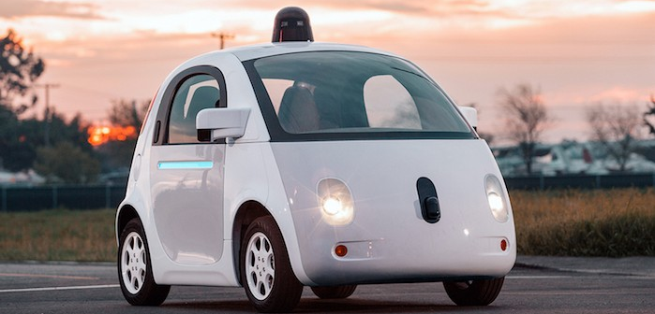
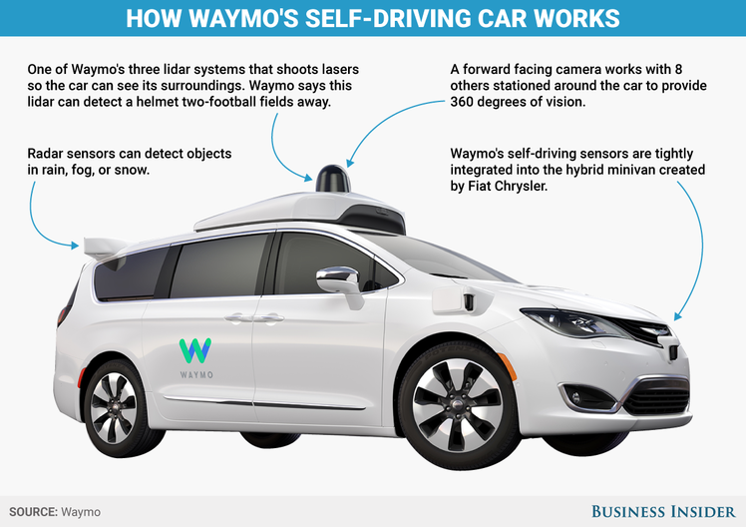
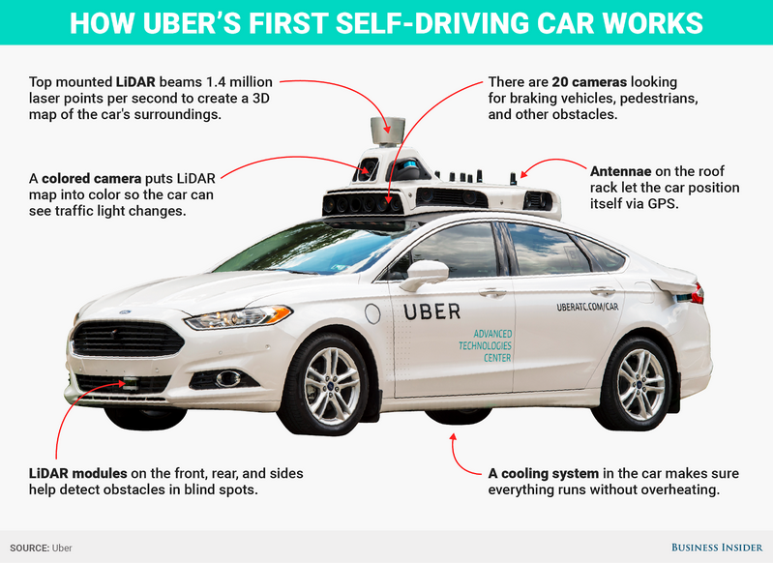
Robotics Self Driving Cars
Google Firefly, 2015
Google, 2009
https://waymo.com/tech/
Waymo, 2017 -

Slide 9
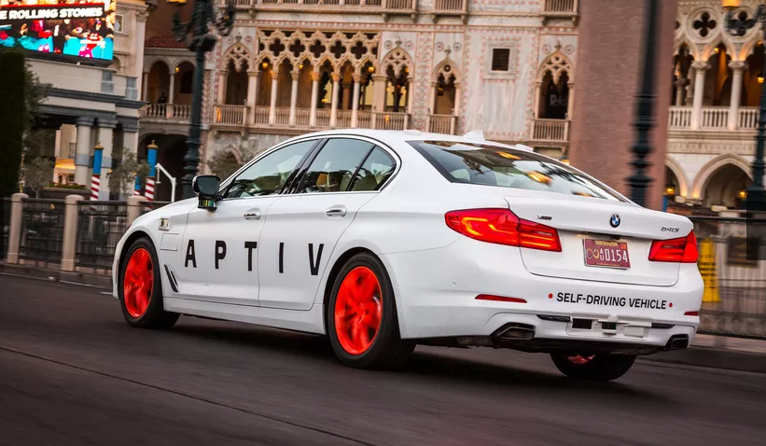
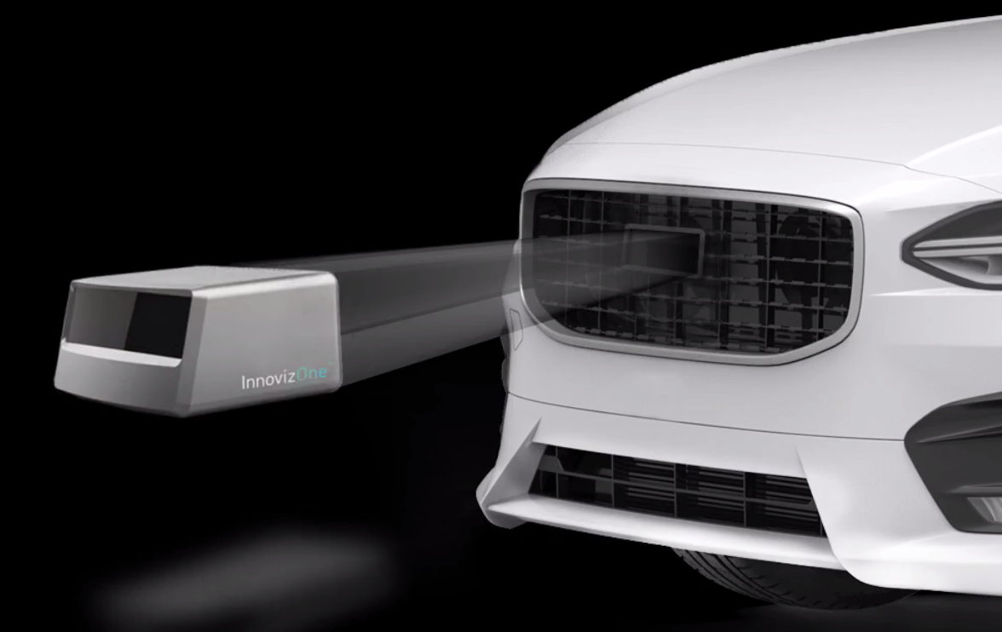
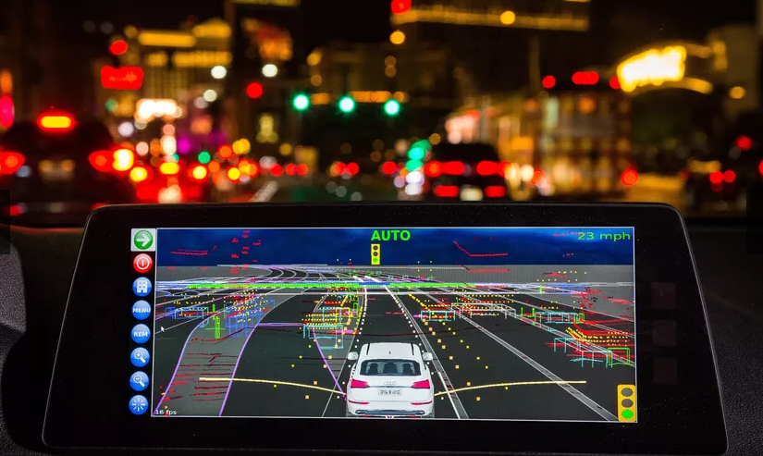
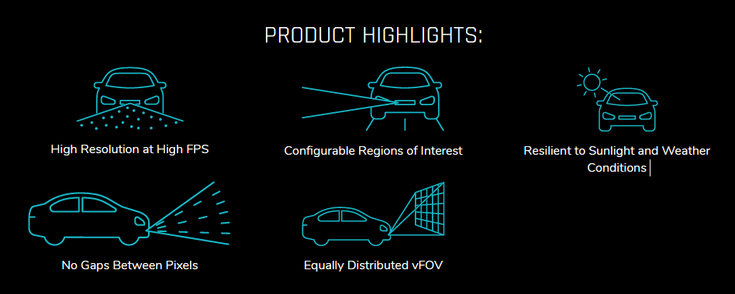
CES2019
BMW Self Driving Car
InnovizOne Solid-state Lidar (goal: sub $1000 sensor)
Angular resolution 0.1º x 0.1⁰
FOV 120º x 25º
25 FPS
Range 250m
Perception Capabilities
Object detection and classification
Lane detection
Object Tracking
SLAM

Slide 10
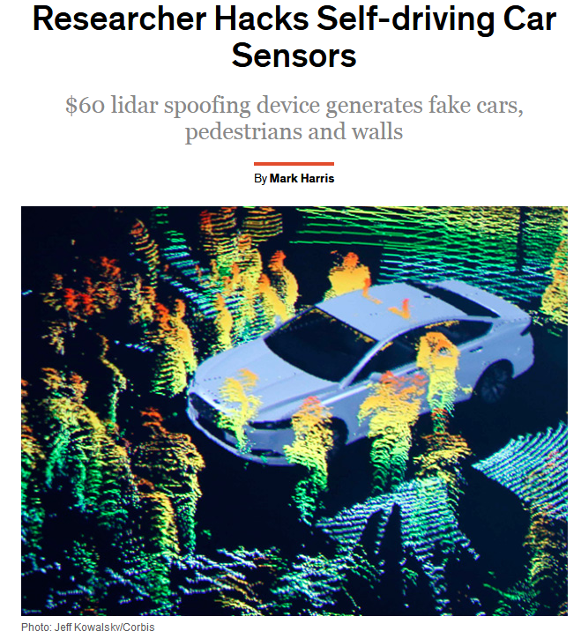
(2015)
https://spectrum.ieee.org/cars-that-think/transportation/self-driving/researcher-hacks-selfdriving-car-sensors

Slide 11
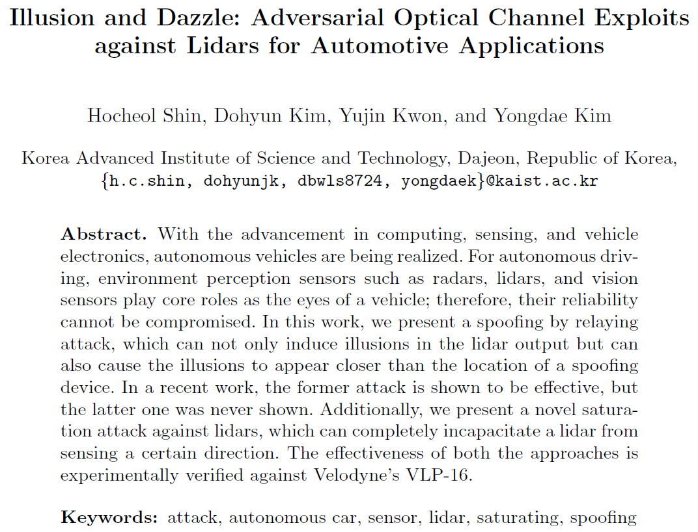
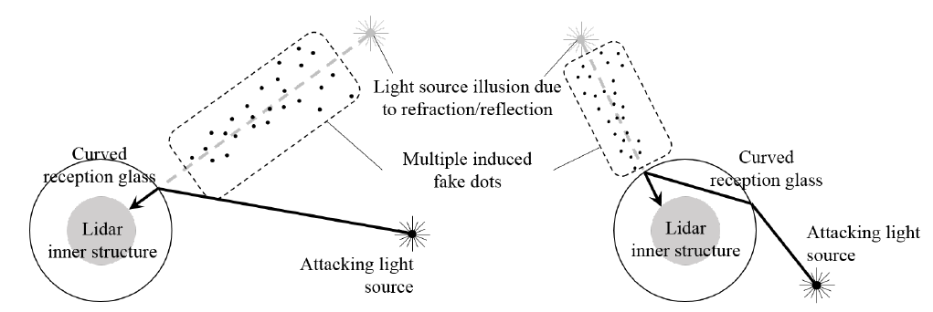
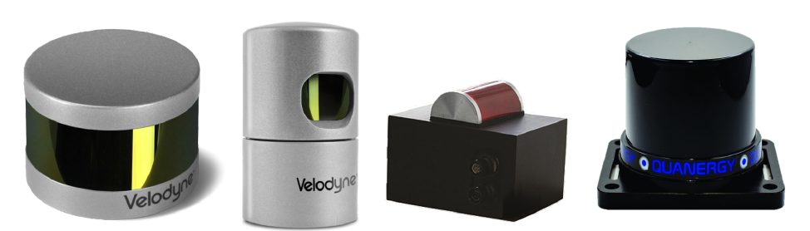
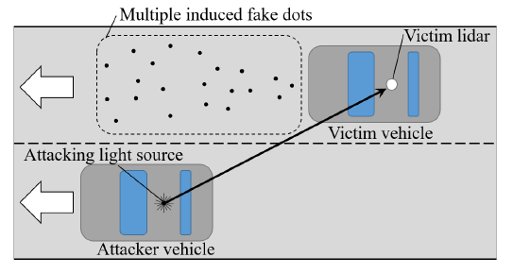
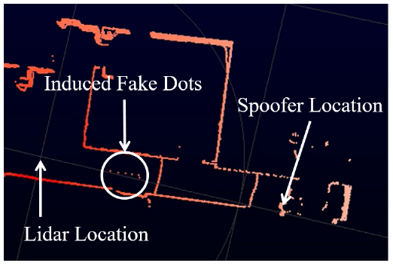
(2017)

Slide 12

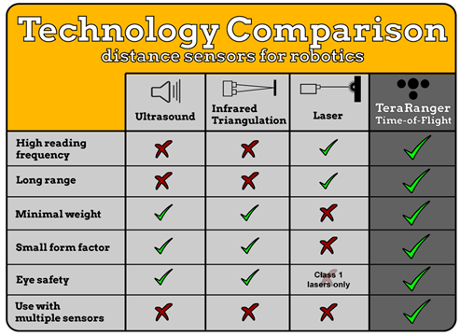

Slide 13

RaspberryPi Sensors Kit
GrovePi+ Board for Raspberry Pi
De ATMEGA328 microcontroller communicates with the Raspberry Pi.
Sound Sensor
Temperature & Humidity
Light Sensor
Button
UItrasonic Ranger
Rotary Angle Sensor

Slide 14
Lane Tracking
Joel C. McCall and Mohan M. Trivedi, Video Based Lane Estimation and Tracking for Driver Assistance: Survey, System, and Evaluation. IEEE Transactions on Intelligent Transportation Systems, 2006
A. Bar Hillel, R. Lerner, D. Levi, G. Raz, Recent progress in road and lane detection: a survey. Machine Vision and Applications (2014) 25:727–745
J. Fritsch, T. Kühnl, F. Kummert, Monocular Road Terrain Detection by Combining Visual and Spatial Information. IEEE Transactions on Intelligent Transportation Systems, 2014.
J. Sattar, J. Mo, SafeDrive: A Robust Lane Tracking System for Autonomous and Assisted Driving Under Limited Visibility. January 31, 2017
( https://arxiv.org/abs/1701.08449 )
Some example project for detecting road features using OpenCV:
https://navoshta.com/detecting-road-features/ by Alex Staravoitau

Slide 15
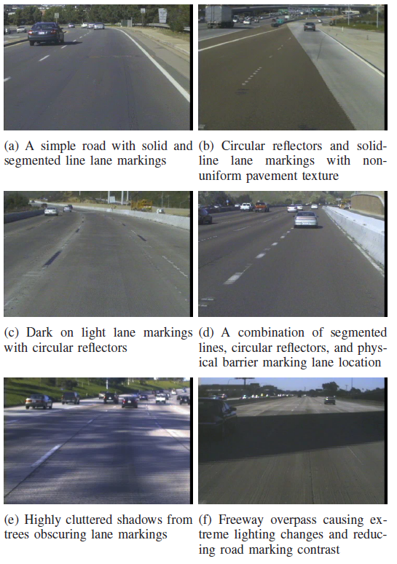
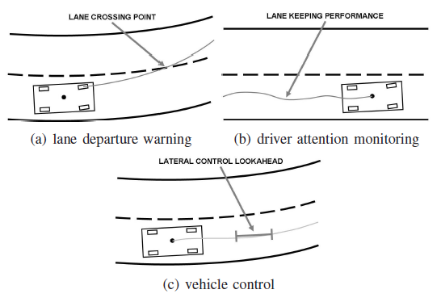
Lane Tracking
Joel C. McCall and Mohan M. Trivedi, Video Based Lane Estimation and Tracking for Driver Assistance: Survey, System, and Evaluation. IEEE Transactions on Intelligent Transportation Systems, 2006

Slide 16
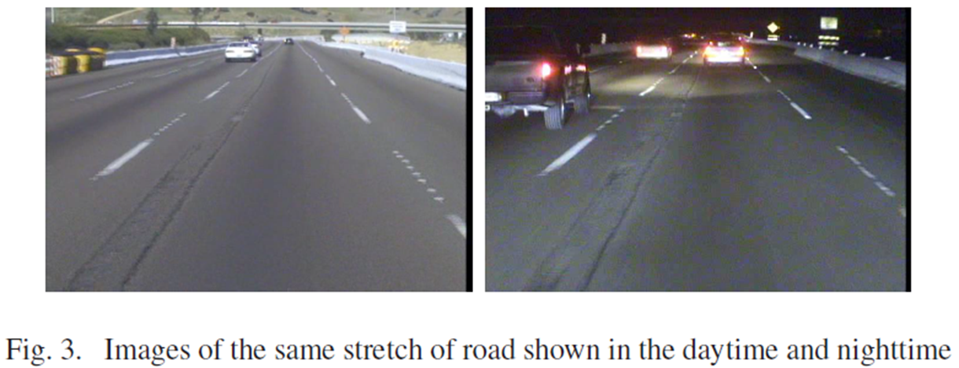
Lane Tracking by Day and Night

Slide 17
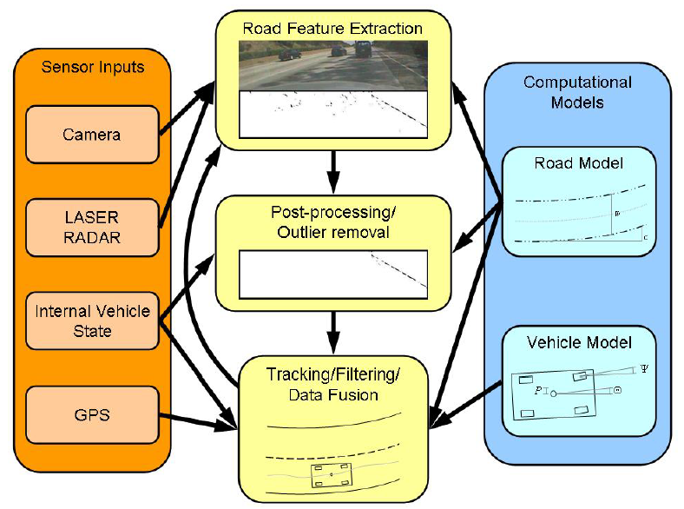
General System
camera and vision sensors
internal vehicle state sensors
line sensors
LASER RADAR sensors
GPS sensors
A generalized flow chart for lane position detection systems combining multiple modalities an iterative detection/tracking loop and road and vehicle models.

Slide 18
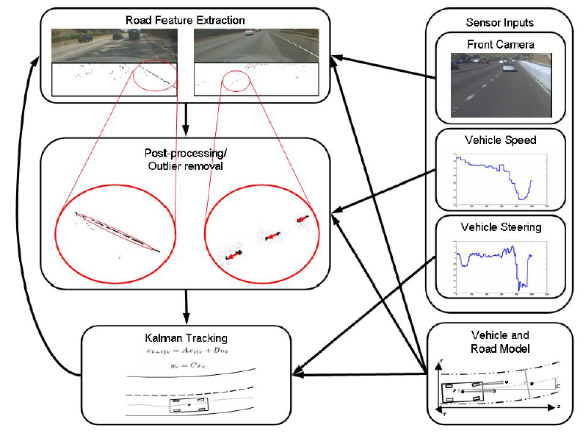
A generalized flow chart for lane position detection systems combining multiple modalities an iterative detection/tracking loop and road and vehicle models.

Slide 19
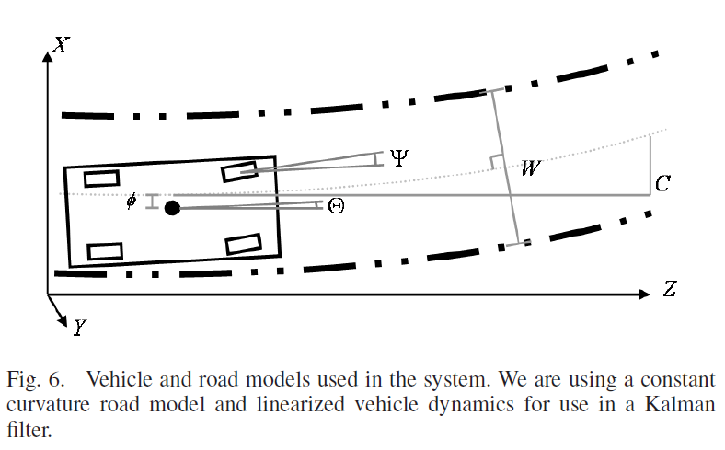
Vehicle and Road Models
Kalman Filter: Linear Quadratic Estimation to cope with noisy data.

Slide 20
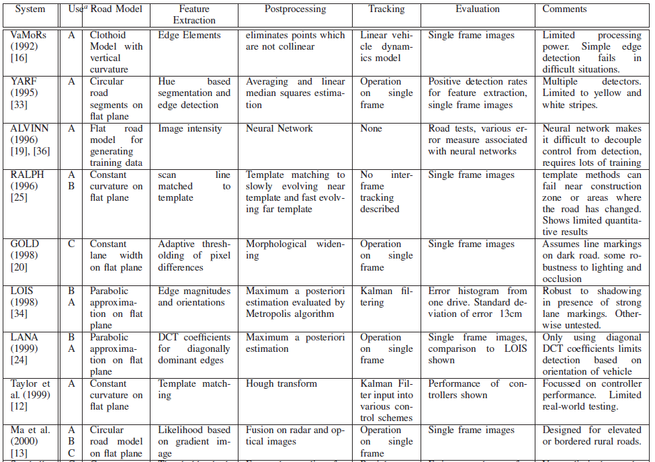


Slide 21
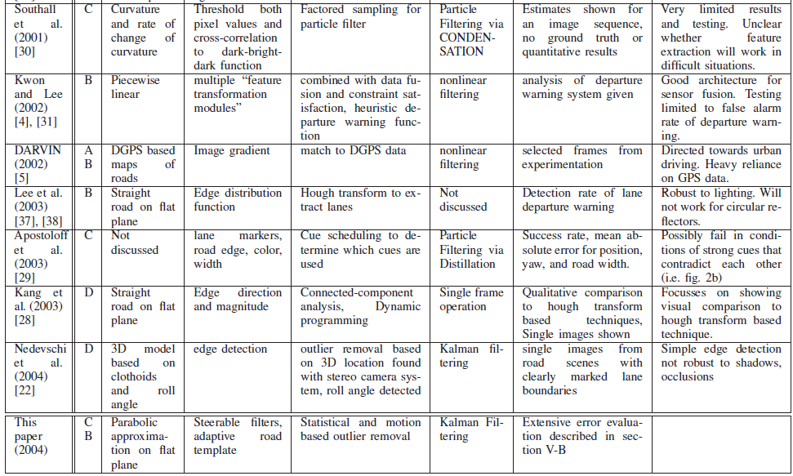

Slide 22
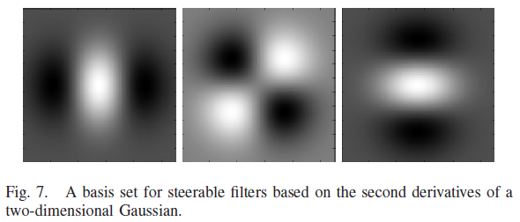
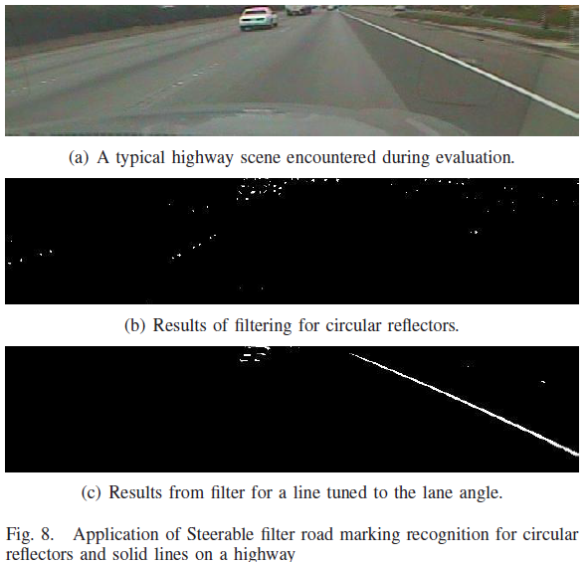
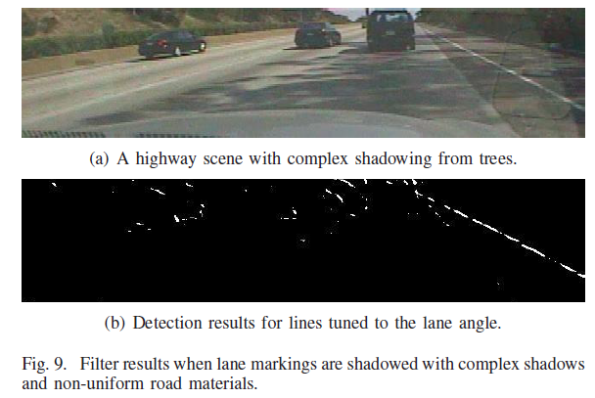
Steerable Filters

Slide 23
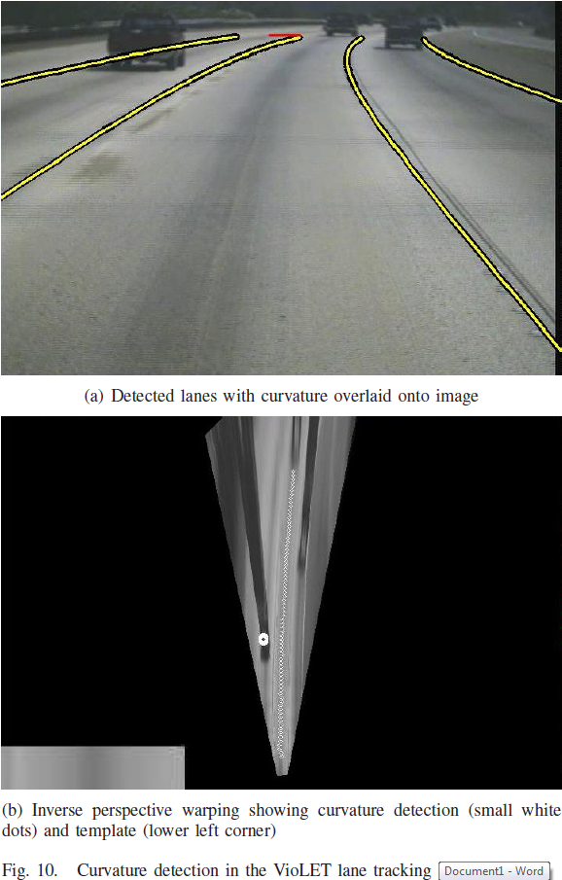
Inverse Perspective Warping and Template Matching
Curvature detection done by using an intensity template of past images in order to detect the curvature of the road ahead.

Slide 24
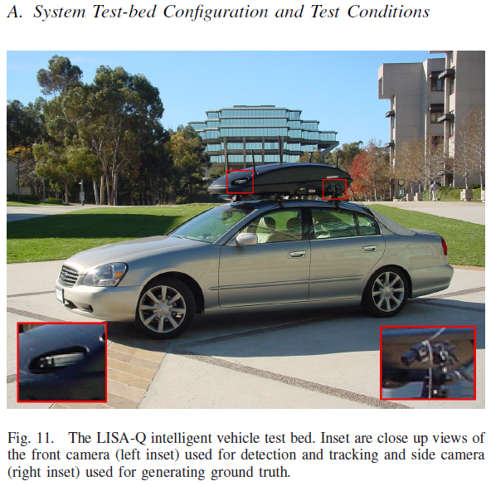
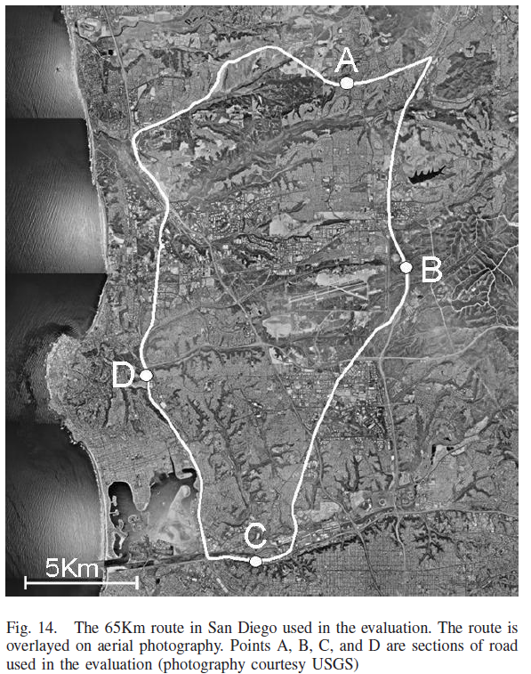

Slide 25
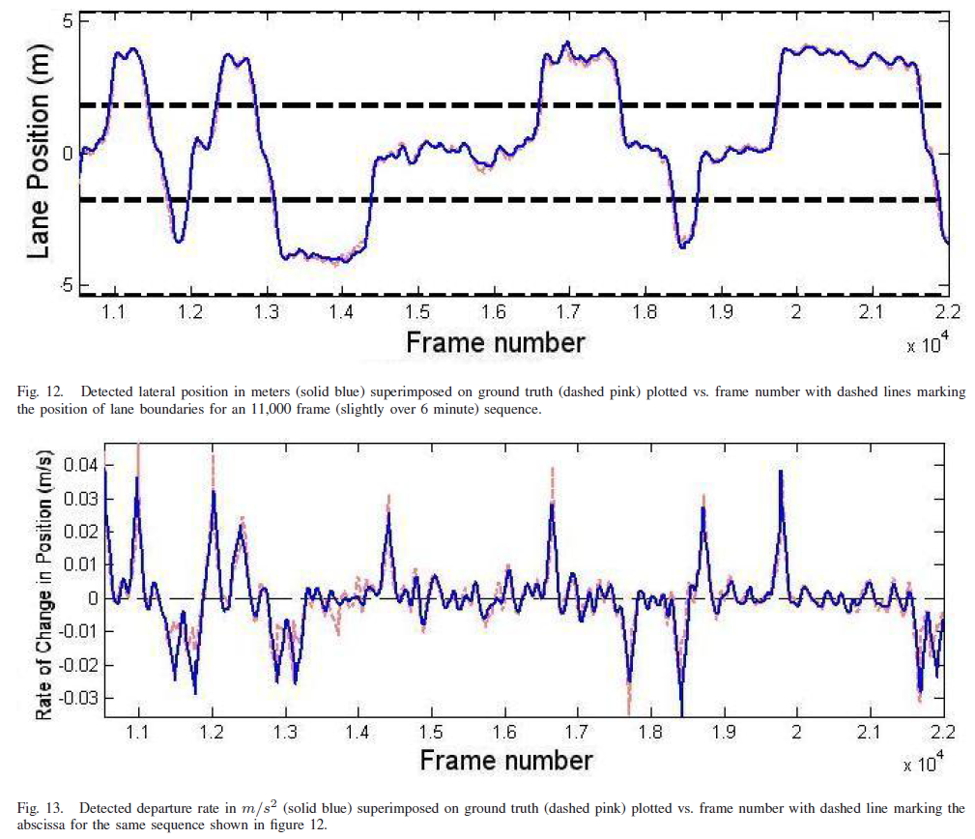
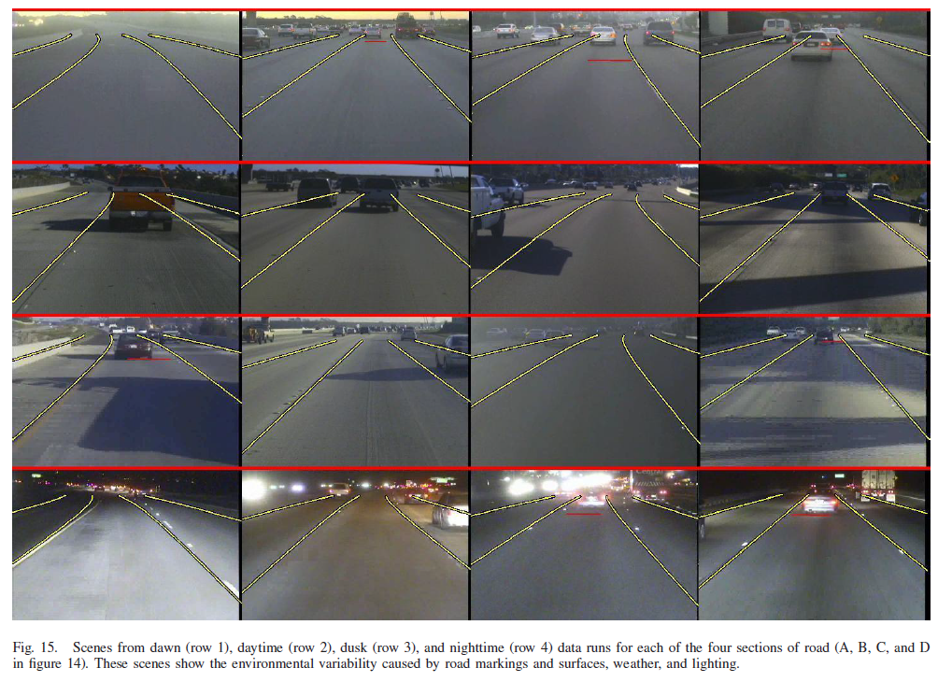
Results

Slide 26
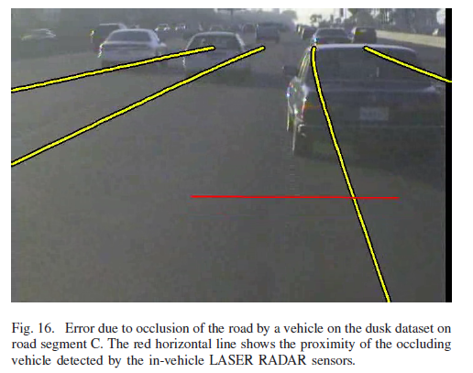
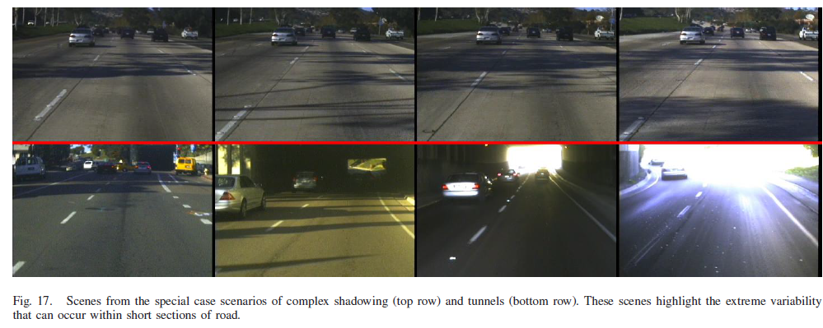
Challenges: Occlusions and Highlights

Slide 27
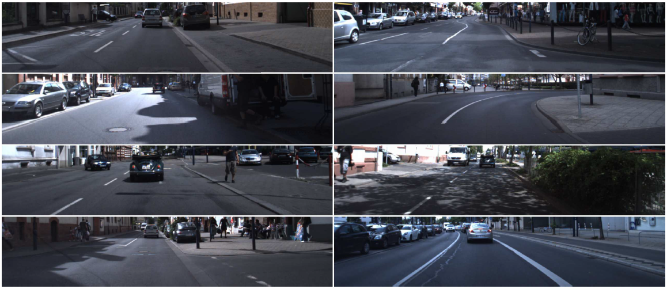
Lane Tracking
J. Fritsch, T. Kühnl, F. Kummert, Monocular Road Terrain Detection by Combining Visual and Spatial Information. IEEE Transactions on Intelligent Transportation Systems, 2014.

Slide 28


Overview System

Slide 29

Ground Truth

Slide 30


Slow Feature Analysis (SFA)
Slow Feature Analysis (SFA)
  Generating the slowest varying output functions y_{j}(t) from a multidimensional input signal x(t)
Spatial patch sequence extraction for SFA training: on the left the horizontal path and on the right the vertical path is illustrated.The paths are partitioned into road (dotted) and non-road (dashed) sections.

Slide 31


Result of the base road and base boundary classification for the given ground truth scene.
From left to right the positive and negative part of the confidence values is depicted for each base classifier.
Dark points denote high confidence of the classification.
Feature vectors:
- SFA features
- Color features (RGB)
- Walsh Hadamard texture features
Notes:
The Hadamard transform can be regarded as being built out of size-2 discrete Fourier transforms (DFTs), and is in fact equivalent to a multidimensional DFT of size 2 × 2 × ⋯ × 2 × 2
The Hadamard transform is also used in data encryption, as well as many signal processing and data compression algorithms, such as JPEG XR and MPEG-4 AVC. In video compression applications, it is usually used in the form of the sum of absolute transformed differences. It is also a crucial part of Grover's algorithm and Shor's algorithm in quantum computing. The Hadamard transform is also applied in experimental techniques such as NMR, mass spectrometry and crystallography.

Slide 32


SPRAY Features: Spatial Rays
1) 2) 3)
Distribution of base points in metric space
The SPRAY feature generation procedure for one base point (BP)
The ego SPRAY feature.

Slide 33

Ground Truth

Slide 34



Results
Result of the road terrain classification for the ground truth (above):
The classification result for road area (middle blue).
The classification result for the ego-lane (right green)

Slide 35

Results
Ego Lanes

Slide 36


Results
(BL = Baseline)

Slide 37

J. Sattar, J. Mo, SafeDrive: A Robust Lane Tracking System for Autonomous and Assisted Driving Under Limited Visibility. January 31, 2017 ( https://arxiv.org/abs/1701.08449 )
Visual lane tracking on several urban scenes from YouTubeTM videos. Snapshot (1a) (output in (1b)): lane markers not distinct in the center, though side markers are detectable. Snapshot (1c) (output in (1d)): lane markers mostly washed out. Snapshot (1e) (output in (1f)): evening drive, low-light conditions make the lane markers almost undetectable. Snapshot (1g) (output in (1h)): snow-covered roads, no lane markers visible.

Slide 38


System Overview
The process of extracting pixels with \common" visual content. The feature-based matching (in red lines) are used to choose the point features, and for each feature point, a square subwindow is extracted from the candidateimage, centered on that feature point. Stitching together all these windowsresults in an image with most \uncommon" visual elements removed.

Slide 39



Slide 40

Image Processing using OpenCV
Core module: the basic building blocks of this library for manipulating the images on a pixel level.
Imgproc module: the image processing (manipulation) functions inside OpenCV.
High Level GUI and Media (highgui module)
Image Input and Output (imgcodecs module)
Video Input and Output (videoio module)
Camera calibration and 3D reconstruction (calib3d module)
2D Features framework (feature2d module): feature points detectors, descriptors and matching framework found inside OpenCV.
Video analysis (video module) algorithms usable on your video streams like motion extraction, feature tracking and foreground extractions.
Object Detection (objdetect module) face detectors, etc.
Deep Neural Networks (dnn module)
Machine Learning (ml module) machine learning classes for statistical classification, regression and clustering of data.
Graph API (gapi module)
Computational photography (photo module) for advanced photo processing.
Images stitching (stitching module) create photo panoramas and more with OpenCV stitching pipeline.
GPU-Accelerated Computer Vision (cuda module); OpenCV iOS:

Slide 41

Lane Tracking
Some example project for detecting road features using OpenCV:
https://navoshta.com/detecting-road-features/ by Alex Staravoitau

Slide 42
Overview Processing Pipeline
Camera calibration
Each camera gives image distortions, these can be rectified using information from a camera calibration. OpenCV has functionality to calibrate and correct camera images. Calibration is done using chessboard images.
Edge detection
OpenCV has many different edge detectors using gradient and color information. These edges can be used for the detection of structures such as lines etc.
Perspective transformation
Aperspective transformation, can be used to obtain an overview of the road ahead of the vehicle. This can make the problem of lane boundaries extraction easier.
Fitting boundary lines
The resulting frame pixels are determined that may belong to lane boundaries.
These are then used to approximate lines, road properties and vehicle position.
Furthermore a rough estimate on road curvature and vehicle position within the lane is determined using known road dimensions.

Slide 43

Processing Pipeline: Camera Calibration
… cv2.findChessboardCorners(image, (9, 6), None) // Inner corners 9x6
… cv2.calibrateCamera( pattern_points, image_points, (image.shape[1], image.shape[0]), None, None)
corrected_image = cv2.undistort(image, self.camera_matrix, self.dist_coefficients, None, self.camera_matrix)

Slide 44

Processing Pipeline: Edge Detection
Gradient Absolute Values, Ranges within certain magnitudes, Gradient Directions
Sobel Operator (using a convolutional Kernel)
Color Ranges
HLS Color Space: Hue, Saturation, and Level (for road detection, etc.)

Slide 45

Processing Pipeline: Perspective Transformation
…. transform_matrix = cv2.getPerspectiveTransform(source, destination)
…. image = cv2.warpPerspective(image, transform_matrix, (w, h))

Slide 46

Processing Pipeline: Perspective Transformation
Left: The original image after the camera calibration and perspective transform.
Right: After edge detection with edges highlighted in green and blue.
Scanning windows boundaries for areas with pixel that may belong to lines are highlighted in yellow,
A second order polynomial approximation of the collected points in red.

Slide 47

Lane and Vehicle Tracking

Slide 48
Some remarks
Alex Staravoitau:
“This clearly is a very naive way of detecting and tracking road features, and wouldn’t be used in real world application as-is, since it is likely to fail in too many scenarios: “
Going up or down the hill.
Changing weather conditions.
Worn out lane markings.
Obstruction by other vehicles or vehicles obstructing each other.
Vehicles and vehicle positions different from those classifier was trained on.
…

Slide 49
YetiBorg Race
Each time 2 teams will race 2 times against each other. The second time lanes will be switched.
Note, the second race will take place after all teams have completed their first race. So you have ample time to restart and change batteries and setup, if necessary.
The teams that won at least one race will proceed to the next round.
The YetiBorg should not cross the inner orange line with a complete tire. If that happens you should manually place it to the middle of the track parallel to where it first crossed the inner orange line.
If the YetiBorg crosses the outer white line completely, it should be manually placed to the middle of the track parallel to where it first crossed the outer white line.
If the placement as in 4) and 5) is not possible because the other YetiBorg is driving there, it should be placed to the right of the other YetiBorg. If that is not possible you should wait until it passed.
The rough shape of the racing track will be available Friday 29th onwards.
The race will continue until one winner remains.
Notes:
Laat plaatjes zien van oplossingen.

Slide 50
References
Joel C. McCall and Mohan M. Trivedi, Video Based Lane Estimation and Tracking for Driver Assistance: Survey, System, and Evaluation. IEEE Transactions on Intelligent Transportation Systems, 2006
A. Bar Hillel, R. Lerner, D. Levi, G. Raz, Recent progress in road and lane detection: a survey. Machine Vision and Applications (2014) 25:727–745
J. Fritsch, T. Kühnl, F. Kummert, Monocular Road Terrain Detection by Combining Visual and Spatial Information. IEEE Transactions on Intelligent Transportation Systems, 2014.
J. Sattar, J. Mo, SafeDrive: A Robust Lane Tracking System for Autonomous and Assisted Driving Under Limited Visibility. January 31, 2017 ( https://arxiv.org/abs/1701.08449 )
https://navoshta.com/detecting-road-features/ by Alex Staravoitau
OpenCV.org

Slide 51
Robotics

