Slide 1
Robotics
Erwin M. Bakker| LIACS Media Lab

Slide 2
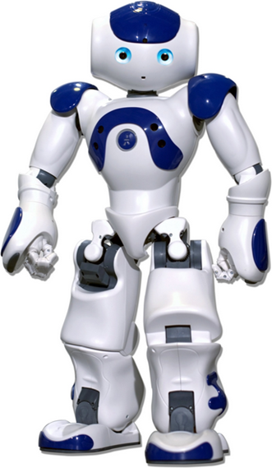
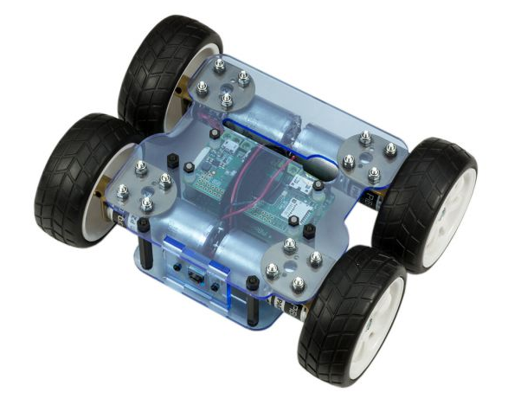
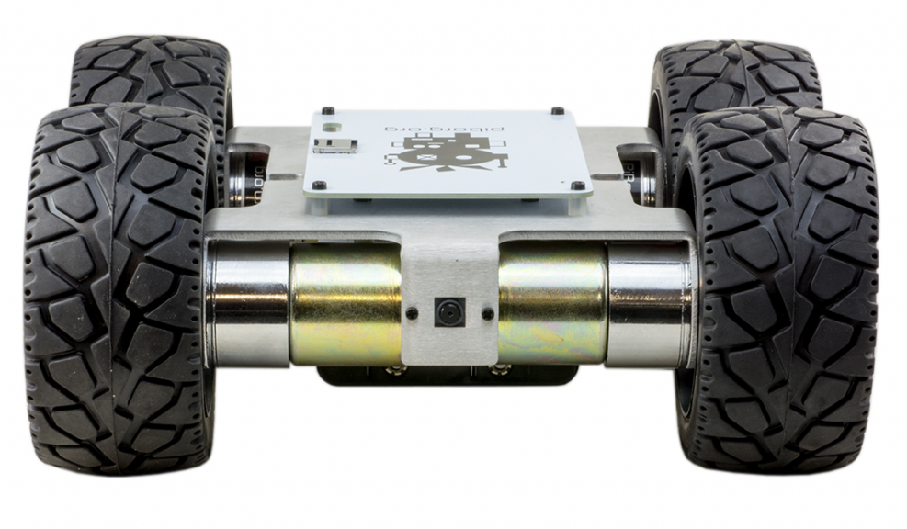
Organization and Overview
Period: February 15th - May 10th 2019
Time: Friday 09.00 – 10.45
Place: LIACS, Room 401 (Workshops Room 303)
Lecturer: Dr Erwin M. Bakker ( erwin@liacs.nl )
Assistant: Andrius Bernatavicius
NB E-mail your name and student number to erwin@liacs.nl
Schedule:
15-2 Introduction and Overview
22-2 Control Space, Locomotion and Kinematics
1-3 Inverse Kinematics and Sensors
8-3 Yetiborg Introduction and SLAM Workshop I
15-3 Project Proposals (presentation by students)
22-3 Yetiborg Qualification and ROS Workshop II
29-3 Robotics Image Processing
5-4 Yetiborg Race and/or Nao Workshop III
12-4 Robotics Image Processing and Understanding
19-4 No Class
26-4 Robotics Reinforcement Learning.
3-5 Robotics Reinforcement Learning Workshop IV
10-5 Project Demos (by students)
Website: http://liacs.leidenuniv.nl/~bakkerem2/robotics/
Grading (6 ECTS): Presentations and Robotics Project (60% of grade). Class discussions, attendance, workshops and assignments (40% of grade). It is necessary to be at every class and to complete every workshop.

Slide 3
Overview
Configuration Space
Rigid Body Motion
Forward Kinematics
Inverse Kinematics
Sensors
Link: http://modernrobotics.org
K.M. Lynch, F.C. Park, Modern Robotics: Mechanics, Planning and Control, Cambridge University Press, 2017

Slide 4
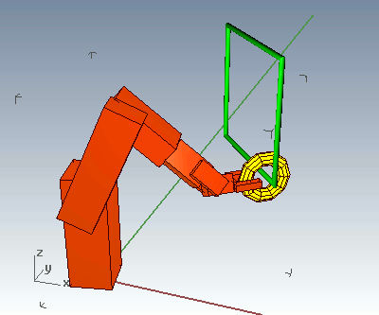
How to move to a goal?
Problem: How to move to a goal?
Grasp, Walk, Stand, Dance, Follow, etc.
Solution:
Program step by step
Computer Numerical Control (CNC), Automation.
Inverse kinematics:
take end-points and move them to designated points.
Tracing movements
by specialist, human, etc.
Learn the right movements
Reinforcement Learning, give a reward when the movement resembles the designated movement.
Notes:
C:\Users\admin\Desktop\OpenDag 2013\mydemos\bullet-2.75 ragdoll

Slide 5
Configuration Space
Robot Question: Where am I?
Answer:
The robot’s configuration: a specification of the positions of all points of a robot.
Here we assume:
Robot links and bodies are rigid and of known shape => only a few variables needed to describe it’s configuration.
K.M. Lynch, F.C. Park, Modern Robotics: Mechanics, Planning and Control, Cambridge University Press, 2017

Slide 6
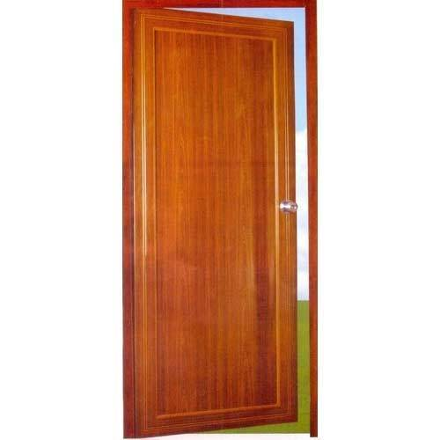
Configuration Space
x
Degrees of Freedom of a Rigid Body: the smallest number of real-valued coordinates needed to represent its configuration

Slide 7
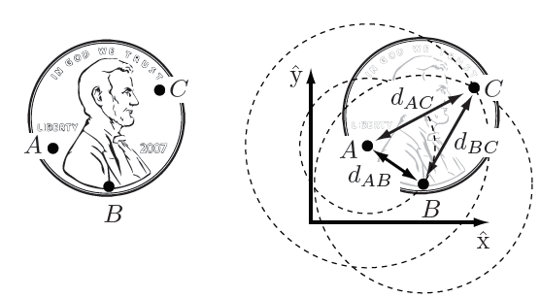
Configuration Space
Assume we have a coin with 3 points A, B, C on it.
In the plane A,B,C have 6 degrees of freedom:
(x_{A},y_{A}) , (x_{B},y_{B}) , (x_{C},y_{C})
A coin is rigid => 3 extra constraints on distances: d_{AB}, d_{AC}, d_{BC}
are fixed, wherever the location of the coin would be.
The coin and hence A can be placed everywhere => (x_{A},y_{A}) free to choose.
B can only be placed under the constraint that its distance to A would be equal to d_{AB}. =>
freedom to turn the coin around A with angle ϕ_{AB} => (x_{A}, y_{A}, ϕ_{AB} ) are free to choose.
C should be placed at distance d_{AC}, d_{BC} from A and B, respectively => only 1 possibility, hence no degree of freedom added.
Degrees of Freedom (DOF) of a Coin
= sum of freedoms of the points – number of independent constraints
= number of variables – number of independent equations = 6 – 3 = 3

Slide 8
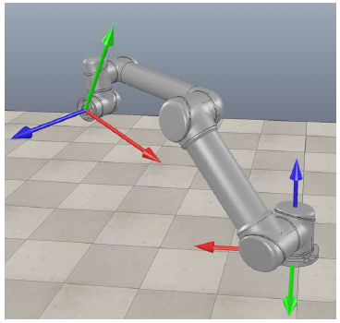
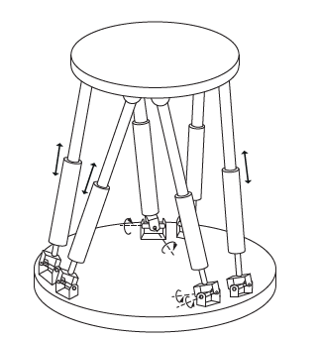
Configuration Space
[1] Definition 2.1.
The configuration of a robot is a complete specification of the position of every point of the robot.
The minimum number n of real-valued coordinates needed to represent the configuration is the number of degrees of freedom (dof) of the robot.
The n-dimensional space containing all possible configurations of the robot is called the Configuration Space (C-space).
The configuration of a robot is represented by a point in its C-space.
Open-chain robot: Manipulator (in V-REP). [1]
Closed-chain robot: Stewart-Gough platform. [1]

Slide 9
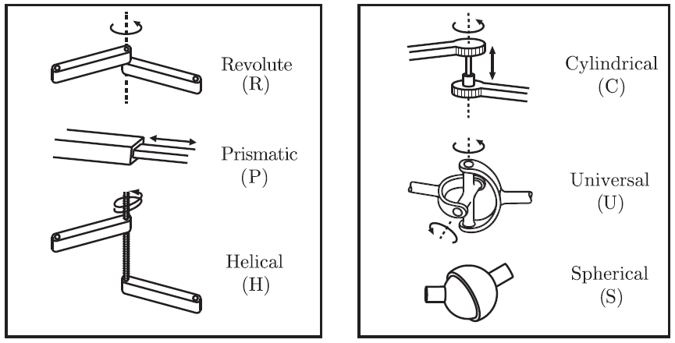
Degrees of Freedom of a Robot
A rigid body in 3D Space has 6 DOF
A joint can be seen to put constraints on the rigid bodies it connects
It also allows freedom to move relative to the body it is attached to.

Slide 10
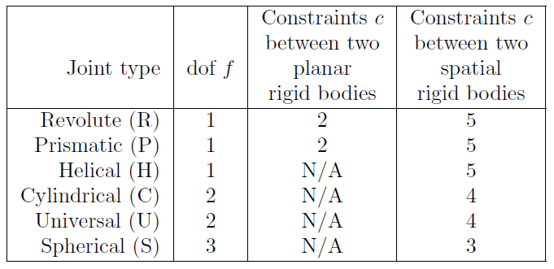
Degrees of Freedom of a Robot
A rigid body in 3D Space has 6 DOF
A joint can be seen to put constraints on the rigid bodies it connects
It also allows freedom to move relative to the body it is attached to.

Slide 11
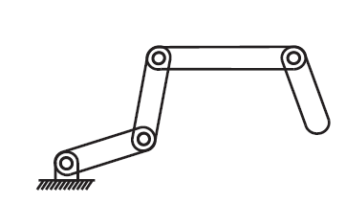
Degrees of Freedom of a Robot
Planar Mechanism DOF = 4
Proposition (Grübler's formula)
Consider a mechanism consisting of
N links, where ground is also regarded as a link.
J number of joints,
m number of degrees of freedom of a rigid body (m = 3 for planar mechanisms and m = 6 for spatial mechanisms),
f_{i} the number of freedoms provided by joint i, and
c_{i} the number of constraints provided by joint i, where f_{i} + c_{i} = m for all i.
Then Grübler's formula for the number of degrees of freedom of the robot is
$$dof=m\left(N−1\right)− \sum_{i=1}^{J}{c_{i}=m\left(N−1−J\right)+\sum_{i=1}^{J}{f_{i}} }$$
This formula holds only if all joint constraints are independent. If they are not independent then the formula provides a lower bound on the number of degrees of freedom.
N = 5 links
J = 4 joints
f_{i} = 1, for all i
c_{i}=2, for all i

Slide 12
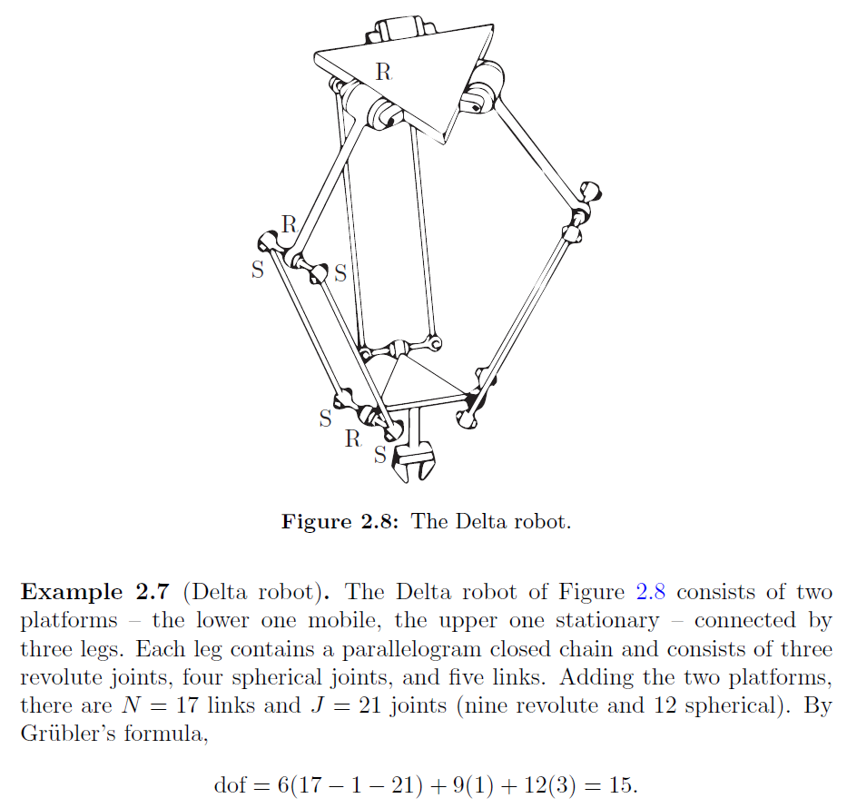
Links: 1 + 3 + 3 + 6 + 3 + 1 = 17
Joints: 21: 9x R(1 dof) and 12 x S(3 dof)
m= 6

Slide 13
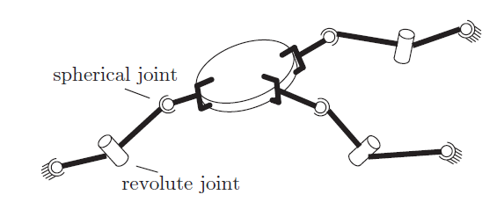
Assignments
3x SRS
M=6, N = 1 + 3 x 3 = 10, J = 3 x 3, dof per leg 3 + 1 + 3
=> dof = 6 (10 – 1 – 9) + 3 x 7 = 21

Slide 14
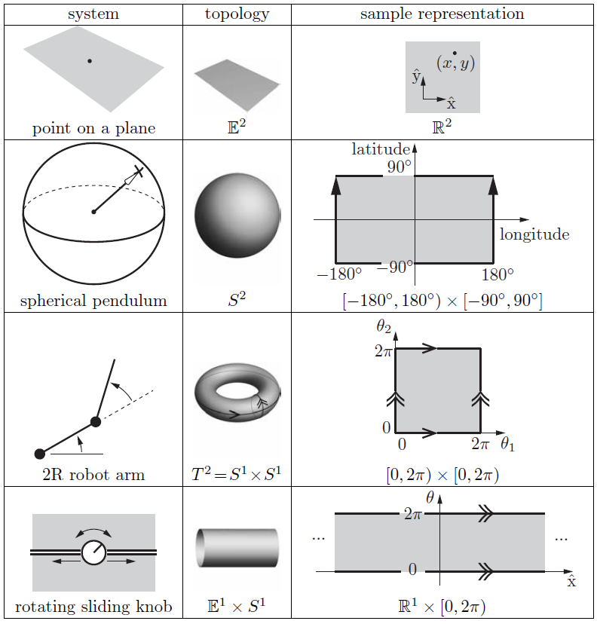
Topologies
Note: S¹ x S¹ = T² (not S²)
Coordinates
Explicit Coordinates
Euclidean (x,y)
Polar (r,ϕ)
Combined (x,y) x (r, ϕ)
Implicit Coordinates
{ (x,y,z) | x²+y²+z²=1 }

Slide 15
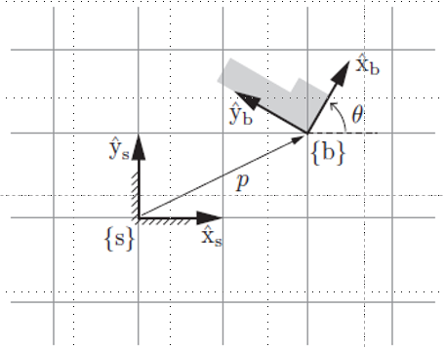
C-Space (Configuration Space)
How to describe a rigid body’s position and orientation in C-Space?
Fixed reference frame {s}
Reference fame attached to body {b}
Described by 4x4 matrix with 10 constraints (unit-length, orthogonal)
Matrix can be used to:
Translate or rotate a vector or a frame
Change the representation of a vector or a frame
for example from relative to {s} to relative to {b}

Slide 16
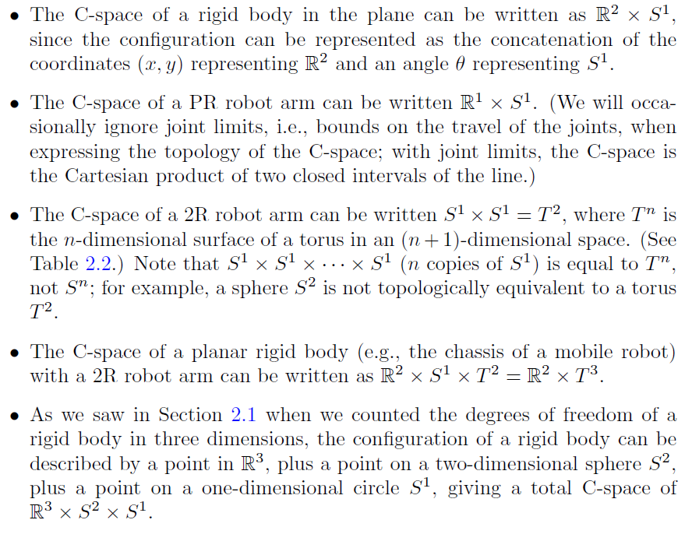
C-Spaces

Slide 17
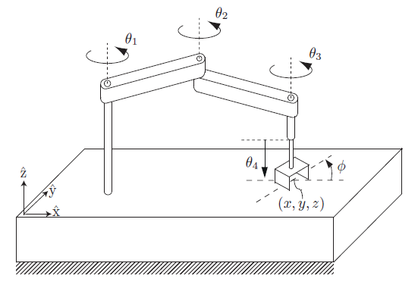
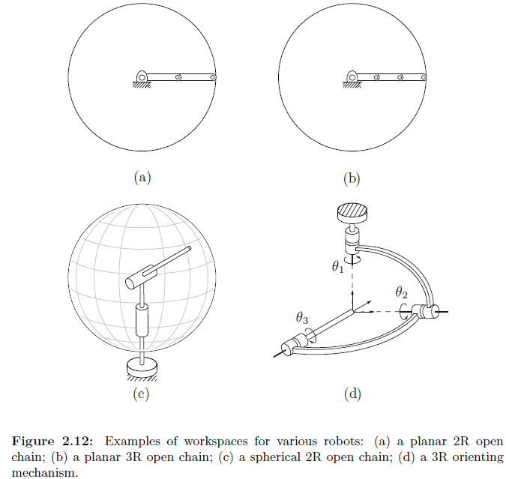
Task Space and Work Space
The SCARA robot is an RRRP open chain that is
widely used for tabletop pick-and-place tasks.
The end-effector configuration is completely
described by (x, y, z, φ)
task space R³ x S¹ and
workspace as the reachable points in (x, y, z), since all orientations φ can be achieved at all reachable points.
The workspace is a specification of the configurations that the end-effector of the robot can reach.

Slide 18
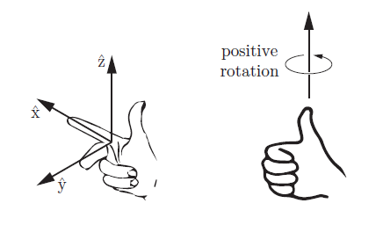
Rigid Body Motion
Rigid-body position and orientation (x, y, z, ϕ, θ, ψ)
Can also be described by 4x4 matrix with 10 constraints.
In general 4x4 matrices can be used for
Location
Translation + rotation of a vector or frame
Transformation of coordinates between frames
Velocity of a rigid body: (∂x/∂t, ∂y/∂t, ∂z/∂t, ∂ϕ/∂t, ∂θ/∂t, ∂ψ/∂t)
Exponential coordinates:
Every rigid-body configuration can be achieved by:
Starting in the fixed home frame and integrating a constant twist for a specified time.
Direction of a screw axis and scalar to indicate how far the screw axis must be followed

Slide 19
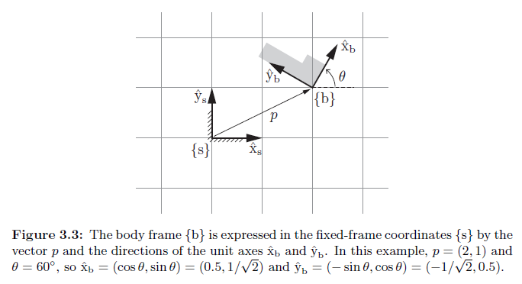
Rigid Body Motions in the Plane
Body
Fixed reference frame

Slide 20
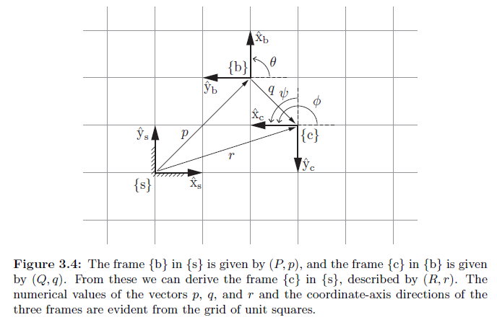
Rigid Body Motions in the Plane
Previously:
{b} relative to {s}
{c} relative to {s}
{c} relative to {b}
Note and verify: R = PQ, and r = Pq+p

Slide 21
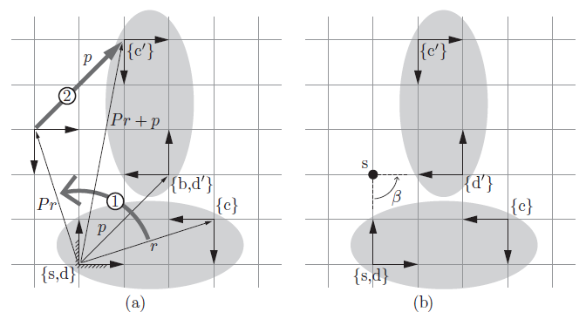
Rigid Body Motions in the Plane
{c} described by (R,r)
Move rigid body such that {d} coincides with {d’}.
Then {c’} described by (R’,r’):
Note: SCREW MOTION
The above rotation followed by a translation can also be expressed as a rotation of the rigid-body about a fixed point s by an angle β
(P, p) can be used to
Represent a configuration of a rigid body in {s}
Change the reference frame for vector representation.
Displace a vector or a frame.

Slide 22
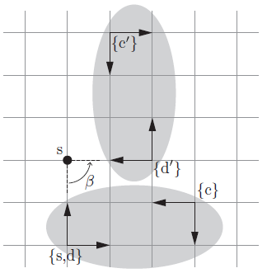
Rigid Body Motions in the Plane
{c} described by (R,r)
Note: SCREW MOTION
The above rotation followed by a translation can also be expressed as a rotation of the rigid-body about a fixed point s by an angle β
(β, s_{x}, s_{y}) , where (s_{x}, s_{y}) = (0, 2)
In the {s}-frame rotate 1 rad/sec with
speed (v_{x},v_{y}) = (2, 0) is denoted as:
S = (ω, v_{x}, v_{y}) = (1, 2, 0)
Following the screw-axis for an angle
θ = π/2 gives the displacement we want:
Sθ = (π/2, π, 0)
These are called the exponential coordinates for the planar rigid-body displacement.
Move rigid body such that {d} coincides with {d’}.
Then {c’} described by (R’,r’):
1 rad/sec
(v_{x},v_{y}) = (2,0)
Note:
- distance = vt
- distance along quarter circle with radius 2 equals π.

Slide 23
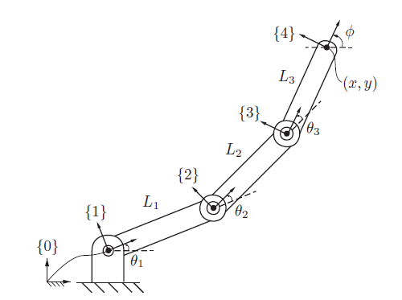
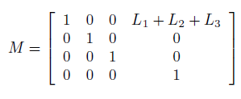
Forward Kinematics
The forward kinematics of 3R Planar Open Chain can be written as a product of four homogeneous transformation matrices: T₀₄ = T₀₁T₁₂T₂₃T₃₄, where
Home position M:

Slide 24
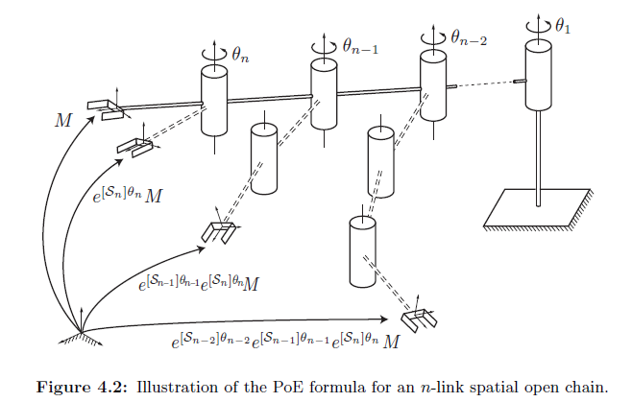
Forward Kinematics: Product of Exponentials
PoE parameters also known as
Euler-Rodrigues parameters.
There are many other representations:
for example Denavit-Hartenberg (1955) representation is very popular, but can be cumbersome
In velocity kinematics Jacobians are used.

Slide 25
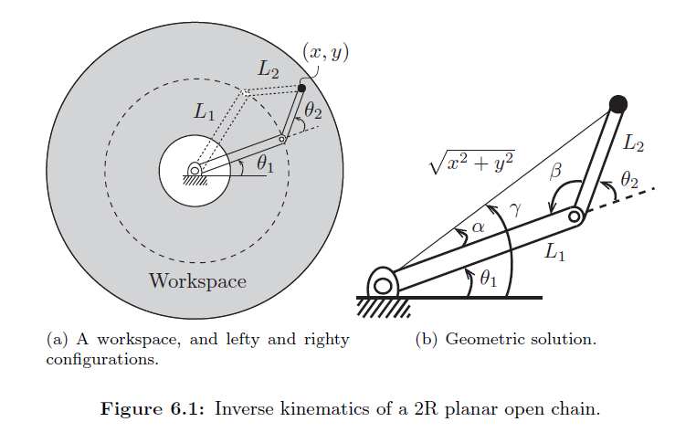
Inverse Kinematics
Which angles θ₁, and θ₁ will lead to location (x,y)?
Law of cosines gives:
, hence
,and similarly
γ= atan2(y,x)
Answer:
In general: IK-Solvers

Slide 26
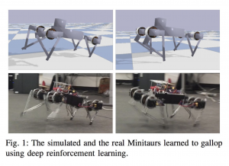
Real Time Physics Modelling
https://pybullet.org/wordpress/
pybullet KUKA
grasp training
Using Tensorflow
OpenAI gym
Baselines DeepQNetworks (DQNs)

Slide 27
Robotics Preparations
1) Form YetiBorg Racing Teams of 3 to 4 people
Appoint one person who will be responsible for the robot.
Email your teams to erwin@liacs.nl with subject ‘Robotics YetiBorg Racing Team’.
Due: Thursday 7-3 at 14.00 PM.
2) Project Proposal Title and Abstract
Give the title and abstract of the project proposal you will present on March 15th.
Also mention the number of people that will cooperate on the project (1-4).
Email your proposal to erwin@liacs.nl with subject ‘Robotics Project Proposal’.
Due: Thursday 7-3 at 14.00 PM.
Notes:
Laat plaatjes zien van oplossingen.

Slide 28
References
K.M. Lynch, F.C. Park, Modern Robotics: Mechanics, Planning and Control, Cambridge University Press, 2017. ( DOI: 10.1017/9781316661239 )
https://pybullet.org/wordpress/

Slide 29
Robotics

