Slide 1
Reinforcement Learning for Robotics
Erwin M. Bakker
LIACS Media Lab

Slide 2
Reinforcement Learning
François Chollet, Deep Learning with Python, 2nd Edition. Manning, 2021.
R. Atienza, Advanced Deep Learning with Keras: Apply deep learning techniques, autoencoders, GANs, variational autoencoders, deep reinforcement learning, policy gradients, and more, 2018.
R.S. Sutton, A.G. Barto, Reinforcement Learning: An Introduction (Adaptive Computation and Machine Learning series) 2nd Edition, 2018.
W. Zhao, J.P. Queralta, T. Westerlund, Sim-to-Real Transfer in Deep Reinforcement Learning for Robotics: a Survey, 2020 IEEE Symposium Series on Computational Intelligence (SSCI), 2020.

Slide 3
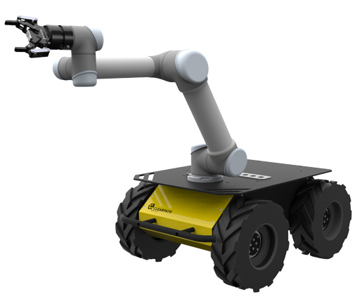
Reinforcement Learning
Agent: Robot
Environment
State
Action
Reward
Agent: e.g. a Robot
Environment: is in a certain state.
Actions of the Agent:
Environment transitions to a new state
Agent receives a reward
Policy: decides for each given state which action should be taken.
Goal: Learn a policy that maximizes the accumulated future rewards
Notes:
Challenges: Exploit what it has experienced versus Explore in order to make better action selections in the future.
A goal directed agent interacting with an uncertain environment.
Examples:
Chess player: anticipate possible replies and counter replies etc. – and current intuitive judgement of how desirable a position or move is
Mobile trash collecting robot: decides to search for more trash based on current charge level of its battery vs how quickly it can find a recharger in past
Note: effect of actions can not be fully predicted! Decisions by agent to obtain goal in an uncertain environment.

Slide 4
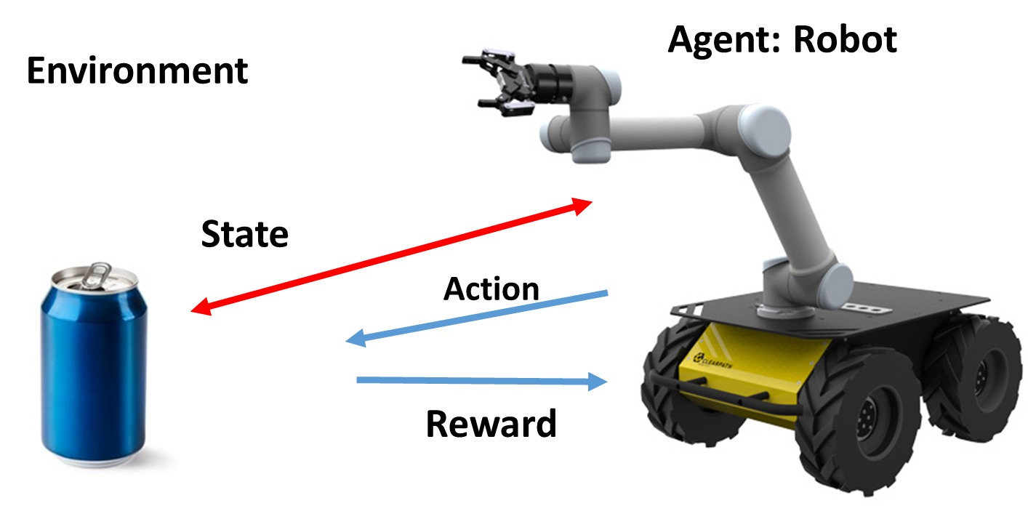
Markov Decision Process
Environment
At time step t the environment is in state $s_{t}∈S$,
where S is the state space, $s_{0}$ is the start state, $s_{t}$ is the current end state.
Actions
The agent takes actions from the action space A.
It follows a probabilistic policy $π\left(a_{t} | s_{t}\right)$
i.e., the probability that action $a_{t}$ is taken given the environment is in state $s_{t}$.
Reinforcement Learning (RL) methods specify how
an agent changes its policy $πt$as a result of its experience.
Environment: responds using the state transition $T\left(s_{t+1} | s_{t},a_{t}\right)$.
Reward: The agent receives a reward $R_{t+1}=R\left(s_{t},a_{t}\right)$
Notes:
A policy is a mapping from perceived states of the environment to actions to be taken when in such a state.
Psychology: stimulus-response rules. Defines the behavior of the agent.
If probabilistic/stochastic it has a probability for each action.
Can be look up, but may be a complex search process.
Reward signal defines the goal of the reinforcement problem learning problem. (Analogous: pleasure vs pain.)
Stochastic functions of state and action, indicate how good an action is in an immediate way.
Goal of agent is maximize the total reward it receives over the long run.
Note: A value function specifies what is good in the long run.
Very difficult to determine: maybe much pain before the final pleasure.
Value estimation has a central role in RL.
Model-based vs Model free methods (trial and error learners).

Slide 5
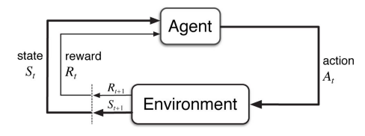
Agent-Environment Interaction
The Markov Decision Process and Agent give rise to
a trajectory: S₀, A₀, R₁, S₁, A₁, R₂, S₂, A₂, R₃, S₃, …
Notes:
This is the Reinforcement Learning Cycle.
RL methods specify how an agent changes its policy $πt$as a result of its experience.
= A mapping from states to probabilities of selecting each possible action.
Goal of agent is maximize the total reward it receives over the long run.
Time steps do not have to be fixed intervals, can be successive stages in the decision making and acting.

Slide 6
Markov Decision Process (MDP)
Environment at time t in state $s_{t}∈S.$
Action: - $a_{t}$ following $π\left(a_{t} | s_{t}\right)$
Result: - Environment state transition $T\left(s_{t+1} | s_{t},a_{t}\right)$.
- Agent’s reward $R_{t+1}=R\left(s_{t},a_{t}\right)$
Note:
Functions T and R may or may not be known to the agent.
Future rewards can be discounted by $γ^{k}$, where $γ∈\left[0,1\right]$, and k a future time step.
Process can have episodes => a horizon H is used, with T the number of time steps to complete one episode from $s_{0}$ to $s_{T}$, …, etc.

Slide 7
Reinforcement Learning (RL)
Environment
Can be fully or Partially Observable (=> PO-MDP)
Note:
The decision process sometimes takes past observations into account.
Obeying the Markov-property: all information should be maintained in the current state.
Our robot agent:
State can be a camera estimate of the 3D position of the soda can with respect to the gripper.
Reward
+1, if the robot gets closer to the soda can.
-1, if the robot gets farther away from the soda can.
+100 when it successfully picks up the soda can.
Notes:
Markov
Consider how a general environment might respond at time t+1 to the action taken at time t. In the most general, causal case this response may depend
on everything that has happened earlier.
Markov Property:
If the state signal has the Markov property, then the environment's response at t+1 depends only on the state and
action representations at t

Slide 8
Markov Decision Process (MDP) Framework
Time
can be abstract, stages
Actions
low-level: voltages applied to a motor in a robot arm, …
high level: grab lunch, grab can, recharge, …
abstract: internal actions
Environment and States
low-level: sensor readings, …
high level: symbolic descriptions of objects, …
abstract: past sensations, subjective, etc.

Slide 9
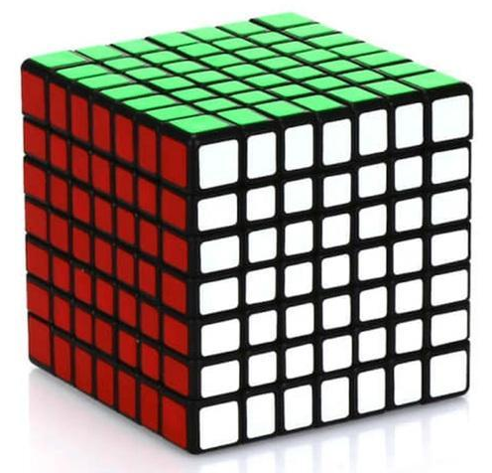
Markov Decision Process (MDP) Framework
Boundary between Environment and Agent:
motors, links, and sensors are part of environment
Represents the limit of the agent’s absolute control, not of it’s knowledge
Note: An Agent may know everything about how it’s environment works, but still it would be a challenging reinforcement learning task.

Slide 10
Example I: Pick and Place Robot
Task: control the motion of a robot arm in a repetitive pick and place task.
Goal: fast and smooth movements
Agent:
Direct low level control of motors
Low-latency information of position and velocities of mechanical links
Actions
Voltage applied to each motor at each joint
Readings of joint angles and velocities
Reward
+1 for each object that is picked and placed
Small negative reward as function of the jerkiness of the motion (per moment).

Slide 11
Example II: Recycling Robot
Transition
Transition prob.
Current state
Action
Next state
Transition reward
Action Node
State Node
High level agent decides to search, wait or recharge:
Environment State space: two charge levels: high, low
Robot Action set: state low -> {search, wait, recharge}; state high -> {search, wait}
Environment responds with state s’ and reward r(s,a,s’)
Notes:
Action nodes and state nodes.
Starting in state s and taking action a will let the environment respond with state s’ and reward r(s,a,s’).

Slide 12
Goals and Rewards
Agent receives after each time step t a reward R_{t+1}
Goal is to maximize the total amount of received rewards.
The maximization of the expected value of the cumulative sum
of a received scalar signal (called reward).
More formally (but still a simplification):
Sequence of rewards after time step t: R_{t+1}, R_{t+2}, R_{t+3}, …
T final time step, sum of rewards G_{t} = R_{t+1} + R_{t+2} + R_{t+3} +… + R_{T}
Notes:
This is just 1 possible sequence of rewards.
Expected sum of rewards: take the sum of all possible future rewards and determine the average weighted by each probability

Slide 13
Reinforcement Learning (RL)
Goal:
Maximize the expected discounted return:
$$G_{t}=R_{t+1}+{γR}_{t+2}+γ^{2}R_{T+3}+…=\sum_{k=0}^{∞}{γ^{k}R_{t+k+1}}, γ∈\left[0,1\right]$$
Note:
$γ∈\left[0,1\right] the discount rate.$
$γ=0$, if only the immediate reward matters
$γ=1$, if future rewards weigh the same as the immediate reward

Slide 14
Reinforcement Learning (RL)
Goal:
Maximize the expected discounted return:
$$G_{t}=R_{t+1}+{γR}_{t+2}+γ^{2}R_{T+3}+…=\sum_{k=0}^{∞}{γ^{k}R_{t+k+1}}, γ∈\left[0,1\right]$$
Note:
$$G_{t}=R_{t+1}+{γR}_{t+2}+γ^{2}R_{T+3}+…$$
$=$ $R_{t+1}+{γ(R}_{t+2}+{γR}_{t+3}+γ^{2}R_{T+4}+…)$
$$=R_{t+1}+{γG}_{t+1}$$

Slide 15
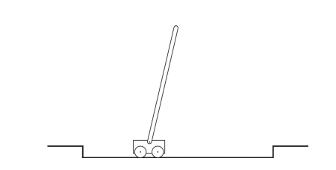
Example III: Pole-Balancing
Objective: Apply forces to the cart such that pole does not fall over.
Failure: If pole falls, or cart runs off the track.
Task of pole-balancing seen as repeated attempts, episodes, during which it is balanced:
Reward: +1 for every time step without failure
expected return -> ∞ if successful balancing for ever.
Pole-balancing seen as a continuous task:
Reward: -1 on each failure, 0 otherwise.
=> discounted return related to $−γ^{K}$ ($γ∈\left[0,1\right]$), where K is the number of time steps before failure.
Notes:
Discounted return as the penalty is discounted over the time it does not fail.

Slide 16
Policies and Estimations: Value Functions
Try to estimate value-functions (of states, or state-action pairs) that estimate for an agent:
how good it is to be in a state or
how good it is to perform a given action in a given state
The value function of a state s under a policy π is defined as:
$v_{π}\left(s\right)=Ε_{π}\left[G_{t} | S_{t}=s\right] =Ε_{π}[\sum_{k=0}^{∞}{γ^{k}R_{t+k+1}\left|S_{t}=s\right]}$, for all $s∈S$
(2) The expected return starting from s, taking action a and further on following policy π is defined as:
$$q_{π}\left(s,a\right)=Ε_{π}\left[G_{t} | S_{t}=s, A_{t}=a\right] =Ε_{π}[\sum_{k=0}^{∞}{γ^{k}R_{t+k+1}\left|S_{t}=s,A_{t}=a\right]}$$
Notes:
$Ε_{π}$ denotes the expected value of a random variable given that the agent follows policy π.
G_{t} the random variable denoting the return.

Slide 17
Reinforcement Learning (RL)
Goal:
Learn an optimal policy $π^{∗}$, where
$$π^{∗}={argmax}_{π}G_{t}, where G_{t}=\sum_{k=0}^{T}{γ^{k}R_{t+k+1}}, γ∈\left[0,1\right], and R_{t+1}=R\left(s_{t},a_{t}\right)$$
Methods:
Brute Force, Tabular Methods, Monte Carlo Methods, DNN for RL, Adversarial RL, Sim-to Real Transfer DRL, etc.
Notes:
Gt the random variable denoting the return.

Slide 18
[1] L. Pinto, J. Davidson, R. Sukthankar, A. Gupta, Robust Adversarial Reinforcement Learning, March 2017.
Deep neural networks successes in the field of Reinforcement Learning:
Fast computations
Fast Simulations
Improved networks
But, most RL-based approaches fail to generalize, because:
gap between simulation and real world
policy learning in real world is hampered by data scarcity

Slide 19
RL Challenges for Real-world Policy Learning
The training of the agent’s policy
in the real-world:
too expensive
dangerous
time-intensive
scarcity of data.
training often restricted to a limited set of scenarios, causing overfitting.
If the test scenario is different (e.g., different friction coefficient, different mass),
the learned policy fails to generalize.
But a learned policy should be robust and generalize well for different scenarios.

Slide 20
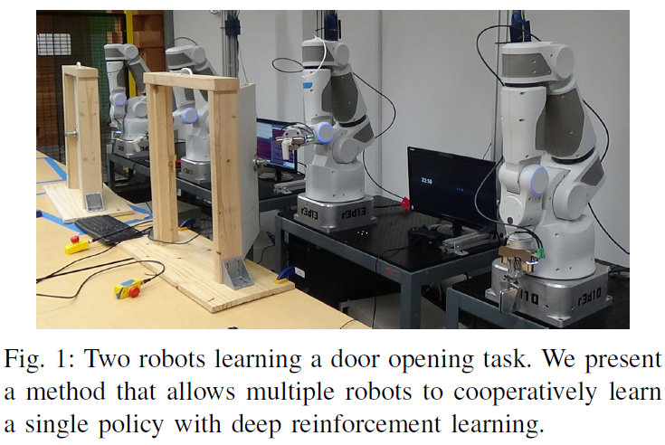
RL in the Real World: use more robots
From [2] Gu et al. , Nov. 2016.

Slide 21
Reinforcement Learning in simulation:
Facing the data scarcity in the real-world by
Learning a policy in a simulator
Transfer learned policy to the real world
But:
environment and physics of the simulator are not the same as the real world.
=> Reality Gap
This reality gap often results in an unsuccessful transfer, if the learned policy isn’t robust to modeling errors (Christiano et al., 2016; Rusu et al., 2016).
Notes:
Show Bullet

Slide 22
Robust Adversarial Reinforcement Learning (RARL)
Training of an agent in the presence of a destabilizing adversary
Adversary can employ disturbances to the system
Adversary is trained at the same time as the agent
Adversary is reinforced: it learns an optimal destabilization policy.
Here policy learning can be formulated as
a zero-sum, minimax objective function.
Minimax in zero-sum games: minimizing the opponent's maximum payoff.
Here a zero-sum game is identical to:
minimizing one's own maximum loss, and to
maximizing one's own minimum gain
Zero-sum game: gain and loss cancel each other out.

Slide 23
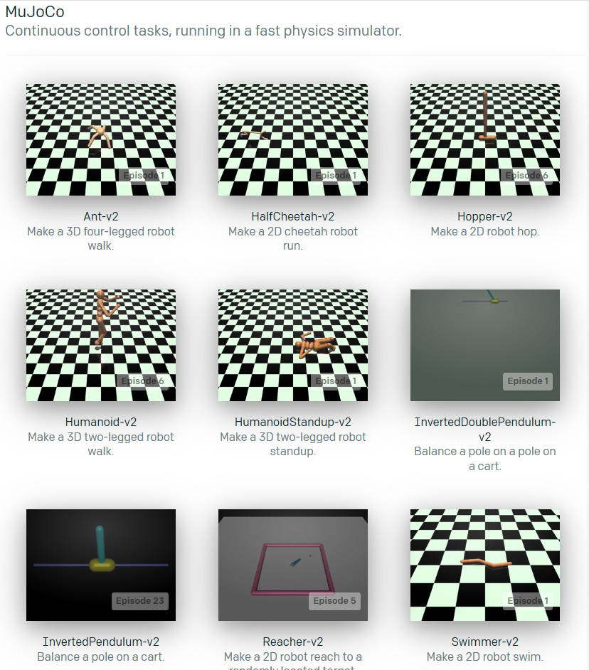
Experimental Environments
InvertedPendulum
HalfCheetah
Swimmer
Hopper
Walker2d
https://gym.openai.com/

Slide 24
Unconstrained Scenarios: Challenges
In unconstrained scenarios:
the space of possible disturbances could be larger than the space of possible actions
=> sampled trajectories for learning etc. become even sparser

Slide 25
Challenges of unconstrained scenarios
Use adversaries for modeling disturbances:
we do not want to and can not sample all possible disturbances
we jointly train a second agent (the adversary)
goal of adversary is to impede the original agent (the protagonist)
by applying destabilizing forces.
rewarded only for the failure of the protagonist
=> the adversary learns to sample hard examples, disturbances that make original agent fail
=> the protagonist learns a policy that is robust to any disturbances created by the adversary.
Notes:
Empede: belemmeren
Protagonist: hoofdrolspeler

Slide 26
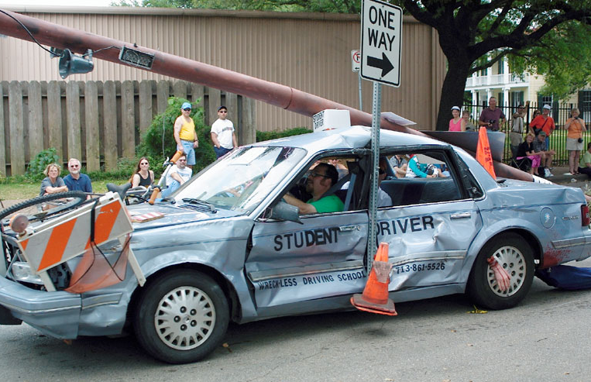
Challenges of unconstrained scenarios
Use adversaries that incorporate
domain knowledge:
Naïve: give adversary the same action space as the protagonist
Like a driving student and driving instructor fighting for control of a dual-controlled car.
Proposal paper:
exploit domain knowledge
focus on the protagonist’s weak points;
give the adversary “super-powers”
=> it can affect the robot or environment in ways the protagonist cannot
e.g. sudden changes in frictional coefficient, mass, etc.

Slide 27
Adversary with Domain Knowledge
Figure from [1].

Slide 28
Standard Reinforcement Learning (RL)
RL for continuous space Markov Decision Processes
(S, A, P, r, γ, s₀), where
S the set of continuous states
A the set of continuous actions
P: S x A x S → ℝ the transition probability
r: A → ℝ the reward function
γ the discount factor
s₀ the initial state distribution

Slide 29
Standard Reinforcement Learning (RL)
RL for continuous space Markov Decision Processes
(S, A, P, r, γ, s₀), where
S the set of continuous states
A the set of continuous actions
P: S x A x S → ℝ the transition probability
r: S x A → ℝ the reward function
γ the discount factor
s₀ the initial state distribution
Batch policy algorithms [Williams 1992, Kakade 2002, Shulman 2015]:
Learning a stochastic policy:
π_{θ}: S x A → ℝ which maximizes
$\sum_{t=0}^{T−1}{γ^{t}r(s_{t},a_{t})}$
the cumulative discounted reward
Θ the parameters of the policy π.
Policy π: probability taking action a_{t} given state s_{t} at time t

Slide 30
2 Player γ discounted zero-sum Markov Game (Litman 1994, Perolat 2015)
2 Player continuous space Markov Decision Processes
(S, A₁, A₂, P, r, γ, s₀), where
S the set of continuous states
A₁ the set of continuous actions of Player 1
A₂ the set of continuous actions of Player 2
P: S x A₁ x A₂ x S → ℝ the transition probability
r: S x A₁ x A₂ → ℝ the reward function of both players
γ the discount factor
s₀ the initial state distribution
If Player 1 use strategy μ and Player 2 use strategy ϑ , then the reward function r_{μ,ϑ} is given by:
r_{μ,ϑ}=$E_{a^{1}\sim μ\left(. | s\right), { a}^{2}\sim θ\left(. | s\right)}[r\left(s,a^{1},a^{2}\right)]$
Player 1 tries maximizing while Player 2 minimizes the exp. cummulative γ discounted reward R¹
(=> Zero Sum 2 player game)
Notes:
Starting in s0 with prob distributie

Slide 31
Robust Adversarial RL Algorithm
The initial parameters for both players’ policies are sampled from a random distribution.
Two phases
Learn the protagonist’s policy while holding the adversary’s policy fixed.
Learn the adversary’s policy while protagonist’s policy is held fixed.
Repeat until convergence.
In each phase a roll-function is used sampling the N_{traj} trajectories in environment ℇ .
ℇ contains the transition function P and reward functions r¹ and r²

Slide 32
(= ϑ in our notation)
Notes:
Refer to paper.

Slide 33
Experimental Setup
Environments built using OpenAI gym’s (Brockman et al., 2016).
Control of environments with the MuJoCo physics simulator (Todorov et al., 2012) .
RARL is built on top of rllab (Duan et al., 2016)
Baseline: Trust Region Policy Optimization (TRPO) (Schulman et al., 2015)
For all the tasks and for both the protagonist and adversary,
a policy network with two hidden layers with 64 neurons per layer is used.
Robust Adversarial RL and the baseline are trained with
100 iterations on InvertedPendulum
500 iterations on the other environments
Hyper-parameters of Trust Region Police Optimization (TRPO) are selected by grid search.

Slide 34
Experiments
InvertedPendulum
State space 4D: position, velocity
Protagonist: 1D forces; Adversary: 2D forces on center of pendulum
HalfCheetah
State space 17D: joint angles and joint velocities, …
Adversary: 6D actions with 2D forces
Swimmer
State space 8D: joint angles and joint velocities, …
Adversary: 3D forces to center of swimmer
Hopper
State space 11D: joint angles and joint velocities, …
Adversary: 2D force on foot
Walker2d
State space 17D: joint angles and joint velocities, …
Adversary: 4D actions with 2D forces on both feet

Slide 35
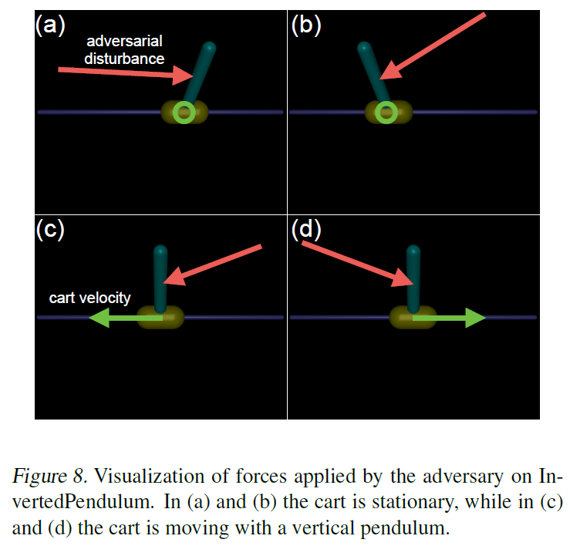
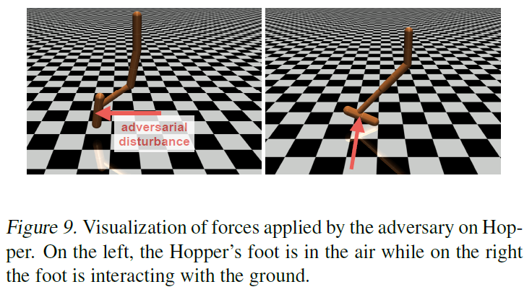
Actions of Adversary

Slide 36
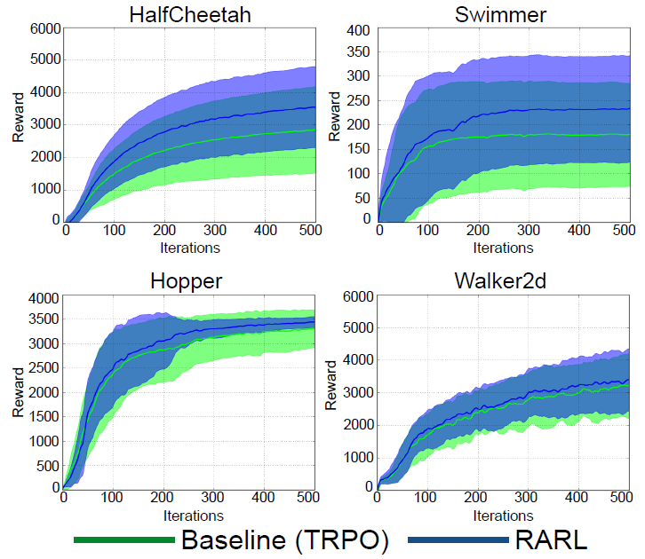
Results
RARL achieves better mean than Baseline.
Notes:
Well: for some Baseline is better (gets better cumulative reward), for others RARL

Slide 37
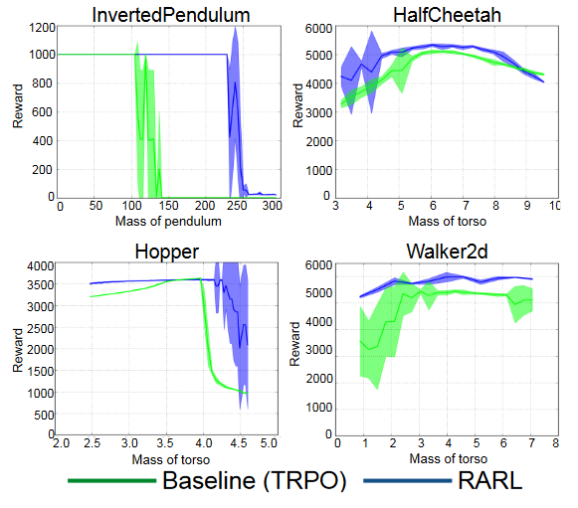
Results Robustness to Changing Mass
Inverted Pendulum:
- mass of pendulum changed.
For others:
- mass of torso changed.

Slide 38
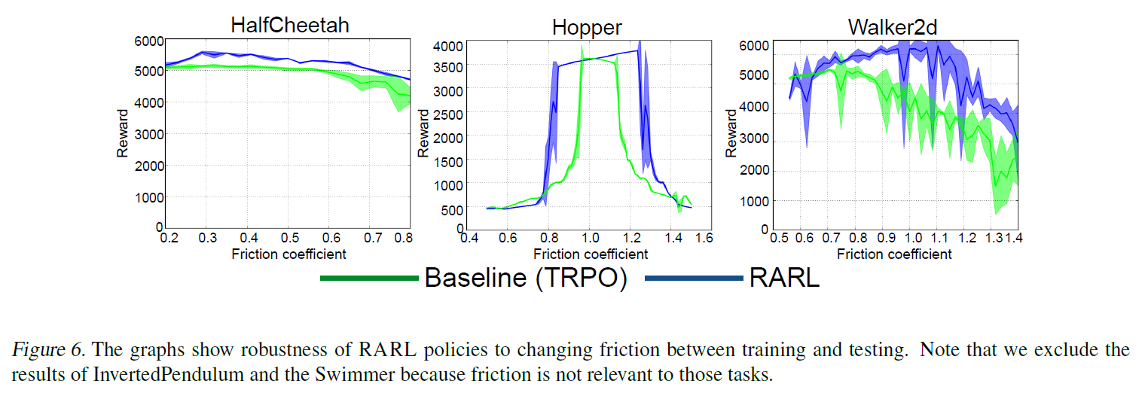
Results Robustness to Changing Friction

Slide 39
Conclusions Experiment Results
improves training stability
is robust to differences in training/test conditions
outperform the baseline even in the absence of the adversary

Slide 40
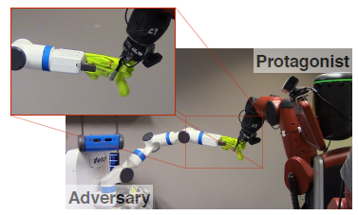
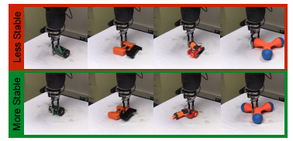
Discussion
Results for completely simulated environments: how does it translate to the real world?
Adversary can be very easily too powerful. How do you incorporate/ formulate the adversary’s powers in your RARL model?
Can you think of a good hybrid setup: part simulator, part the real thing. Have the adversary coming from/to the real world into the simulation…
…
From [4] Pinto et al., 2016.

Slide 41
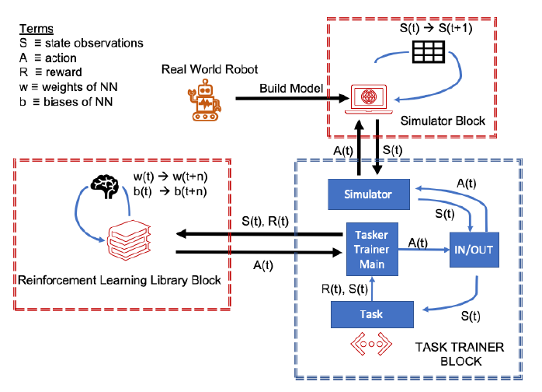
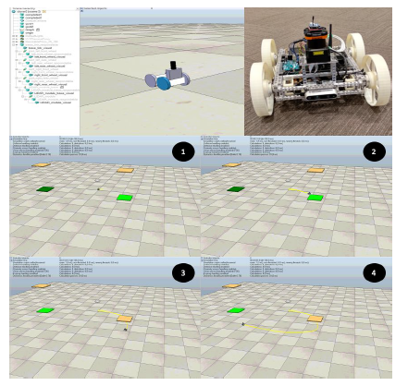
T. Blum et al. RL STaR Platform: Reinforcement Learning for Simulation based Training of Robots, i-SAIRAS2020, Oct. 2020.
CoppeliaSim (used in alternative
platforms with Pyrep)
OpenAI’s Baselines;
Stable Baselines,
Tenserflow RL Agents
https://github.com/Space-Robotics-Laboratory/rlstar ; Others: https://github.com/chauby/CoppeliaSimRL ;
https://github.com/stepjam/PyRep; most used https://gym.openai.com/

Slide 42
W. Zhao, et al., Sim-to-Real Transfer in Deep Reinforcement Learning for Robotics: a Survey, IEEE SSCI, 2020.
Zero-shot Transfer
build a realistic simulator; use extensive simulator time => direct transfer to real-world
System Identification
Use mathematical models and calibrate them to the real environment
Domain Randomization
Visual randomization, and/or dynamics randomization of simulator
Domain Adaptation
Use data from source domain to further train the model.
Learning with Disturbances
Noisy rewards; environmental perturbations (when learning in parallel); etc.
Simulation Environments
Gazebo (with ROS), Unity3D, PyBullet, MuJuCo (last 2 good integration with DL and RL)

Slide 43
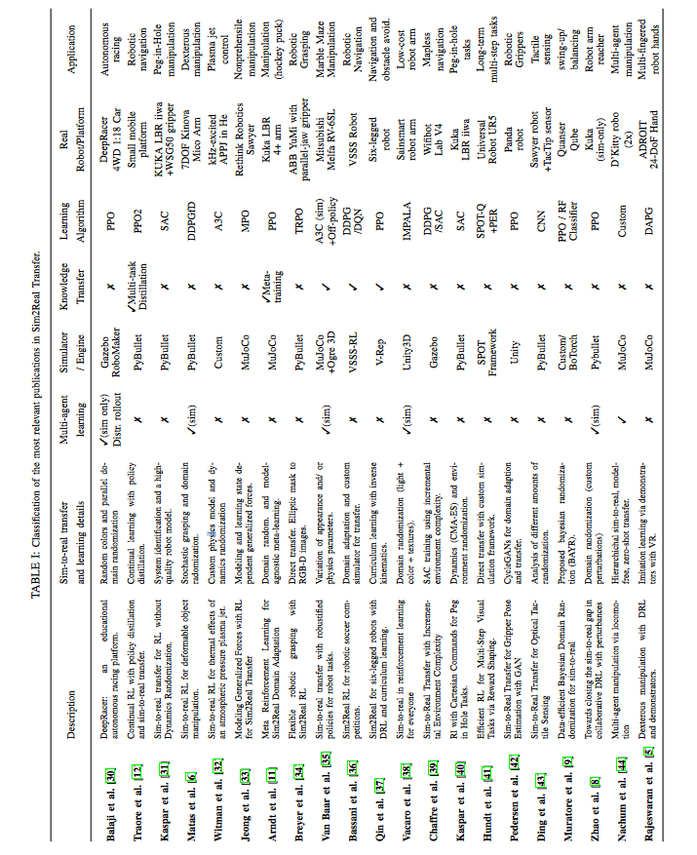
See the original
paper by Zhao et al. [8]
for a more careful look
at this table.

Slide 44
Very nice primer for RL to have a look at:
https://spinningup.openai.com/en/latest/spinningup/rl_intro.html
MuJoCo is a proprietary software that requires a license,
There is a free trial and above that it is free for students.

Slide 45
References
L. Pinto, J. Davidson, R. Sukthankar, A. Gupta, Robust Adversarial Reinforcement Learning, Proceedings of the 34th International Conference on Machine Learning, PMLR 70:2817-2826, 2017.
S. Gu, E. Holly, T. Lillicrap, S. Levine, Deep Reinforcement Learning for Robotic Manipulation with Asynchronous Off-Policy Updates, arXiv:1610.00633v2 [cs.RO], October 2016.
C. Finn, S. Levine, Deep Visual Forsight for Planning Robot Motion, arXiv:1610.00696, ICRA 2017, October 2016.
L. Pinto, J. Davidson, A. Gupta, Supervision via Competition: Robot Adversaries for Learning Tasks, arXiv:1610.01685, ICRA 2017, October 2016.
K. Bousmalis, N. Silberman, D. Dohan, D. Erhan, D. Krishnan, Unsupervised Pixel–Level Domain Adaptation with Generative Adversarial Networks, arXiv:1612.05424, CVPR 2017, December 2016.
A. Banino et al., Vector-based navigation using grid-like representations in artificial agents, https://doi.org/10.1038/s41586-018-0102-6, Research Letter, Nature, 2018.
R. Borst, Robust self-balancing robot mimicking, Bachelor Thesis, August 2017
W. Zhao, J.P. Queralta, T. Westerlund, Sim-to-Real Transfer in Deep Reinforcement Learning for Robotics: a Survey, 2020 IEEE Symposium Series on Computational Intelligence (SSCI), 2020.

Slide 46
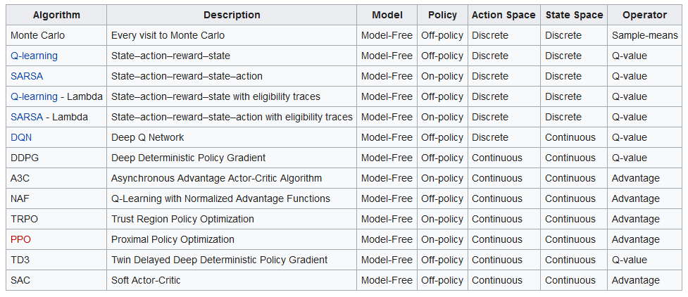

Slide 47
Agent: Robot
Environment
State
Action
Reward

