Slide 1
Reinforcement Learning for Robotics
Erwin M. Bakker
LIACS Media Lab

Slide 2
Reinforcement Learning
E. Charniak, Introduction to Deep Learning. The MIT Press, 2018.
R. Atienza, Advanced Deep Learning with Keras: Apply deep learning techniques, autoencoders, GANs, variational autoencoders, deep reinforcement learning, policy gradients, and more, 2018.
R.S. Sutton, A.G. Barto, Reinforcement Learning: An Introduction (Adaptive Computation and Machine Learning series) 2nd Edition, 2018

Slide 3
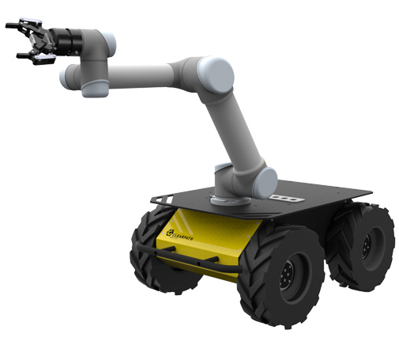
Reinforcement Learning
Environment
Agent: Robot
State
Action
Reward
Agent: e.g. a Robot
Environment: is in a certain state.
Actions of the Agent :
Environment transitions to a new state
Agent receives a reward
Policy: decides for each given state which action should be taken.
Goal: Learn a policy that maximizes the accumulated future rewards

Slide 4
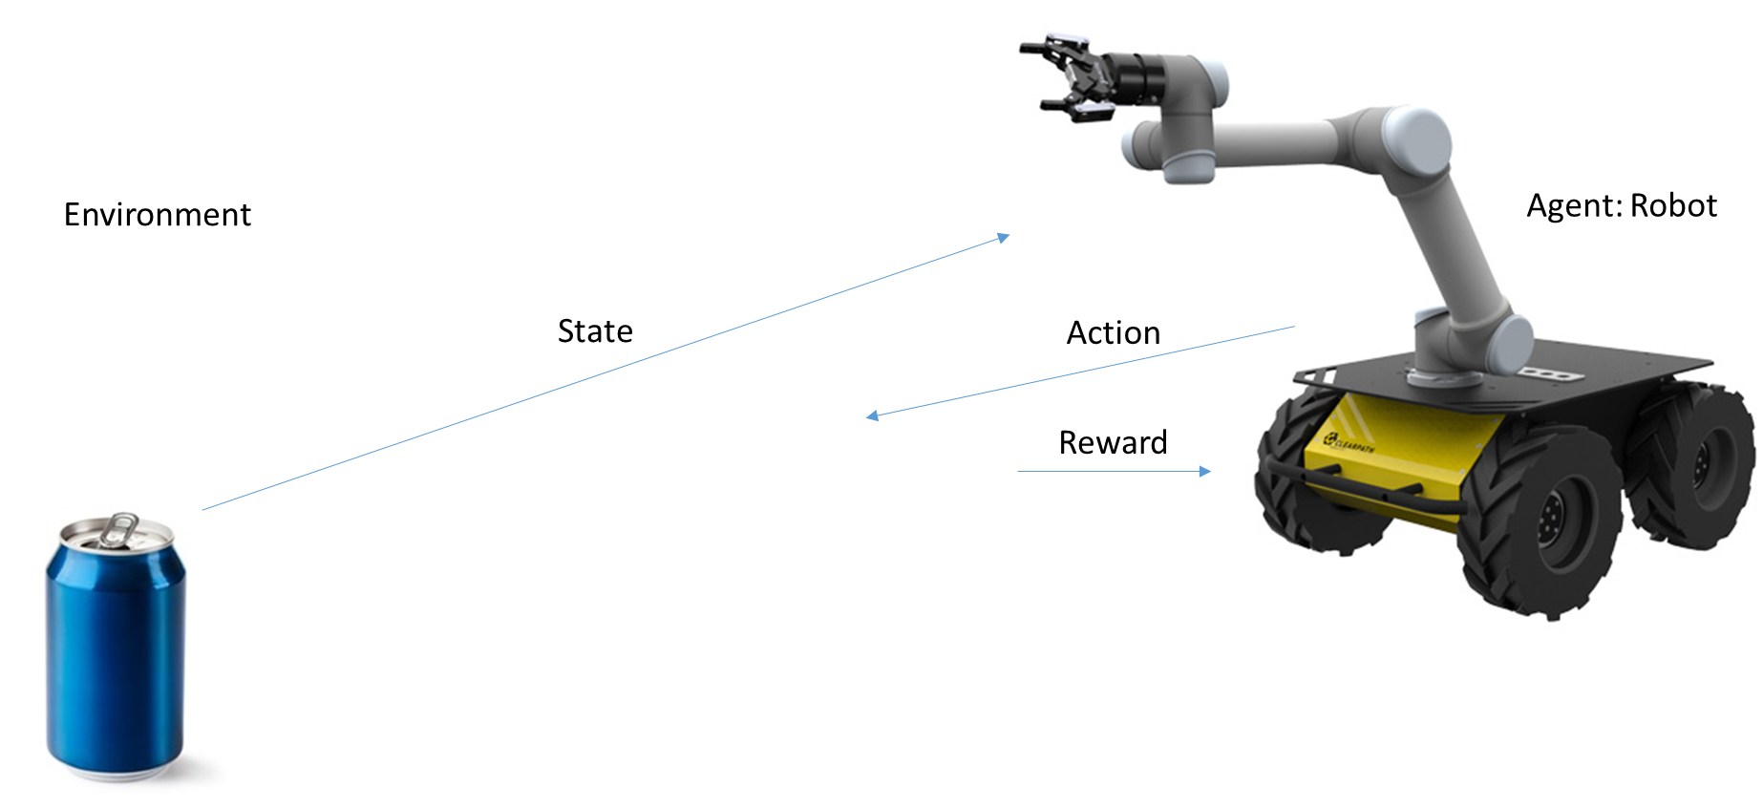
Markov Decision Process
Environment
At time step t the environment is in state $s_{t}∈S$,
where S is the state space, $s_{0}$ is the start state, $s_{t}$ is the end state.
Actions
The agent takes actions from the action space A, following a policy $π\left(a_{t} | s_{t}\right)$,
i.e., when the agent finds the environment in state $s_{t}$, it follows policy $π$ and takes action $a_{t}$ (can be deterministic, or probabilistic)
The environment uses the state transition $T\left(s_{t+1} | s_{t},a_{t}\right)$.
The agent receives a reward $R_{t+1}=R\left(s_{t},a_{t}\right)$

Slide 5
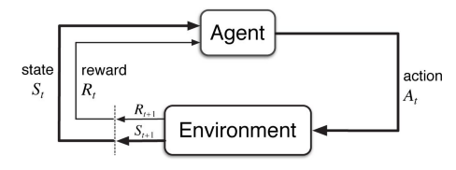
Agent-Environment Interaction
The MDP and Agent give rise to a trajectory: S₀, A₀, R₁, S₁, A₁, R₂, S₂, A₂, R₃, S₃, …

Slide 6
Markov Decision Process (MDP)
Environment at time t in state $s_{t}∈S.$
Action: - $a_{t}$ following $π\left(a_{t} | s_{t}\right)$
Result: - Environment state transition $T\left(s_{t+1} | s_{t},a_{t}\right)$.
- Agent’s reward $R_{t+1}=R\left(s_{t},a_{t}\right)$
Note:
T, and R may or may not be known to the agent.
Future rewards can be discounted by $γ^{k}$, where $γ∈\left[0,1\right]$, and k a future time step.
Process can be episodic: then H a horizon is used, with T the number of time steps to complete one episode from $s_{0}$ to $s_{t}$.

Slide 7
Reinforcement Learning (RL)
Environment
Can be fully or partially observable (POMDP)
For the decision process sometimes past observations are also taken into account.
For obeying the Markov-property, all information should be maintained in the current state.
Our robot agent:
State can be a camera estimate of the 3D position of the soda can with respect to the gripper.
Reward
+1, if the robot gets closer to the soda can.
-1, if the robot gets farther away from the soda can.
+100 when it successfully picks up the soda can.

Slide 8
Markov Decision Process (MDP) Framework
Time
can be abstract, stages
Actions
can be low-level (voltages applied to a motor in a robot arm) or
high level (grab lunch, grab can, recharge, etc.)
Abstract internal
Environment and States
can be low-level (sensor readings) or
high level (symbolic descriptions of objects),
past sensations, subjective, etc.

Slide 9
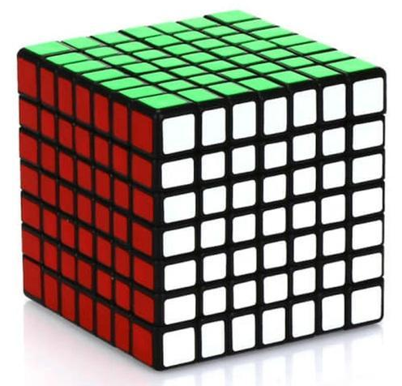
Markov Decision Process (MDP) Framework
Boundary between Environment and Agent:
motors, links, and sensors part of environment
Represents the limit of the agent’s absolute control, not of it’s knowledge
Note: An Agent may know everything about how it’s environment works, but still it would be a challenging reinforcement learning task.

Slide 10
Example: Pick and Place Robot
Task:
Reinforcement Learning to control the motion of a robot arm in a repetitive pick and place task.
Goal: fast and smooth movements
Agent needs:
Direct low level control of motors
Low-latency information of position and velocities of mechanical links
Actions
Voltage applied to each motor at each oint
Readings of joint angles and velocities
Reward
+1 for each object that is picked and placed
Small negative reward as function of the jerkiness of the motion (per moment).

Slide 11
Example: Recycling Robot
transition
action prob.
reward
Action Node
State Node
High level agent decides to search, wait or recharge:
Two charge levels: high, low
Action set: π(high)={search, wait}, π(low) = {search, wait, recharge}

Slide 12
Goals and Rewards
Agent receives at each time step a reward R_{t}
Goal is to maximize the total amount of received rewards.
The maximization of the expected value of the cumulative sum of a received scalar signal (called reward).
More formally:
Sequence of rewards after time step t: R_{t+1}, R_{t+2}, R_{t+3}, …
T final time step, sum of rewards G_{t} = R_{t+1} + R_{t+2} + R_{t+3} +… + R_{T}

Slide 13
Reinforcement Learning (RL)
Goal:
Maximize the expected discounted return:
$$G_{t}=R_{t+1}+{γR}_{t+2}+γ^{2}R_{T+3}+…=\sum_{k=0}^{∞}{γ^{k}R_{t+k+1}}, γ∈\left[0,1\right]$$
Note:
$γ∈\left[0,1\right] the discount rate.$
$γ=0$, if the immediate reward matters
$γ=1$, if future rewards weigh the same as the immediate reward

Slide 14
Reinforcement Learning (RL)
Goal:
Maximize the expected discounted return:
$$G_{t}=R_{t+1}+{γR}_{t+2}+γ^{2}R_{T+3}+…=\sum_{k=0}^{∞}{γ^{k}R_{t+k+1}}, γ∈\left[0,1\right]$$
Note:
$$G_{t}=R_{t+1}+{γR}_{t+2}+γ^{2}R_{T+3}+…$$
$=$ $R_{t+1}+{γ(R}_{t+2}+{γR}_{t+3}+γ^{2}R_{T+4}+…)$
$$=R_{t+1}+{γG}_{t+1}$$

Slide 15
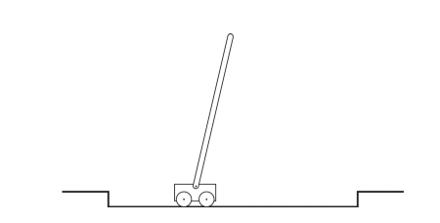
Example: Pole-Balancing
Objective: Apply forces to the cart such that pole does not fall over.
Failure: If pole falls, or cart runs off the track.
Task of pole-balancing seen as repeated attempts, episodes, during which it is balanced:
Reward: +1 for every time step without failure
reward = ∞ if successful balancing for ever.
Pole-balancing seen as a continuous task:
Reward: -1 on each failure, 0 otherwise.
=> reward related to $−γ^{K}$, where K is the number of time steps before failure.

Slide 16
Policies and Value Functions
Try to estimate value-functions (of states, or state-action pairs) that estimate for an agent:
how good it is to be in a state or
how good it is to perform a given action in given state
The value function of a state s under a policy π is defined as:
$v_{π}(s)=Ε_{π}\left[G_{t} | S_{t}=s\right]=Ε_{π}[\sum_{k=0}^{∞}{γ^{k}R_{t+k+1}\left|S_{t}=s\right]}$, for all $s∈S$
The expected return starting from s, taking action a and further on following policy π is defined as:
$$q_{π}(s,a)=Ε_{π}\left[G_{t} | S_{t}=s, A_{t}=a\right]=Ε_{π}[\sum_{k=0}^{∞}{γ^{k}R_{t+k+1}\left|S_{t}=s,A_{t}=a\right]}$$

Slide 17
Reinforcement Learning (RL)
Goal:
Learn an optimal policy $π^{∗}$, where
$$π^{∗}={argmax}_{π}G_{t}, where G_{t}=\sum_{k=0}^{T}{γ^{k}R_{t+k+1}}, γ∈\left[0,1\right], and R_{t+1}=R\left(s_{t},a_{t}\right)$$
Methods:
Brute Force, Tabular Methods, Monte Carlo Methods, DNN for RL, Adversarial RL.

Slide 18
[1] L. Pinto, J. Davidson, R. Sukthankar, A. Gupta, Robust Adversarial Reinforcement Learning, March 2017.
Deep neural networks success in the field of Reinforcement Learning:
Fast computations
Fast Simulations
Improved networks
But, most RL-based approaches fail to generalize, because:
gap between simulation and real world
policy learning in real world is hampered by data scarcity

Slide 19
RL Challenges for Real-world Policy Learning
The training of the agent’s policy
in the real-world:
too expensive
dangerous
time-intensive
=> scarcity of data.
=> training often restricted to a limited set of scenarios, causing overfitting.
=> If the test scenario is different (e.g., different friction coefficient, different mass), the learned policy fails to generalize.
But a learned policy should be robust and generalize well for different scenarios.

Slide 20
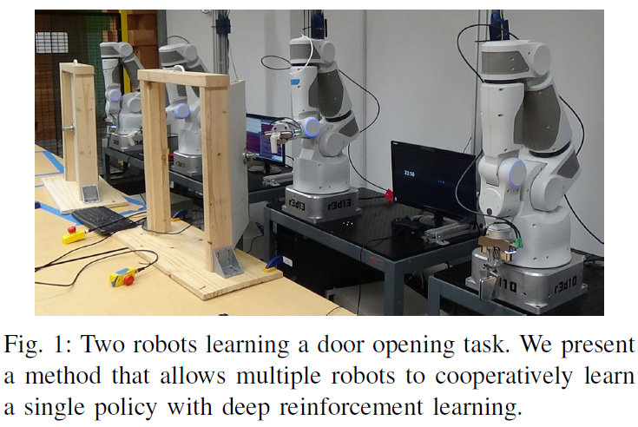
RL in the Real World: use more robots
From [2] Gu et al. , Nov. 2016.

Slide 21
Reinforcement Learning in simulation:
Facing the data scarcity in the real-world by
Learning a policy in a simulator
Transfer learned policy to the real world
But the environment and physics of the simulator
are not the same as the real world.
=> Reality Gap
This reality gap often results in unsuccessful transfer if the learned policy isn’t robust to modeling errors (Christiano et al., 2016; Rusu et al., 2016).
Notes:
Show Bullet

Slide 22
Robust Adversarial Reinforcement Learning (RARL)
Training of an agent in the presence of a destabilizing adversary
Adversary can employ disturbances to the system
Adversary is trained at the same time as the agent
Adversary is reinforced: it learns an optimal destabilization policy.
Here policy learning can be formulated as a zero-sum, minimax objective function.
Minimax in zero-sum games denotes minimizing the opponent's maximum payoff.
In a zero-sum game, this is identical to:
minimizing one's own maximum loss, and to
maximizing one's own minimum gain
Zero-sum game: gain and loss cancel each other out.

Slide 23
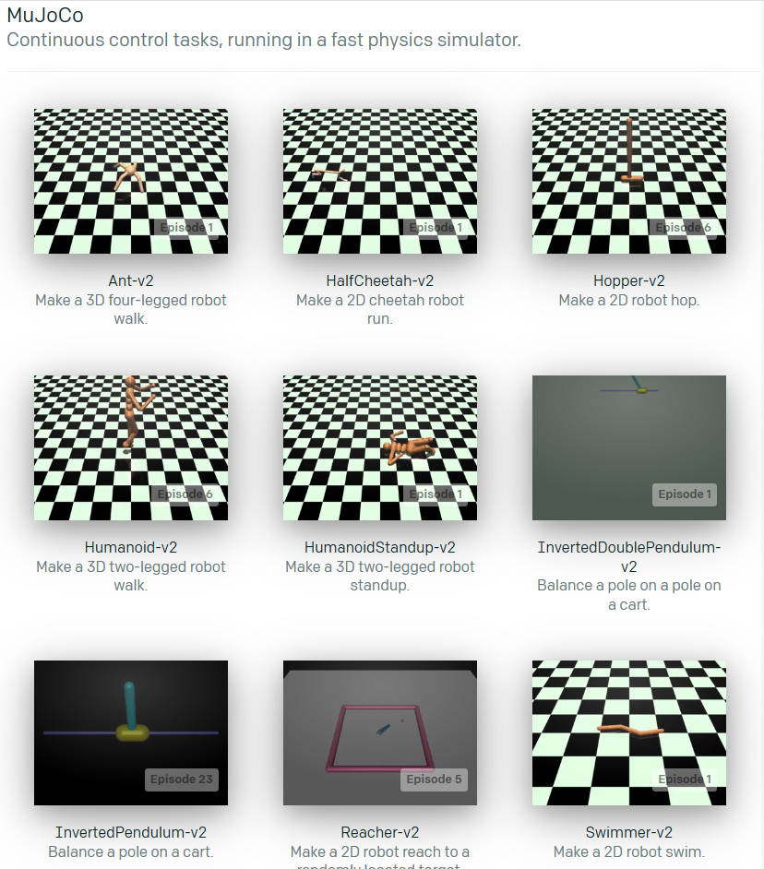
Experimental Environments
InvertedPendulum
HalfCheetah
Swimmer
Hopper
Walker2d
https://gym.openai.com/

Slide 24
Unconstrained Scenarios: Challenges
In unconstrained scenarios:
the space of possible disturbances could be larger than the space of possible actions
=> sampled trajectories for learning etc. even sparser

Slide 25
Challenges of unconstrained scenarios
Use adversaries for modeling disturbances:
we do not want to and can not sample all possible disturbances
we jointly train a second agent (the adversary)
goal of adversary is to impede the original agent (the protagonist)
by applying destabilizing forces.
rewarded only for the failure of the protagonist
=> the adversary learns to sample hard examples, disturbances that make original agent fail
the protagonist learns a policy that is robust to any disturbances created by the adversary.

Slide 26
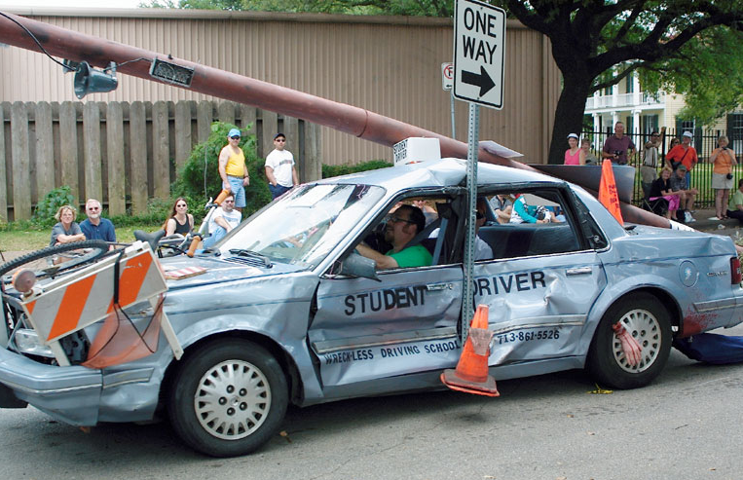
Challenges of unconstrained scenarios
Use adversaries that incorporate
domain knowledge:
Naïve: give adversary the same action space as the protagonist
Like a driving student and driving instructor fighting for control of a dual-control car.
Proposal paper:
exploit domain knowledge
focus on the protagonist’s weak points;
give the adversary “super-powers” – the ability to affect the robot or environment in ways the protagonist cannot (e.g. suddenly change frictional coefficient or mass).

Slide 27
Adversary with Domain Knowledge
Figure from [1].

Slide 28
Standard Reinforcement Learning (RL)
RL for continuous space Markov Decision Processes
(S, A, P, r, γ, s₀), where
S the set of continuous states
A the set of continuous actions
P: S x A x S → ℝ the transition probability
r: A → ℝ the reward function
γ the discount factor
s₀ the initial state distribution

Slide 29
Standard Reinforcement Learning (RL)
RL for continuous space Markov Decision Processes
(S, A, P, r, γ, s₀), where
S the set of continuous states
A the set of continuous actions
P: S x A x S → ℝ the transition probability
r: S x A → ℝ the reward function
γ the discount factor
s₀ the initial state distribution
Batch policy algorithms [Williams 1992, Kakade 2002, Shulman 2015]:
Learning a stochastic policy:
π_{θ}: S x A → ℝ which maximizes
$\sum_{t=0}^{T−1}{γ^{t}r(s_{t},a_{t})}$
the cumulative discounted reward
Θ the parameters of the policy π.
Policy π takes action a_{t} given state s_{t} at time t

Slide 30
2 Player γ discounted zero-sum Markov Game (Litman 1994, Perolat 2015)
2 Player continuous space Markov Decision Processes
(S, A₁, A₂, P, r, γ, s₀), where
S the set of continuous states
A the set of continuous actions
P: S x A₁ x A₂ x S → ℝ the transition probability
r: S x A₁ x A₂ → ℝ the reward function of both players
γ the discount factor
s₀ the initial state distribution
Let Player 1 use strategy μ and Player 2 use strategy ϑ , then the reward function is given by:
r_{μ,ϑ}=$E_{a^{1}\sim μ\left(. | s\right), a^{2}\sim θ\left(. | s\right)}[r\left(s,a^{1},a^{2}\right)]$
Player 1 will be maximizing while Player 2 minimizes the γ discounted reward.
(=> Zero Sum 2 player game)

Slide 31
RALR Algorithm
The initial parameters for both players’ policies are sampled from a random distribution.
Two phases
Learn the protagonist’s policy while holding the adversary’s policy fixed.
The protagonist’s policy is held constant and the adversary’s policy is learned.
Repeat until convergence.
In each phase a roll-function is used sampling the N_{traj} trajectories in environment ℇ .
ℇ contains the transition function P and reward functions r¹ and r²

Slide 33
Experimental Setup
Environments built using OpenAI gym’s (Brockman et al., 2016).
Control of environments with the MuJoCo physics simulator (Todorov et al., 2012) .
RARL is built on top of rllab (Duan et al., 2016)
Baseline: Trust Region Policy Optimization (TRPO) (Schulman et al., 2015)
For all the tasks and for both the protagonist and adversary,
a policy network with two hidden layers with 64 neurons per layer is used.
RARL and the baseline are trained with
100 iterations on InvertedPendulum
500 iterations on the other environments
Hyperparameters of TRPO are selected by grid search.

Slide 34
Experiments
InvertedPendulum
State space 4D: position, velocity
Protagonist: 1D forces; Adversary: 2D forces on center of pendulum
HalfCheetah
State space 17D: joint angles and joint velocities, …
Adversary: 6D actions with 2D forces
Swimmer
State space 8D: joint angles and joint velocities, …
Adversary: 3D forces to center of swimmer
Hopper
State space 11D: joint angles and joint velocities, …
Adversary: 2D force on foot
Walker2d
State space 17D: joint angles and joint velocities, …
Adversary: 4D actions with 2D forces on both feet

Slide 35
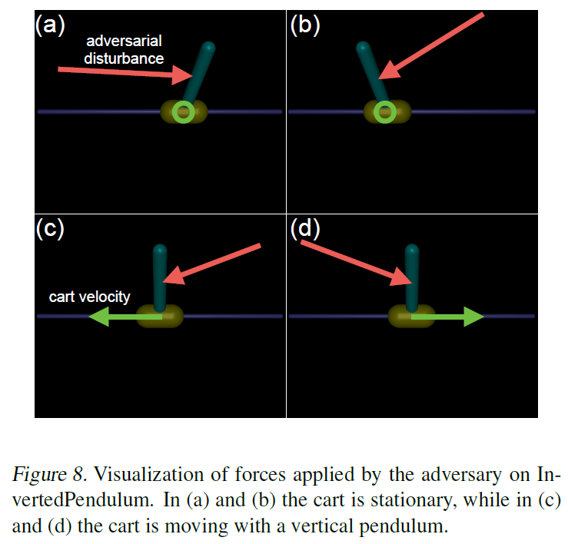
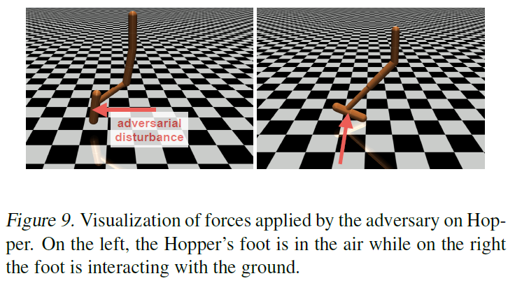
Actions of Adversary

Slide 36
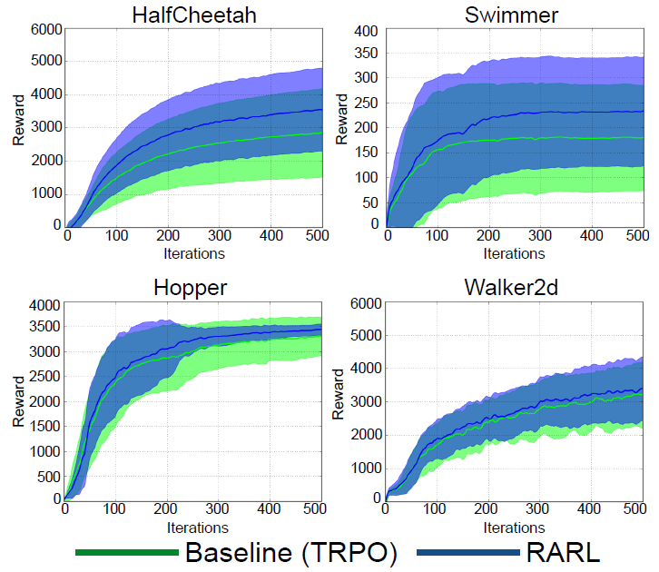
Results

Slide 37
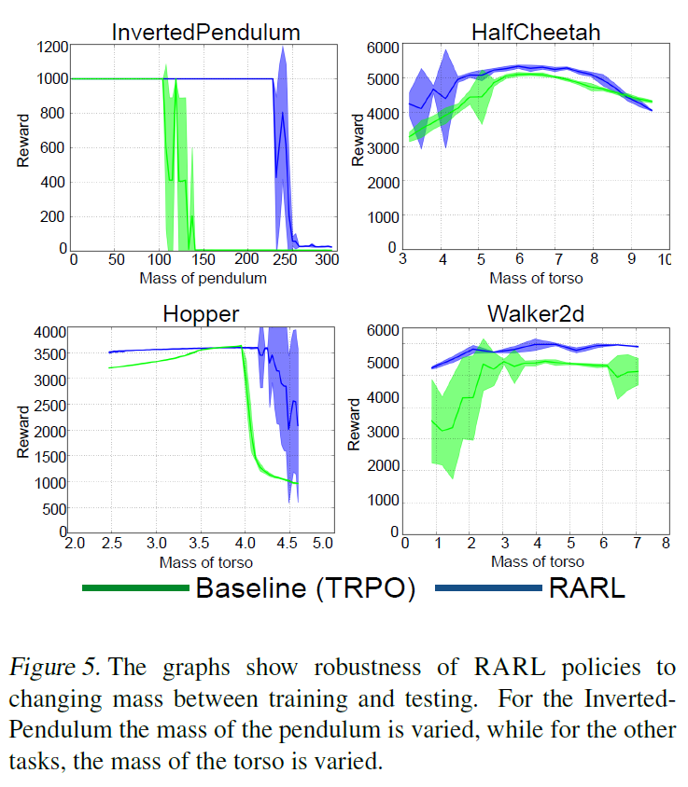
Results Robustness to Changing Mass

Slide 38
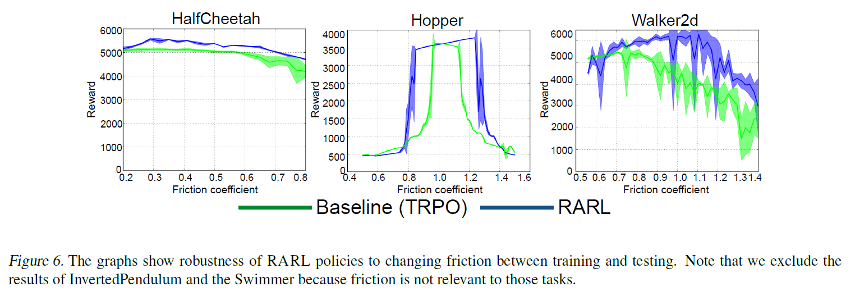
Results Robustness to Changing Friction

Slide 39
Conclusions Experiment Results
improves training stability
is robust to differences in training/test conditions
outperform the baseline even in the absence of the adversary

Slide 40
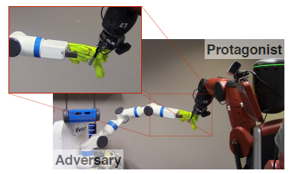
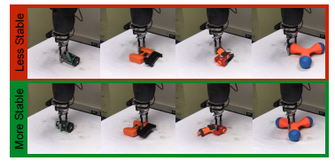
Discussion
Results for completely simulated environments: how does it translate to the real world?
Adversary can be very easily too powerful. How do you incorporate/ formulate the adversary’s powers in your RARL model?
Can you think of a good hybrid setup: part simulator, part the real thing. Have the adversary coming from/to the real world into the simulation…
…
From [4] Pinto et al., 2016.

Slide 41
References
L. Pinto, J. Davidson, R. Sukthankar, A. Gupta, Robust Adversarial Reinforcement Learning, arXiv:1703.02702, March 2017.
S. Gu, E. Holly, T. Lillicrap, S. Levine, Deep Reinforcement Learning for Robotic Manipulation with Asynchronous Off-Policy Updates, arXiv:1610.00633v2 [cs.RO], October 2016.
C. Finn, S. Levine, Deep Visual Forsight for Planning Robot Motion, arXiv:1610.00696, ICRA 2017, October 2016.
L. Pinto, J. Davidson, A. Gupta, Supervision via Competition: Robot Adversaries for Learning Tasks, arXiv:1610.01685, ICRA 2017, October 2016.
K. Bousmalis, N. Silberman, D. Dohan, D. Erhan, D. Krishnan, Unsupervised Pixel–Level Domain Adaptation with Generative Adversarial Networks, arXiv:1612.05424, CVPR 2017, December 2016.
A. Banino et al., Vector-based navigation using grid-like representations in artificial agents, https://doi.org/10.1038/s41586-018-0102-6, Research Letter, Nature, 2018.
R. Borst, Robust self-balancing robot mimicking, Bachelor Thesis, August 2017

