Slide 1
Robotic Vision
E.M. Bakker

Slide 2
Overview
OpenCV
Some Neural Networks and AlexNet
Computer Vision and Pattern Recognition (CVPR)
Object Tracking
Human Robot Interaction
Some problems with Neural Networks
…
Notes:
/build/bin/release/ facedetect, lkdemo, edge

Slide 3
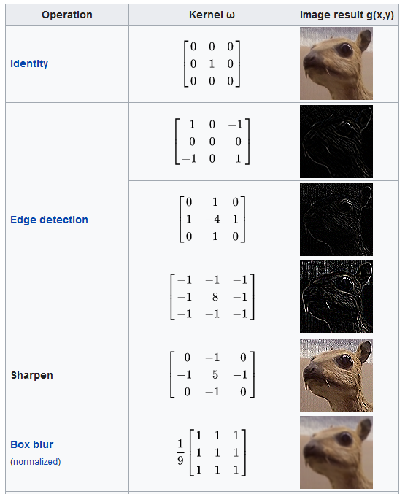
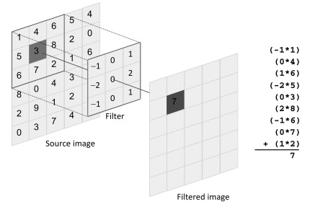
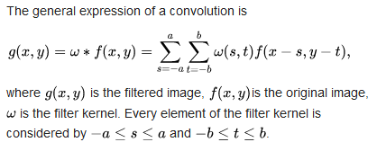
OpenCV
Low level image processing.
Convolutional Kernels: filters, edge detectors, etc.
Blob tracking
Face and people detector
Neural networks
Wikipedia
Image from [1].
[1] https://www.sciencedirect.com/topics/computer-science/convolution-filter
Wikipedia

Slide 4
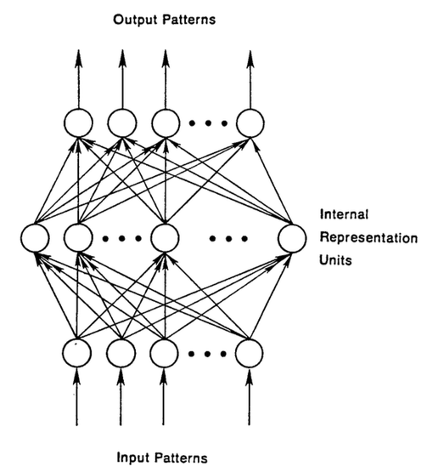
Some Neural Networks
Feed Forward Neural Network
Recurrent Neural Network

Slide 5
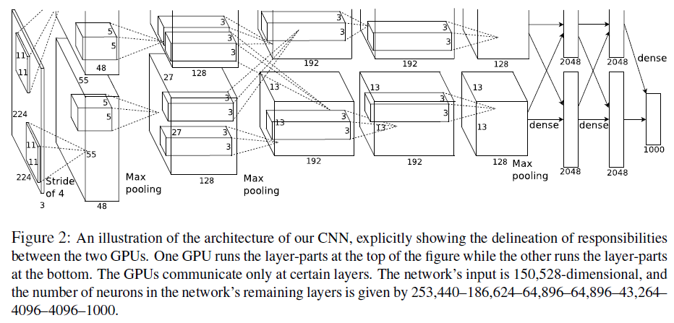
DNN: AlexNet, VGG16, ResNet, etc.
Krizhevsky, Alex; Sutskever, Ilya; Hinton, Geoffrey E. "ImageNet classification with deep convolutional neural networks" Communications of the ACM. 60 (6): 84–90.
Notes:
Max pooling sample based discretization method: down sampling, dimensionality reduction, etc.
Stride of 4, is an extra area around the image to make the convolutional operations faster.
2x 48 = 96 results of the 96 convolutional filters (no pooling)

Slide 6
AlexNet Visualization

Slide 7
Object Tracking
Conference on Computer Vision and Pattern Recognition (CVPR)
Real-Time Tracking
A. He et al. A Twofold Siamese Network for Real-Time Object Tracking
B. Yang et al. PIXOR: Real-Time 3D Object Detection From Point Clouds
B. Tekin et al., Real-Time Seamless Single Shot 6D Object Pose Prediction

Slide 8
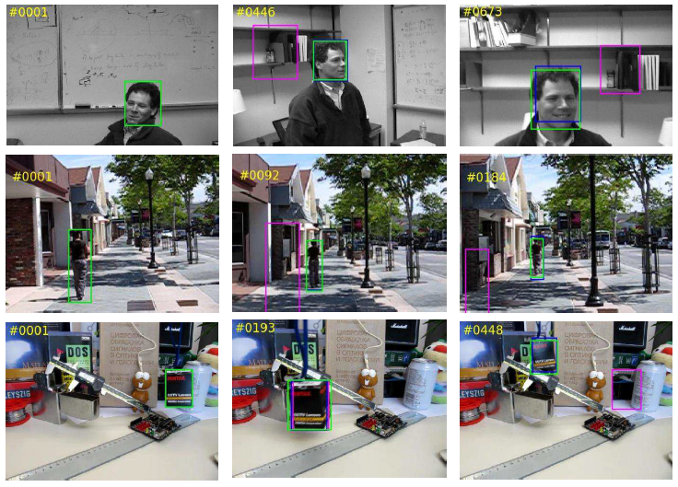
A. He et al. A Twofold Siamese Network for Real-Time Object Tracking, CVPR2018.
Green is ground truth.
Purple is tracked by SiamFC.
Blue is tracked by the novel twofold Siamese network 2FSiamFC.
2FSiamFC is more robust to shooting angle change and scale change.

Slide 9
A. He et al. A Twofold Siamese Network for Real-Time Object Tracking, CVPR2018.
Object Tracking is a similarity learning problem
Compare the target image patch with the candidate patches in a search region.
Track the object to the location where the highest similarity score is obtained.
Similarity learning with deep CNNs is done using so called Siamese architectures (SiamFC).
CNNs can process a larger search image where all sub-windows are evaluated as similarity candidates. (Efficient.)

Slide 10
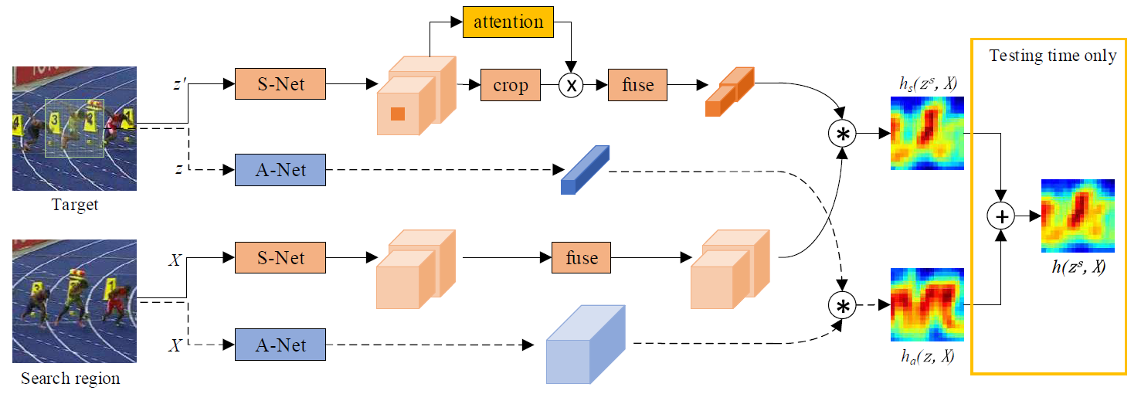
A-Net is an appearance network.
The dotted lines is a SiamFC (Fully Convolutional Siamese Network Bertinetto et al. 2016.)
S-Net is a semantic network.
The channel attention module determines the weight for each feature channel based on both target and context information.
Appearance branch and Semantic branch are trained separately.
Notes:
The architecture of the proposed twofold SA-Siam network. A-Net indicates the appearance network. The network and data
structures connected with dotted lines are exactly the same as SiamFC [3]. S-Net indicates the semantic network. Features from the last
two convolution layers are extracted. The channel attention module determines the weight for each feature channel based on both target
and context information. The appearance branch and the semantic branch are separately trained and not combined until testing time.

Slide 11
B. Yang et al. PIXOR: Real-Time 3D Object Detection From Point Clouds (CVPR2018)
PIXOR, a proposal-free, single-stage detector that outputs oriented 3D object estimates decoded from pixel-wise neural network predictions.
real-time 3D object detection from point clouds in the context of autonomous driving.
3D data by representing the scene from the Bird’s Eye View (BEV)
Evaluation 10fps state-of-the-art: using the KITTI BEV object detection benchmark, and a large-scale 3D vehicle detection benchmark.

Slide 12
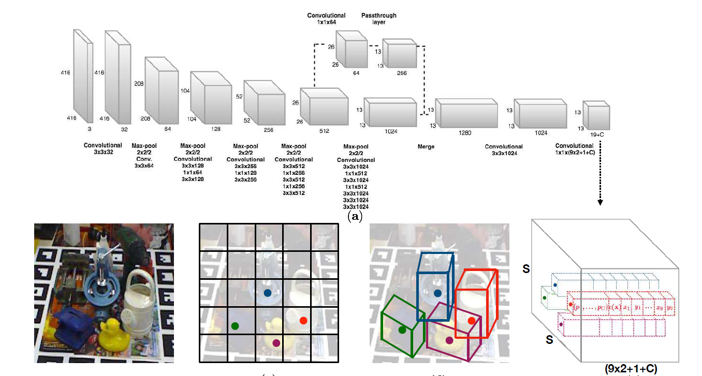
Tekin et al., Real-Time Seamless Single Shot 6D Object Pose Prediction (CVPR2018)
Notes:
6D = Location and Orientation

Slide 13
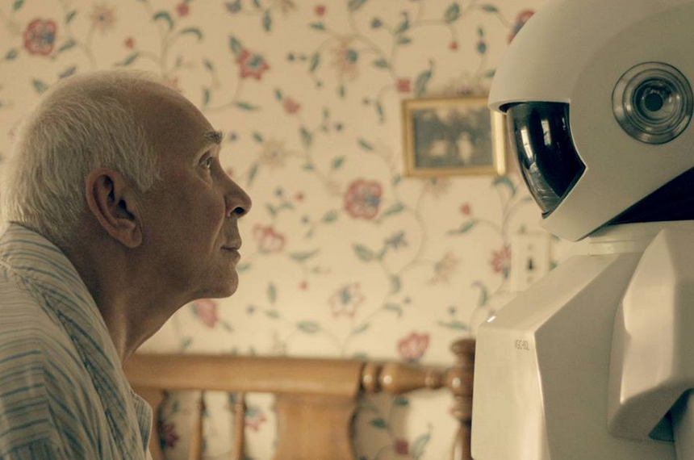
Human Robot Interaction
Face Recognition
Pose Recognition
Hand Tracking
Person Tracking
Emotion Recognition
Action Recognition

Slide 14
Face Recognition
Yancheng Bai, et al., Finding Tiny Faces in the Wild With Generative Adversarial Network, CVPR, 2018.
Xuanyi Dong, et al., Aggregated Network for Facial Landmark Detection, CVPR, 2018.
Yaojie Liu, et al., Learning Deep Models for Face Anti-Spoofing: Binary or Auxiliary Supervision, CVPR, 2018.
CVPR2018 58 papers on Face Recognition
CVPR2019 similar

Slide 15
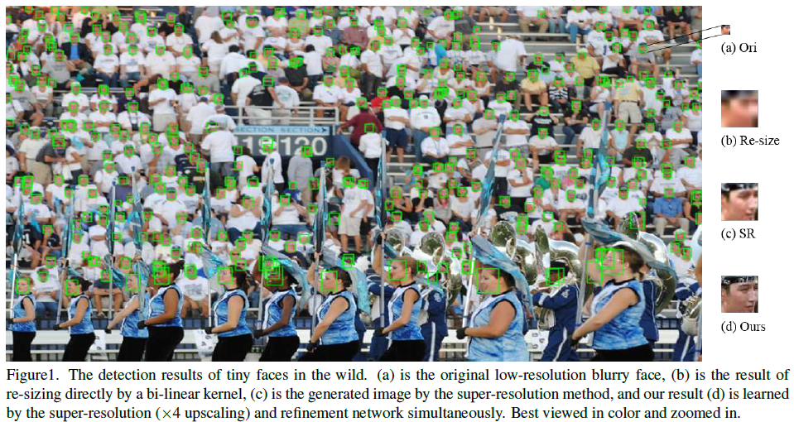
Yancheng Bai, et al., Finding Tiny Faces in the Wild With Generative Adversarial Network, CVPR, 2018.

Slide 16
Generative Adversarial Network.
Notes:
The pipeline of the proposed tiny face detector system.
(A) The images are fed into the network;
(B) MB-FCN detector is our
baseline, it crops the positive data (i.e. faces) and negative data (i.e. non-faces) from the input images for training the generator network
and the discriminator network, or generates the regions of interest (ROIs) for testing.
(C) The positive data and negative data (or ROIs)
are generated by the MB-FCN detector.
(D) The generator network is trained to reconstruct a clear super-resolution image (4× upscaling)
from the low-resolution input image, which includes the upsample sub-network and the refinement sub-network.
(D) The discriminator
network is the vgg19 architecture with two parallel fc layers, and the first fc layer is to distinguish the natural real images or the generated
super-resolution images and the second one is to classify faces or non-faces.

Slide 17
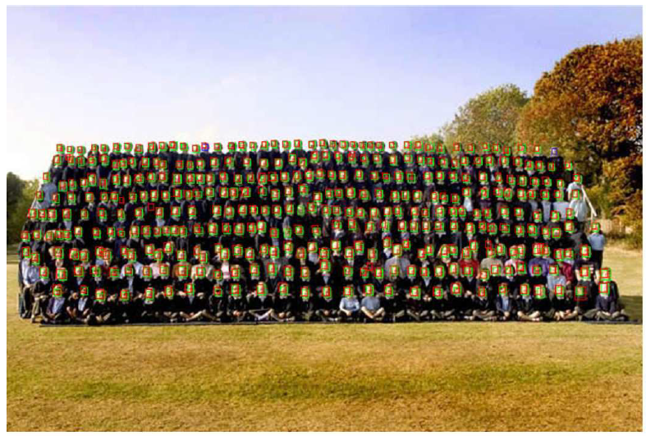
Some Qualitative Results Green ground truth, red selected by the network.

Slide 18
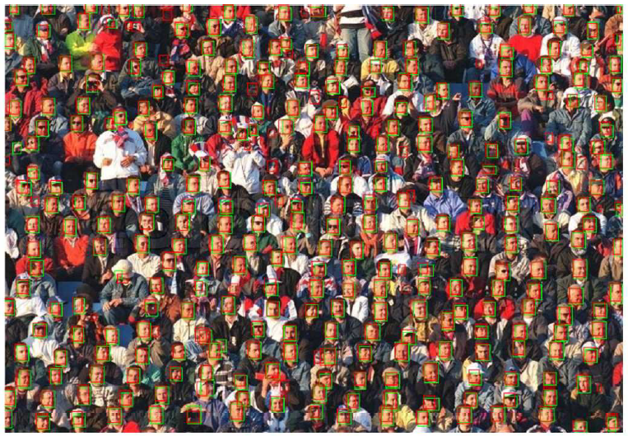
Some Qualitative Results Green ground truth, red selected by the network.

Slide 19
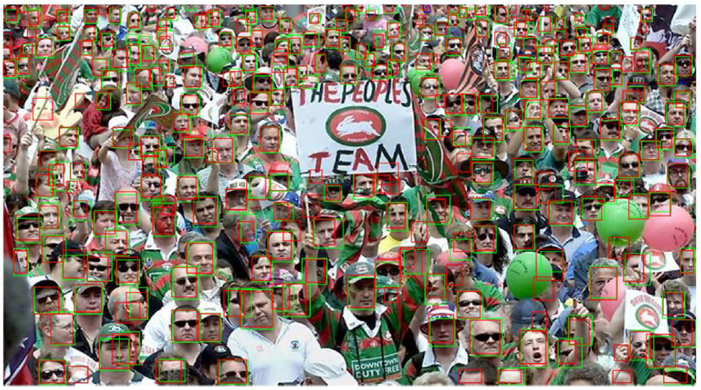
Some Qualitative Results Green ground truth, red selected by the network.

Slide 20
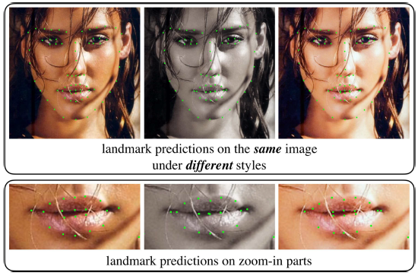
Xuanyi Dong, et al., Aggregated Network for Facial Landmark Detection, CVPR2018.
Landmark detection robust to ‘style’ changes: dark, light, color, gray. (300-W data set.)

Slide 21
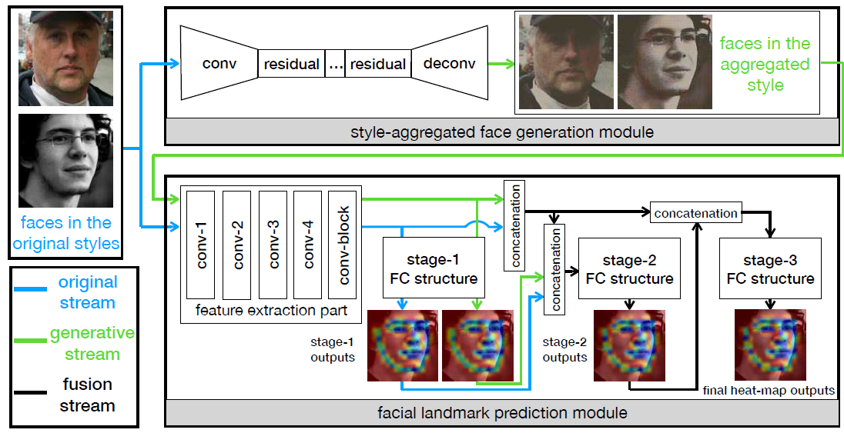
Xuanyi Dong, et al., Aggregated Network for Facial Landmark Detection, CVPR, 2018.
From VGG-16.
Landmark detection robust to ‘style’ changes: dark, light, color, gray. (300-W data set.) Network uses a GAN for generated aggregated styles (green lines).

Slide 22
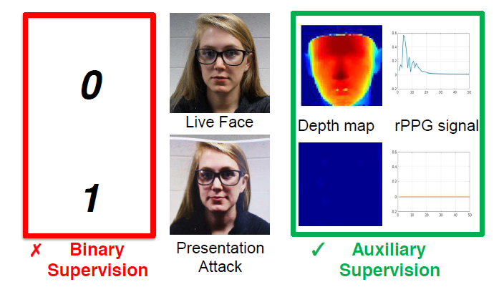
Yaojie Liu, et al., Learning Deep Models for Face Anti-Spoofing: Binary or Auxiliary Supervision, CVPR2018.
Use extra, live information for face recognition in order to make spoofing more difficult.

Slide 23
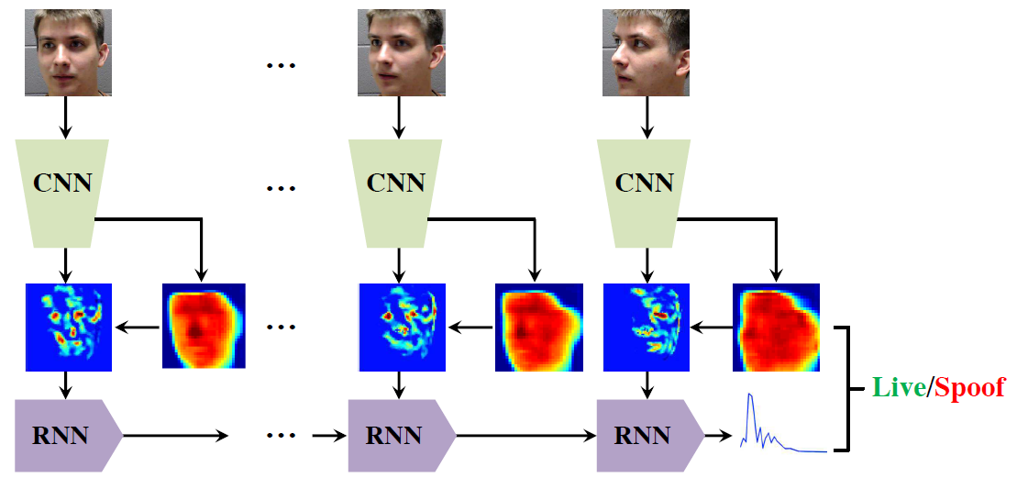
Yaojie Liu, et al., Learning Deep Models for Face Anti-Spoofing: Binary or Auxiliary Supervision, CVPR, 2018.

Slide 24
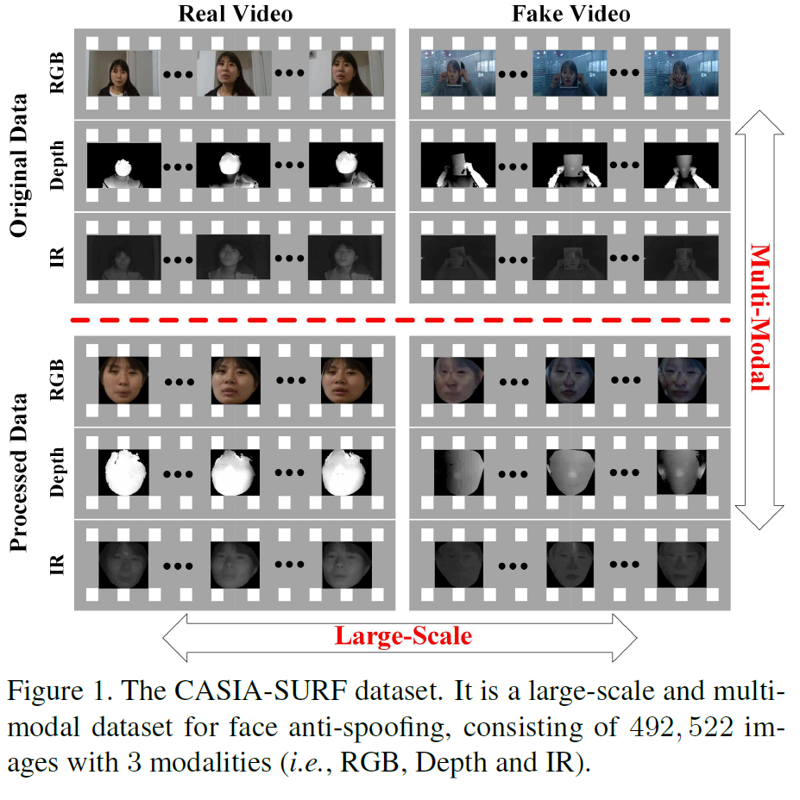
S. Zhang et al. A Dataset and Benchmark for Large-scale Multi-modal Face Anti-spoofing. CVPR2019
Notes:
• Attack 1: One person hold his/her flat face photo where eye regions are cut from the printed face.
• Attack 2: One person hold his/her curved face photo where eye regions are cut from the printed face.
• Attack 3: One person hold his/her flat face photo where eyes and nose regions are cut from the printed face.
• Attack 4: One person hold his/her curved face photo where eyes and nose regions are cut from the printed face.
• Attack 5: One person hold his/her flat face photo where eyes, nose and mouth regions are cut from the printed face.
• Attack 6: One person hold his/her curved face photo where eyes, nose and mouth regions are cut from the printed face.

Slide 25
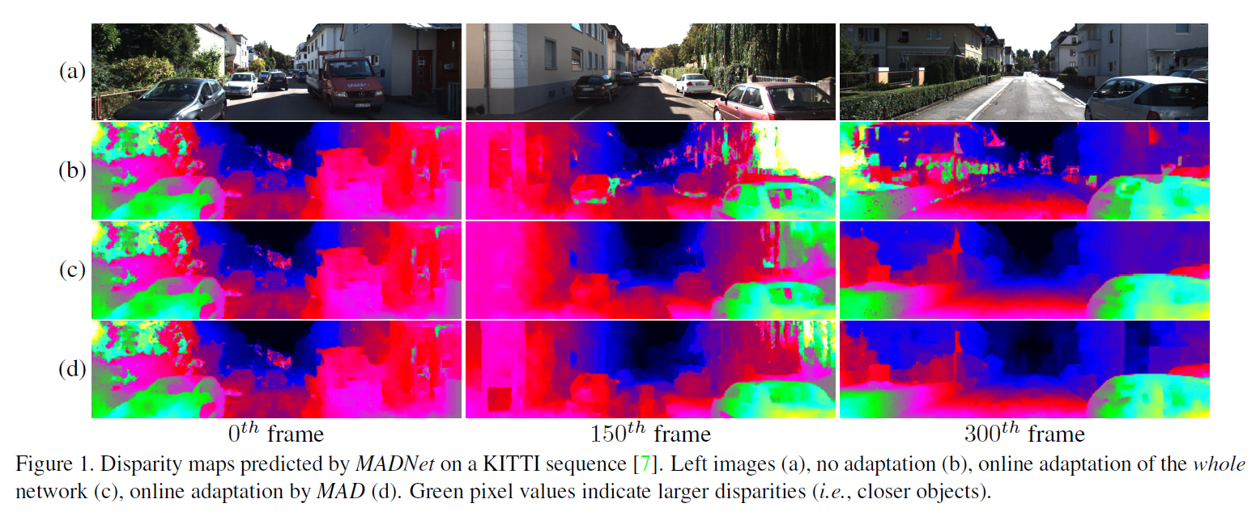
A. Tonioni et al. Real-time self-adaptive deep stereo. CVPR2019 https://github.com/CVLAB-Unibo/Real-time-self-adaptive-deep-stereo
Notes:
Instead, we propose to perform unsupervised and continuous online adaptation of a deep stereo
network, which allows for preserving its accuracy in any environment. However, this strategy is extremely computation-
ally demanding and thus prevents real-time inference. We address this issue introducing a new lightweight, yet effec-
tive, deep stereo architecture, Modularly ADaptive Network (MADNet), and developing a Modular ADaptation (MAD)
algorithm, which independently trains sub-portions of the network.

Slide 26
Hand Pose Recogntion
F. Mueller, et al., GANerated Hands for Real-Time 3D Hand Tracking From Monocular RGB, CVPR2018.
G. Garcia-Hernando, et al., First-Person Hand Action Benchmark With RGB-D Videos and 3D Hand Pose Annotations, CVPR2018.

Slide 27
F. Mueller, et al., GANerated Hands for Real-Time 3D Hand Tracking From Monocular RGB, CVPR2018.
Input: RGB Image
Output: Hand Pose Skeleton.

Slide 28
F. Mueller, et al., GANerated Hands for Real-Time 3D Hand Tracking From Monocular RGB, CVPR, 2018.
Real-time 3D hand tracking from monocular RGB-only input.
Works on unconstrained videos from YouTube
Is robust to occlusions.
Real-time 3D hand tracking using an off-the-shelf RGB webcam in unconstrained setups.

Slide 29
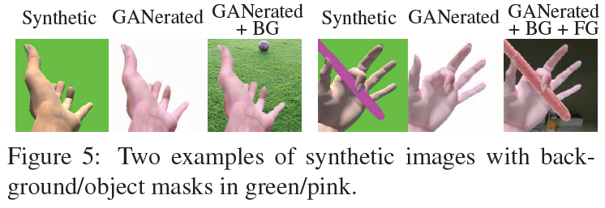
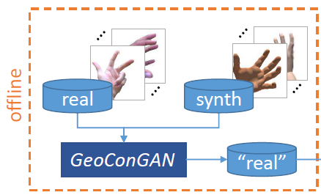
F. Mueller, et al., GANerated Hands for Real-Time 3D Hand Tracking From Monocular RGB, CVPR, 2018.
GeoConGAN produces ‘real’ images from synthetic images. These ‘real’ images are then used to train RegNet.
The trained RegNet is used to recognize global 3d hand poses in real time from RGB video streams.

Slide 30
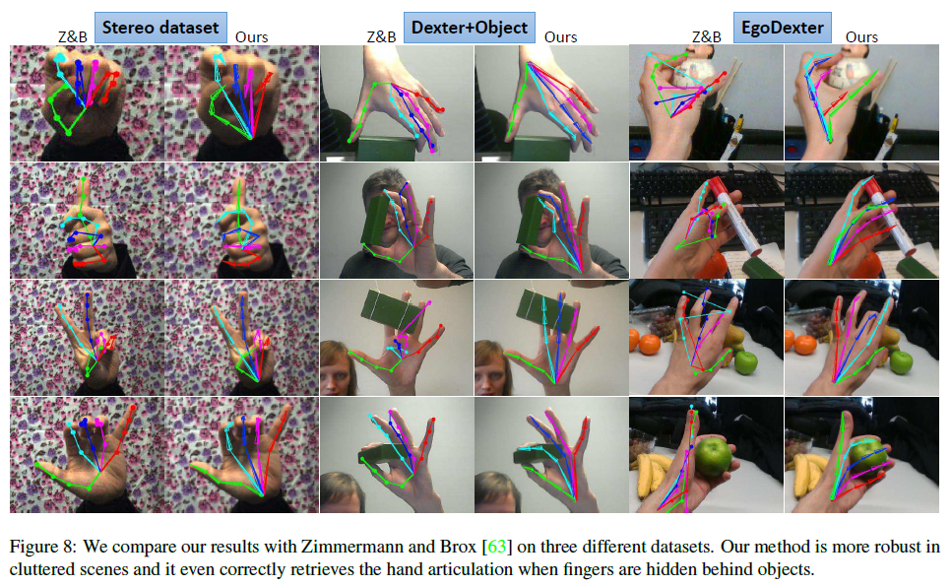

Slide 31
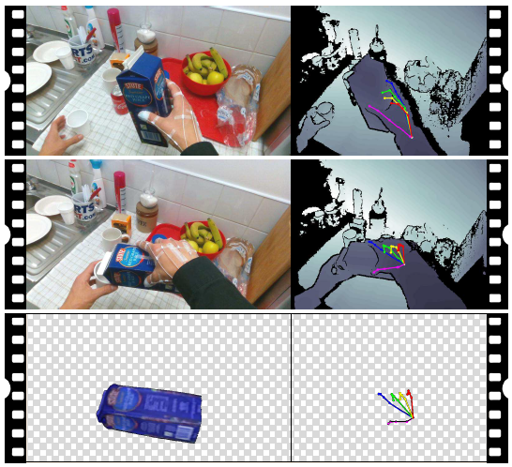
Garcia-Hernando, et al., First-Person Hand Action Benchmark With RGB-D Videos and 3D Hand Pose Annotations, CVPR2018.
Pouring Juice
A novel firstperson action recognition dataset with RGB-D videos and 3D hand pose annotations.
Magnetic sensors and inverse kinematics to capture the hand pose.
Also captured 6D object pose for some of the actions

Slide 32
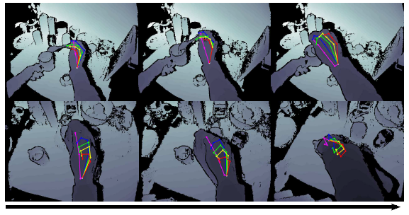
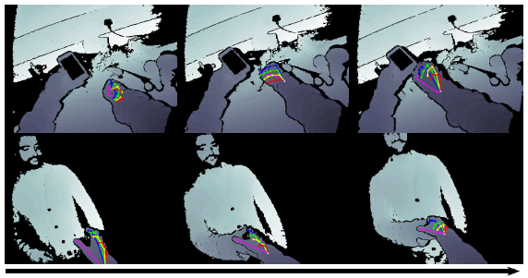
Garcia-Hernando, et al., First-Person Hand Action Benchmark With RGB-D Videos and 3D Hand Pose Annotations, CVPR, 2018.
A novel first person action recognition dataset with RGB-D videos and 3D hand pose annotations.
Put sugar.
Pour milk.
Charge cell-phone.
Shake hand.

Slide 33
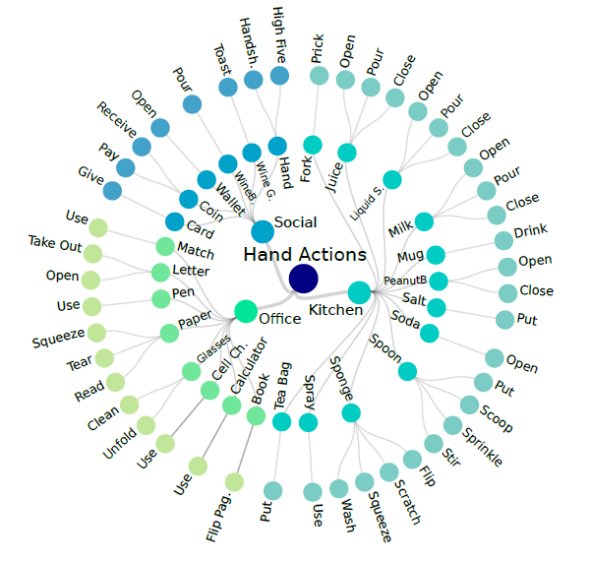
Garcia-Hernando, et al., First-Person Hand Action Benchmark With RGB-D Videos and 3D Hand Pose Annotations, CVPR, 2018.
Visual data: Intel RealSense SR300 RGB-D camera on the shoulder of the subject (RGB 30 fps at 1920×1080 and Depth 640×480.)
Pose annotation:
hand pose
captured using six magnetic sensors (6DOF) attached to the user’s hand, five fingertips and one wrist, following [84].
the hand pose is inferred using inverse kinematics over a defined 21-joint hand model
object pose
1 6DOF magnetic sensor attached to the closest point to the center of mass.
Recording process:
6 people, all right handed performed the actions.

Slide 34
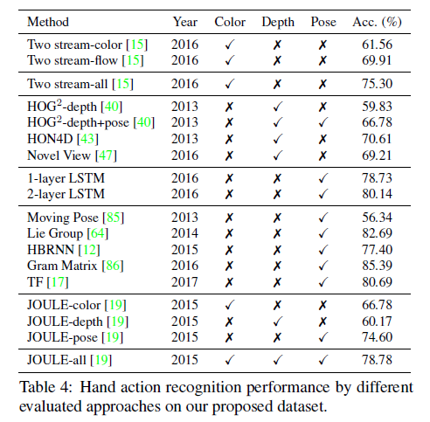
Garcia-Hernando, et al., First-Person Hand Action Benchmark With RGB-D Videos and 3D Hand Pose Annotations, CVPR2018.
Hand pose
recognition
Baseline: RNN LSTM 100 neurons.
1:3 25% training 75% testing
1:1 50% - 50%
3:1 75% - 25%
Cross-person
Leave one of the 6 persons out of the training and test on the person left out.
Tensorflow and Adam optimizer.
Baseline Action recognition results

Slide 35
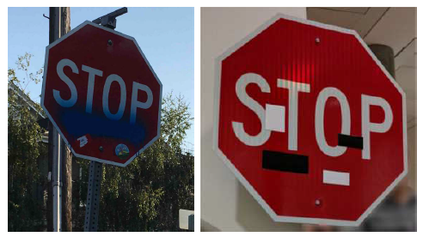
Some Problems with Deep Neural Networks
K. Eykholt, et al. Dawn Song Robust Physical-World Attacks on Deep Learning Visual Classification, CVPR2018.

Slide 36
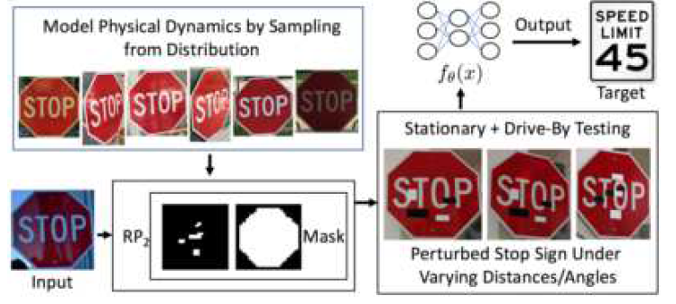
K. Eykholt, et al. Dawn Song Robust Physical-World Attacks on Deep Learning Visual Classification, CVPR2018.
Robust Physical Perturbations (RP2):
generate physical perturbations for physical-world objects such that a DNN-based classifier produces a designated misclassification.
This under a range of dynamic physical conditions, including different viewpoint angles and distances.

Slide 37
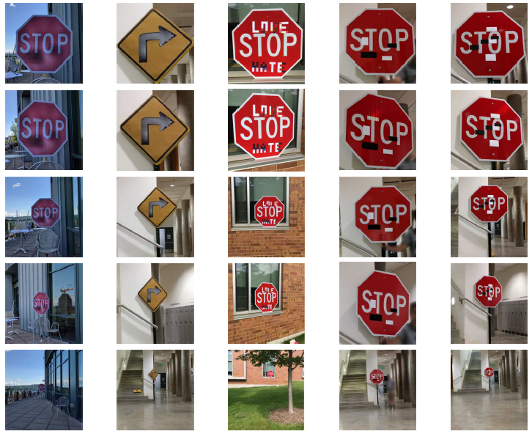
K. Eykholt, et al. Dawn Song Robust Physical-World Attacks on Deep Learning Visual Classification, CVPR2018.
Two types of attacks showing that RP2 produces robust perturbations for real road signs.
poster attacks are successful in 100% of stationary and drive-by tests against LISA-CNN
sticker attacks are successful in 80% of stationary testing conditions

Slide 38
K. Eykholt, et al. Dawn Song Robust Physical-World Attacks on Deep Learning Visual Classification, CVPR2018.
This is a micro-wave.
This is not a micro-wave.

Slide 39
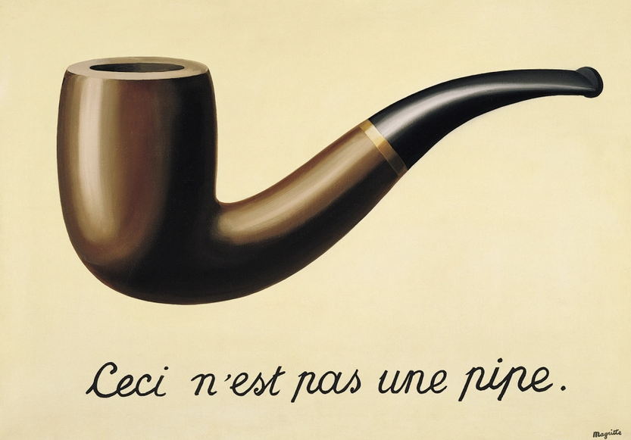

Slide 40
References
Papers can be obtained from http://openaccess.thecvf.com/CVPR2018.py
Real-Time Tracking
[1] A. He et al. A Twofold Siamese Network for Real-Time Object Tracking, CVPR, 2018.
[2] B. Yang et al. PIXOR: Real-Time 3D Object Detection From Point Clouds, CVPR, 2018.
[3] B. Tekin et al., Real-Time Seamless Single Shot 6D Object Pose Prediction, CVPR, 2018.
Face Recognition
[4] Yancheng Bai, et al., Finding Tiny Faces in the Wild With Generative Adversarial Network, CVPR, 2018.
[5] Xuanyi Dong, et al., Aggregated Network for Facial Landmark Detection, CVPR, 2018.
[6] Yaojie Liu, et al., Learning Deep Models for Face Anti-Spoofing: Binary or Auxiliary Supervision, CVPR, 2018.
Hand Pose Recognition
[7] F. Mueller, et al., GANerated Hands for Real-Time 3D Hand Tracking From Monocular RGB, CVPR, 2018.
[8] G. Garcia-Hernando, et al., First-Person Hand Action Benchmark With RGB-D Videos and 3D Hand Pose Annotations, CVPR, 2018.
Problems with Deep Learning Classification
[9] K. Eykholt, et al. Dawn Song Robust Physical-World Attacks on Deep Learning Visual Classification, CVPR, 2018.

Slide 41
Conference on Computer Vision and Pattern Recognition
http://openaccess.thecvf.com/CVPR2018.py
http://openaccess.thecvf.com/CVPR2019.py

