Slide 1
Design Patterns
Programmeertechnieken, Tim Cocx

Slide 2
Interface
An interface is collection of methods ‘to be implemented’ by other classes
  These classes can be sub classes of another class
  An interface has no method implementation
  An interface has no attributes
  One cannot make an object of an interface
  A class that implements an interface must provide implementation for each method in it (or pass it on to sub classes)
An interface offers functionality to other classes without specifying which classes will fulfill the role
  An interface can be seen as a diploma; you don’t care who exactly does the job, as long as he / she is qualified.

Slide 3
Interface: UML Syntax
Director
<< interface >>
CoffeeGetter
uses
manage
getCoffee
*
Interface
1
Dotted line
Director doesn’t know (or cares) who exactly delivers the coffee AS LONG as it is being done.
Having a connection to the interface quarantees this. Run-time a Student can perform the task
Student
code
Student implements the mandatory method
getCoffee
study
doExam

Slide 4
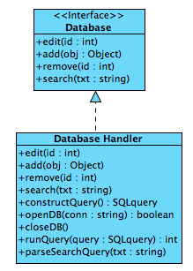
Example application for interface
Users of our database library can only access this functionality. The internal mechanics are (deliberately) unknown to them

Slide 5
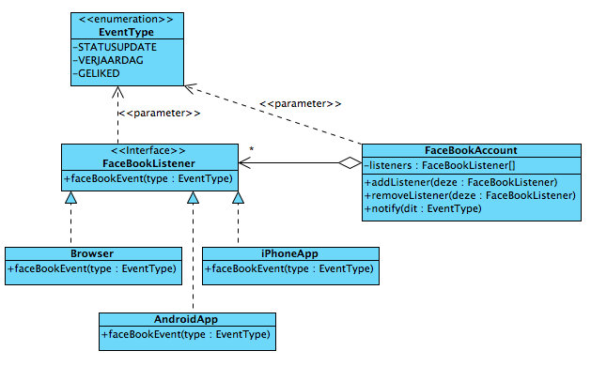
Example application for interface:
Observer pattern
Bij elke gebeurtenis roept het account notify aan.
Hierin wordt van elke luisteraar (in listeners) de methode faceBookEvent aangeroepen. Deze bestaat, want al deze klassen implementeren de interface
Het interesseert Account niet OF, HOEVEEL & WELKE Klassen luisteren naar events. Hiervoor is een interface erg geschikt. Later kunnen nu nog onbekende klassen ook luisteraar worden als ze de methode maar implementeren
Een Facebook account genereert verschillende ‘gebeurtenissen’ (events). Verschillende klassen kunnen zich aanmelden om hierop te reageren.
These are all possible events
NB: in reality this system doesn’t exist; its component would run on different devices. It is just an illustration
Classes can enlist or remove themselves as ‘listener’

Slide 6
A nice interface example
public class datastructure {
public void temp(){
Collection<Object> someCollection = new LinkedList<>();
someCollection.add(new Object());
someCollection.add(new Object());
Iterator itr = someCollection.iterator();
while(itr.hasNext()){
System.out.println(itr.next()); //here as well: nice abstraction!
}
}
}

Slide 7
A nice interface example
public class datastructure {
public void temp(){
Collection<Object> someCollection = new TreeSet<>();
someCollection.add(new Object());
someCollection.add(new Object());
Iterator itr = someCollection.iterator();
while(itr.hasNext()){
System.out.println(itr.next()); //here as well: nice abstraction!
}
}
}

Slide 8
A nice interface example
public class datastructure {
public void temp(){
Collection<Object> someCollection = new HashSet<>();
someCollection.add(new Object());
someCollection.add(new Object());
Iterator itr = someCollection.iterator();
while(itr.hasNext()){
System.out.println(itr.next()); //here as well: nice abstraction!
}
}
}

Slide 9
Definition and purpose of design patterns
Definition
Design pattern is a general reusable solution to a commonly occurring
problem in software design.
It is a description or template for how to solve a problem that can be
used in many different situations.
A design pattern is not a finished design that can be transformed
directly into code.
Purpose:
Reuse of previously invented solutions (not specific code)
Establishing common terminology to improve communication between developers.
Improving maintainability, reusability and changability
Pitfalls
Design patterns are not a goal in itself
Increases the complexity.
Notes:
GoF: zij hebben de patterns niet verzonnen; Zij hebbende patterns herkend en genoteerd.
Pattern: herbruikbare oplossing voor een probleem in een context;

Slide 10
Classification of Design Patterns
Creational patterns | Structural patterns | Behavioral patterns
Creates objects; Abstracts the Instantiation process | Composes classes or objects in larger structures | Concerns about communication between objects; distribution of responsibilities
Abstract Factory | Adapter | Command
Builder | Bridge | Interpreter
Factory Method | Composite | Iterator
Singleton | Decorator | Observer
etc | Facade | Strategy
 | etc | Template (Method)
 |  | etc

Slide 11
Principles and strategies for design patterns
Open-Closed Principle
  Modules, classes and methods should be open for extension, but closed
  for modification
  Design your software so, that you can extend its capabilities without
  changing it.
Design From Context
  First create the big picture, before designing the details
  First design the abstraction (interface, abstract class), then
  the implementation of the subclasses (details = specialization).
Dependency Inversion Principle
  High level modules depend on abstractions (not on low level modules)
  Details (low level modules) depend on abstractions (abstractions
  should not depend on details - low level modules )

Slide 12
Pattern Description - Template
item
Name |  | Unique name
 | classification | [creational, structural, behavioral]
Intent |  | The purpose of the pattern
Problem |  | The problem that the pattern is trying to solve
 | context | and the context in which it shows up
Solution |  | Description of the solution
 | participants | The objects/classes participating in the pattern
 | collaborators | how the classes/objects collaborate
 | responsibilities | and their responsibilties
Consequences |  | The effects that the use of the pattern may have. The good and the bad effects. They are necessary for evaluating design alternatives and for understanding the cost and the benefits of applying the pattern
Generic structure |  | A standard diagram that shows the typical structure for the pattern
Implementation |  | How the pattern can be implemented (example)

Slide 13
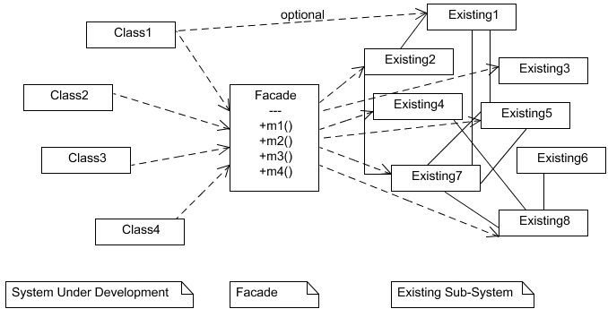
Facade pattern
Participants: System under development, Facade, Existing sybsystem

Slide 14
Facade pattern
Name | Facade pattern (structural pattern)
Intent | You want to simplify the complexity of an existing system. You need to define your own interface.
Problem | You need to use only a subset of an existing complex system. or: You need to interact with the system in a particular way or: You don’t want (have the time) to learn the whole system.
Solution | The Facade presents a new (easier) interface for the existing system, so the client of the existing system, or a new client/system, can use this new interface.
Consequences | The facade simplifies the use of the required subsystem. However, because the facade is not complete, certain functionality may be unavailable for the client.

Slide 15
Façade Pattern
Use the façade pattern when:
You don’t need to use all the functionality of a complex system.
  Create a new class that contains all the rules for accessing that
  subsystem.
  This API (interface) must be much simpler then the original system.
You want to encapsulate or hide the original system.
You want to use the functionality of the original system and
want to add some new functionality as well.
The cost of writing the new class is less than the cost of
everybody learning the original system.

Slide 16
Facade
public class Facade {
//declarations of the necessary objects of the existing system
//Facade class will be written by ”experts”.
  public void m1() {
  //all calls to the existing system
  }
  public String m2(){
  //all calls to the existing system
  return rval;
  }
}

Slide 17
Facade
//An object of the class Facade is already available for the client
Facade facade = new Facade();
//or
import Facade;
public class Client1 {
…
facade.m1();
System.out.println (facade.m2());
}

Slide 18
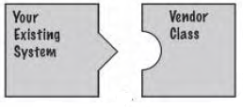

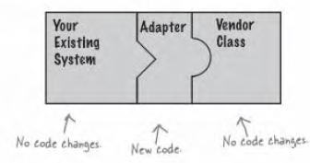
Adapter Pattern

Slide 19
Adapter pattern
Name | Adapter pattern (structural pattern)
Intent | Changing an interface of an existing object. Matching an existing object (beyond your control) to a particular interface
Problem | A system has the right data and behavior but the wrong interface. You want to reuse the behavior of a class, but the class hasn’t the right interface. Typically used when you want to make a class a derivative of an abstract class
Solution | The Adapter provides a wrapper with the desired interface. The adapter converts the interface of a class into another interface the clients expect. Adapter lets classes cooperate, that couldn't otherwise due to incompatible interfaces.
Consequences | Reuse of existing behavior. The adapter allows for existing objects to fit into new class structures without being limited by their interfaces. Needed functionality not present in the existing class, must be implemented in the adapter. Considering the use of an adapter against the savings by reusing the “adaptee”.

Slide 20
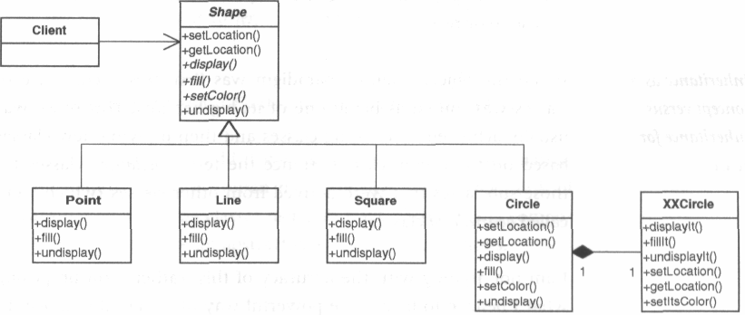
Adapter

Slide 21
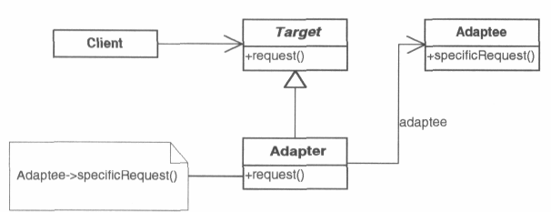
(Object) Adapter
Participants:
Client
Target
Adaptee
Adapter

Slide 22
(Object) Adapter
public class Adapter extends Target {
private Adaptee myAdaptee;
public Adapter (Adaptee adaptee) {
myAdaptee = adaptee;
}
public setAdapter (Adaptee adaptee) {
myAdaptee = adaptee;
}
void public request() {
myAdaptee.specificRequest();
}
}
“Target” can be an interface, abstract class or standard class

Slide 23
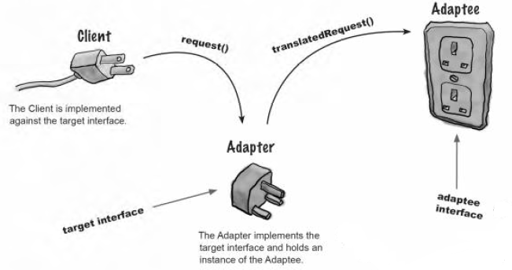
Adapter

Slide 24
Adapter Pattern
With the adapter pattern you don’t have to worry about the interfaces of the
existing classes during design.
When you have a class with the right functionality, you can use the
adapter to give the right interface.
Many patterns require certain classes to derive from the same class.
If there are preexisting classes the adapter pattern can be used
to match this class to appropriate abstract class.

Slide 25
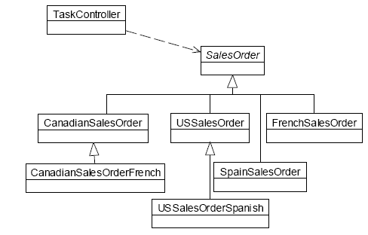
Strategy Pattern
Unwanted subclasses

Slide 26
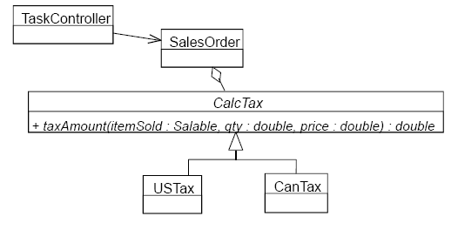
Strategy Pattern

Slide 27
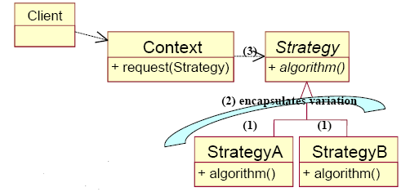
Strategy
Strategy declares an interface (how the different algorithms are used)
StrategyA and StrategyB implement this different algorithms
Context uses the interface to call the concrete algorithm and maintains a reference tot the strategy object (concrete algorithm)
The Client passes the specific Strategy to the Context by a parameter

Slide 28
strategy implementation
public interface Strategy {
public void algorithm();
}
public class StrategyA implements Strategy {
public void algorithm(){
// implement algorithm A
}
}
public class StrategyB implements Strategy {
public void algorithm(){
// implement algorithm B
}
}

Slide 29
strategy implementation
public class Context{
private Strategy strategy;
public Context(Strategy strategy) {
this.strategy = strategy;
}
public setStrategy(Strategy strategy) {
this.strategy = strategy;
}
public request() {
strategy.algorithm();
}
}

Slide 30
strategy implementation
public class Client{
public static void main(String args[]) {
. . . . . . . . . .
Context context = new Context(new StrategA());
context.request();
. . . //algorithm A will be executed
context.setStrategy(new StrategB());
context.request();
. . //algorithm B will be executed
}
}

Slide 31
Strategy pattern
Name | Strategy pattern (behavioral pattern)
Intent | Enables you to use different algorithms, depending on the context in which they occur. You want to change behaviour (algorithms) run-time
Problem | The selection of the algorithm that need to be applied depends on the Client. Different behaviour depends on conditions in the Client class.
Solution | Separate the selection of the algorithm from the implementation. Define a family of algorithms, encapsulate each one and make them interchangeable.
Consequences | The pattern defines a family of algorithms. The algorithms vary independantly from clients that use it. Switches or conditionals can be eliminated. All the algorithms must have the same interface The client must have knowledge of the different strategies to select the required one. Increasing number of classes; Context class increases complexity When behaviour doesn’t change: don’t use the strategy pattern

Slide 32
Strategy Pattern
Strategy pattern simplifies unit testing, because each algorithm is in its
own class and can be tested through its interface alone
Strategy pattern increases cohesion (each object worries only about
one function)
Strategy pattern decreases coupling (independency of different algorithms)

Slide 33
Sorting exercise – strategy pattern
public interface SortInterface {
public void sort(double[ ] list);
}
public class QuickSort implements SortInterface {
public void sort(double[ ] list){
// implement Quicksort algorithm
}
}
public class BubbleSort implements SortInterface {
public void sort(double[ ] list){
// implement Bubblesort algorithm
}
}

Slide 34
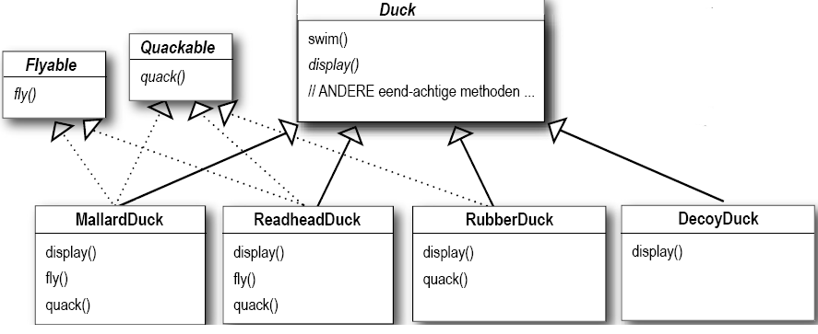
Duck-exercise – design with traditional inheritance
Source Duck-exercise: Freeman, E & E., Head First, Design Patterns

Slide 35
Duck-exercise – strategy pattern

Slide 36
Duck-exercise– strategy pattern
public abstract class Duck {
FlyBehavior flyBehavior;
QuackBehavior quackBehavior;
public Duck() {
}
public void setFlyBehavior (FlyBehavior fb) {
flyBehavior = fb;
}
public void setQuackBehavior(QuackBehavior qb) {
quackBehavior = qb;
}
public void performFly() {
flyBehavior.fly();
}
public void performQuack() {
quackBehavior.quack();
}
}

Slide 37
Duck-exercise – strategy pattern
public class DecoyDuck extends Duck {
public DecoyDuck() {
setFlyBehavior(new FlyNoWay());
setQuackBehavior(new MuteQuack());
}
public void display() {
System.out.println("I'm a duck Decoy");
}
}

Slide 38
Factories
Creational patterns
Een factory verbergt het creëren van objecten. Deze code heeft
veel kennis van de objecten (parameters e.d.) nodig.
De client kan zich concentreren op waar het echt om gaat (de
functionaliteit).
Het deel van de code dat objecten creëert (de factory) bemoeit
zich niet met de functionaliteit.
Conclusie: een object of creëert andere objecten
of gebruikt andere objecten
Goede cohesie
Verbergt wat varieert.
Factories zijn een goed voorbeeld van open closed principe
(open voor uitbreiding, gesloten voor verandering)

Slide 39
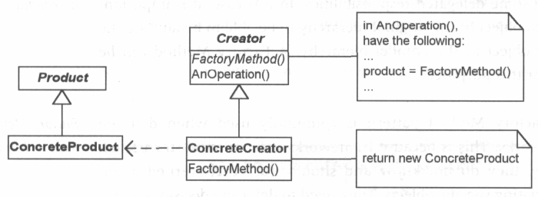
Factory Method pattern
Product: definieert de interface van de objecten die de factory method creëert
ConcreteProduct: implementeert de Product interface
Creator: wordt ook wel Factory genoemd; geeft een product terug.
ConcreteCreator: implemeteert de factoryMethod(), de methode die in feit alle
producten aanmaakt; deze klasse weet als enig hoe de producten te maken

Slide 40
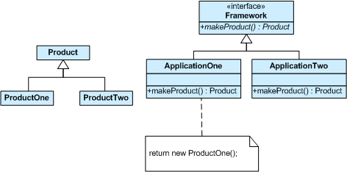
Factory Method pattern

Slide 41
Factory Method pattern
Name | Factory Method pattern (creational pattern)
Intent | Het definiëren van een interface voor het creëren van een object. De subklassen beslissen welke klasse er geïnstantieerd wordt. De subklassen zijn verantwoordelijk voor de instantiatie.
Problem | Een klasse moet een object van een subklasse instantiëren, maar weet niet welke subklasse.
Solution | Definieer een interface met de factory Method. Laat de subklasse van deze interface beslissen welk type object geïnstantieerd wordt en op welke manier.
Consequences | De Client is niet op de hoogte welk object gecreëerd wordt en is dus onafhankelijk van het te creëren object. Soms moet er speciaal hiervoor een hiërarchie van klasse – subklasse opgezet worden (als er maar 1 klasse is).

Slide 42
Factory Method Implementatie
public interface Product{ □ }
public class ConcreteProductA implements Product { □ }
public abstract class Creator {
public void anOperation() {
Product product = factoryMethod();
}
protected abstract Product factoryMethod();
}
public class ConcreteCreatorA extends Creator {
protected Product factoryMethod() {
return new ConcreteProductA();
}
}

Slide 43
factory Method implementatie
public class Client{
public static void main(String args[]) {
. . . . . . . . . .
Creator creator = new ConcreteCreatorA();
creator.anOperation();
. . . //concreteProductA wordt gecreerd
}
}

Slide 44
Factory Example

Slide 45
Factory Method: voorbeeld
Voorbeeld factory method: iterator() in Java

Slide 46
Next up…
Continue with assignment 3

